Slide 1
Evaluating Non-adequate Test-Case Reduction
Mohammad Amin Alipour, August Shi, Rahul Gopinath, Darko Marinov, and Alex Groce
ASE 2016 Singapore, Singapore September 5, 2016
CCF-1054876
CCF-1409423
CCF-1421503

Slide 2
Announcement
Amin is on the job market!
alipourm@oregonstate.edu
http://alipourm.github.io/
Rahul is on the job market!
gopinathr@oregonstate.edu
http://rahul.gopinath.org/

Slide 3
Testing Can Be Slow
T₁
T₂
T₃
T₄
T_{n}
...
Notes:
Testing is commonly used in software engineering, but can be slow because there are many tests to run, manually or automatically generated
Researchers have proposed techniques to speed up testing, such as...

Slide 4
Test-Suite Reduction
T₁
T₂
T₃
T₄
T_{n}
...
T₁
T₃
T_{n}
Still satisfies all
test requirements
Notes:
Mention what boxes are, they are test cases

Slide 5
Non-adequate Test-Suite Reduction
T₁
T₂
T₃
T₄
T_{n}
...
T₁
T₃
T_{n}
Satisfies almost all
test requirements

Slide 6
Test-Case Reduction
T₁
T₂
T₃
T₄
T_{n}
...
T₁’
T₂’
T₃’
T₄’
T_{n}’
Each test case still satisfies
same test requirements
Notes:
Another approach is test-case reduction, where each test case itself is reduced to satisfy test requirements
Smaller test cases also help with debugging and maintenance

Slide 7
Our Work: Non-adequate Test-Case Reduction
T₁
T₂
T₃
T₄
T_{n}
...
T₁’
T₂’
T₃’
T₄’
T_{n}’
Each test case satisfies almost
same test requirements
Notes:
We propose non-adequate test-case reduction…
More agressive test-case reduction, where each test case itself is reduced to satisfy almost all test requirements

Slide 8
Non-adequate Test-Case Reduction: Approaches
Reduce test cases without preserving all test requirements
We propose two approaches:
C%-Coverage: coverage-based non-adequate test-case reduction
N-Mutant: mutant-based non-adequate test-case reduction
Notes:
We propose non-adequate test-case reduction
We propose two approaches…

Slide 9
Non-adequate Test-Case Reduction: Metrics
We evaluate with three metrics:
Size Reduction Rate (SRR): how much test case is reduced
Coverage Preservation Rate (CPR): how much coverage does reduced test case preserve
Mutant Preservation Rate (MPR): how many killed mutants does reduced test case preserve
Notes:
To evaluate the effectiveness of non-adequate test-case reduction, we propose three metrics…

Slide 10
Adequate Test-Case Reduction (Coverage)
T_{o}’’
T_{o}
T_{o}’
Covers lines:
1,2,4,7,8
Covers lines:
1,2,4,7,8
Covers lines:
1,2,4,7,8
...
T_{r}
1-minimal
Covers lines:
1,2,4,7,8
Cause Reduction (based on Delta Debugging)*
*Groce, A., Alipour, M., Zhang, C., Chen, Y., and Regehr, J. Cause reduction for quick testing. ICST 2014
Notes:
To give some background on how adequate test-case reduction works, I will illustrate with an example…
We use existing test-case reduction technique, cause reduction, which is based off of delta-debugging…
To simplify the example, we show here just reducing one part at a time, though in actual cause reduction, many parts are reduced per step…

Slide 11
Adequate Test-Case Reduction (Mutants)
T_{o}’’
T_{o}
T_{o}’
Kills mutants:
M1,M3,M7,M10
Kills mutants:
M1,M3,M7,M10
Kills mutants:
M1,M3,M7,M10
...
T_{r}
1-minimal
Kills mutants:
M1,M3,M7,M10
Notes:
If we consider mutants, the same things can occur…
One important difference is that with mutants, checking if reduced test-case is valid requires running all mutants, which is time-consuming…

Slide 12
Non-adequate Test-Case Reduction
 | Non-adequate Reduction | Adequate Reduction
C%-Coverage | Preserve at least C% of coverage | C=100
N-Mutant | Preserve at least N specified mutants killed | N=all killed mutants

Slide 13
C%-Coverage vs. N-Mutant: 3 Differences
 | Test Requirement | Percentage vs. Absolute | Changing vs. Fixed Test Requirements
C%-Coverage | Lines Covered | Percentage | Any C% lines covered
N-Mutant | Mutants Killed | Absolute | Fixed N killed mutants
Notes:
Key differences between the two include test requirement…
The reason N-Mutants uses absolute number of mutants instead of percentage is performance problem of search as discussed before…
The reason N-Mutants uses specific N mutants is again performance problem of search…

Slide 14
C%-Coverage
T_{o}’’’
T_{o}’’
Covers lines:
1,2,4,7,8
T_{o}
T_{o}’
Covers lines:
1,2,4,7,8
...
T_{r}
Covers lines:
1,2,4,7,8
Covers lines:
1,2,4,7,8
Covers lines:
1,2,4,7,8
C = 80
Notes:
Walk through again, note that can proceed on search even if line 4 is not covered…

Slide 15
N-Mutant
T_{o}’’’
T_{o}’’
Kills mutants:
M1,M3,M7,M10
T_{o}
T_{o}’
Kills mutants:
M1,M3,M7,M10
...
T_{r}
Kills mutants:
M1,M3,M7,M10
Kills mutants:
M1,M3,M7,M10
Kills mutants:
M1,M3,M7,M10
N = 3
{M3,M7,M10}
Notes:
Same for mutants, except no need to even run mutant M1 if we only consider the three mutants

Slide 16
Metrics
Size Reduction Rate (SRR)
Coverage Preservation Rate (CPR)
Mutant Preservation Rate (MPR)
$$SRR\left(T_{o},T_{r}\right)=\frac{Size\left(T_{o}\right)−Size(T_{r})}{Size(T_{o})}$$
$$CPR\left(T_{o},T_{r}\right)=\frac{|Cov\left(T_{o}\right)∩Cov\left(T_{r}\right)|}{|Cov\left(T_{o}\right)|}$$
$$MPR\left(T_{o},T_{r}\right)=\frac{|Mut\left(T_{o}\right)∩Mut\left(T_{r}\right)|}{|Mut\left(T_{o}\right)|}$$
Notes:
We use (not propose) three metrics…
The three metrics, all higher is better…
SRR shows improvement, CPR/MPR show quality preservation
SRR does not need more detail

Slide 17
Research Questions
RQ1: How much are test cases reduced (SRR)?
RQ2: How much are code coverage and mutants killed preserved (CPR and MPR)?
RQ3: How do SRR, CPR, and MPR trade off?
RQ4: How do CPR and MPR for our approaches compare to CPR and MPR for random test-case reduction?
See paper for RQ4 evaluation

Slide 18
Experimental Setup
C from {70,80,90,95,100}
Coverage measured using GCov
N from {1,2,4,8,16,32}
Mutants generated using Andrews et al. mutation tool*
Randomly sampled mutants
See paper for evaluation using minimal mutants
Reduction timeout of 30 minutes per test case
*Andrews, J., Briand, L., and Labiche, Y. Is mutation an appropriate tool for testing experiments? ICSE 2005

Slide 19
Projects
Project | # Test Cases | What is Removed | # Mutants | Min. Killed | Max. Killed
SpiderMonkey | 99 | JavaScript statement | 69,067 | 8,101 | 12,825
YAFFS2 | 99 | API call | 15,046 | 2,071 | 3,439
Grep | 112 | Character in command line | 7,591 | 19 | 993
Gzip | 73 | Byte | 7,175 | 1,813 | 2,046
Experiments use N from 1 to 32, small percentage of min killed
Notes:
Explain what each project is, explain what is a part that gets removed in the algorithm
Briefly mention that the number of mutants killed is rather high compared to the N we do (N is small percentage)

Slide 20
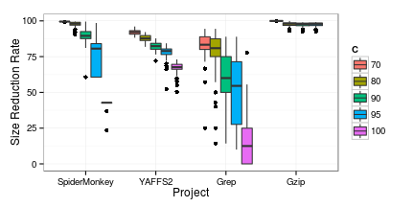
RQ1: Size Reduction Rate (SRR)
C%-Coverage
Median SRR > 50% for non-adequate
Notes:
C~SRR: SpiderMonkey: -0.90, YAFFS2: -0.83, Grep: -0.63, Gzip: -0.45
N~SRR: SpiderMoneky: -0.72, YAFFS2: -0.66, Grep: -0.49, Gzip: -0.42

Slide 21
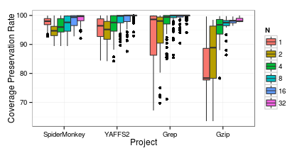
RQ2: Coverage Preservation Rate (CPR)
N-Mutant
Median CPR close to 80% with just one mutant!
Notes:
Only show N-Mutant, as similar trend of CPR increase as more and more adequate
Important thing is to note that CPR is close to 80% with just one mutant!
C~CPR: SpiderMonkey: 0.88, YAFFS2: 0.89, Grep: 0.46, Gzip: 0.83
N~CPR:

Slide 22
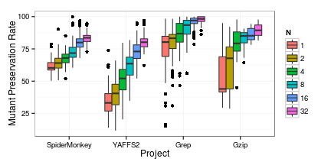
RQ2: Mutant Preservation Rate (MPR)
N-Mutant
Relatively high MPR with even just one mutant!
Notes:
Only show N-Mutant, as similar trend of MPR increase as more and more adequate
Important thing is to note that MPR is relatively high with just one mutant (which only guarantees low percentage)!
C~MPR: SpiderMonkey: 0.89, YAFFS2: 0.80, Grep: 0.67, Gzip: 0.75
N~MPR: SpiderMonkey: 0.66, YAFFS2: 0.68, Grep: 0.55, Gzip: 0.54

Slide 23
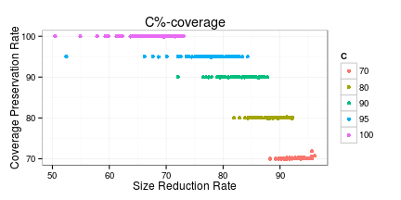
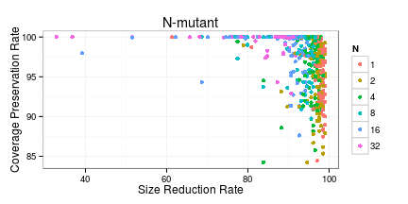
RQ3: SRR vs. CPR (YAFFS2)
C%-Coverage
N-Mutant
Notes:
SRR clustered for C%-Coverage, clustered towards right for N-Mutant (high SRR in general, but CPR ranges widely)

Slide 24
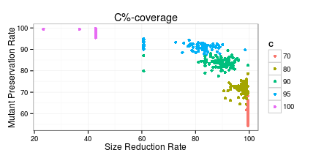
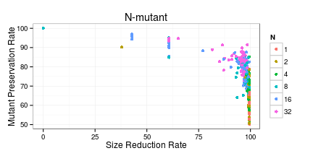
RQ3: SRR vs. MPR (SpiderMonkey)
C%-Coverage
N-Mutant
Notes:
SRR and MPR correlate well in C%-Coverage (a nice “pareoptimal”, upper right)
SRR and MPR correlate almost as well for N-Mutant (still a lot in right, so high SRR in general, fairly wide range of MPR)

Slide 25
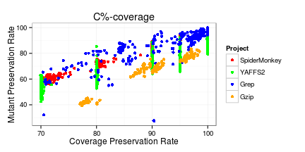
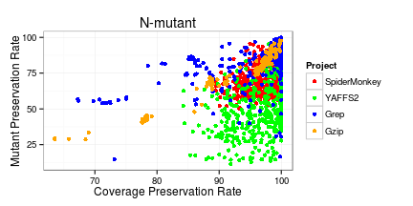
RQ3: CPR vs. MPR
C%-Coverage
N-Mutant
Notes:
CPR and MPR go up almost linearly, correlate well for C%-Coverage
CPR and MPR has clustering towards right for N-Mutant, so high CPR gets wide range of MPR, but generally get high CPR

Slide 26
RQ Highlights
RQ1: High SRR difference from adequate to non-adequate
RQ2: High CPR/MPR even with low non-adequacy, e.g., N=1 for N-Mutant
RQ3: Higher SRR trades off lower CPR/MPR; high CPR tends to imply high MPR
Not so clear trade-offs in case of N-Mutant

Slide 27
Conclusions
We propose non-adequate test-case reduction
Non-adequate test-case reduction:
Provides high size reduction and still largely preserves quality
C%-Coverage offers substantial size reduction with controlled loss in coverage
N-Mutant shows just preserving small number of mutants can still preserve a large percentage
High dependency among mutants needs more investigation
awshi2@illinois.edu

Slide 28
BACKUP

Slide 29
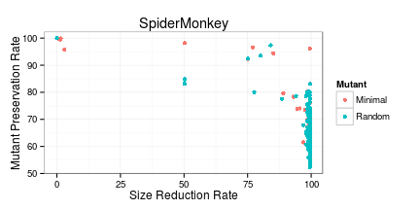
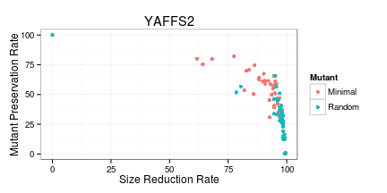
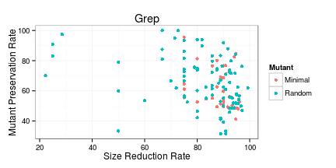
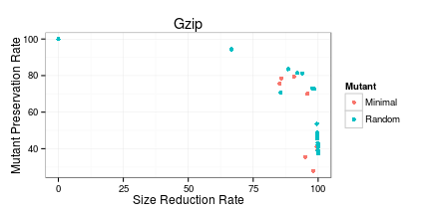
Minimal Mutants vs. 1-Mutant

Slide 30
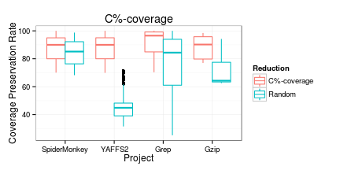
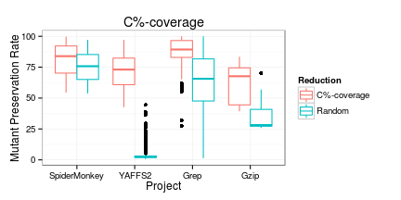
C%-Coverage vs Random (baseline)

Slide 31
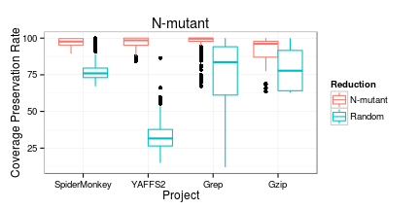
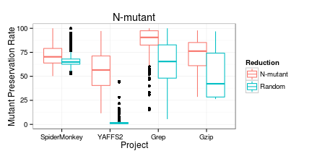
N-Mutant vs Random (baseline)

Slide 32
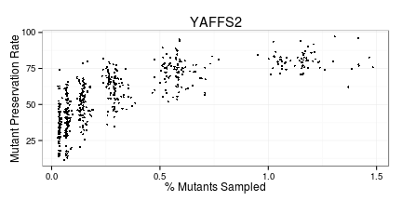
Interdependency between Mutants
Notes:
More?

Slide 33
Reduction Time

