Slide 1


February 27,2019
Effects of meditation on biomarkers of Cellular aging in cancer survivors
Ashley Henneghan, PhD, MSN, RN
Assistant Professor, University of Texas at Austin, School of Nursing
Research reported here was supported by the National Institute of Nursing Research of the National Institutes of Health under Award Number P30NR015335. The content is solely the responsibility of the authors and does not necessarily represent the official views of the National Institutes of Health.

Slide 2

Cancer Related Cognitive Impairment (CRCI)
Late and Long-term Effects
Cancer Related Cognitive Impairment (CRCI)
  Affects up to 60%
Memory, attention, executive functioning, processing speed
Most often attributed to chemotherapy
Evidence from pharmaceutical and behavioral interventions is equivocal
Negative impact on quality of life, social/occupational performance
3.1 million breast cancer survivors (BCS)
Notes:
Cancer is now considered a chronic condition with late and long term psychological and physical effects
Cancer related cognitive impairments are one of the most feared and prevalent long term effects of treatment affecting up to 60% of breast cancer survivors 1 year following the end of treatment
These impairments most often appear in the areas of memory, attention, executive functioning and processing speed
Most often these impairments are attributed to the neurotoxic effects of chemotherapy— which is why colloquially this phenomena is referred to as “chemobrain” however the exact mechanisms underlying CRCI are still unknown
Clinical guidelines for CRCI are lacking, likely because evidence from pharmaceutical and cognitive training intervention studies aimed to improve CRCI are equivocal
Importantly, impairments can have profound negative effects on survivors quality of life and interfere with social and occupational performance
This is especially concerning considering as of 2018 there are over 3.1 million women living with a history of breast cancer in the US

Slide 3
Notes:
In order to improve cognitive impairments in breast cancer survivors, we designed and are now testing the Improving Brain Function After Breast Cancer Study with support from both TCRSS and CHPR
The purpose of this study is to evaluate the effects of a 12 min daily meditation program compared to classical music listening on cognitive function and other patient reported outcomes

Slide 4
Kang et al.’s (2010) Integrated Biobehavioral Model
Psychosocial Factors
Stress
Emotional Distress
-
+
Biological Factor
Cellular Aging (inflammatory dysregulation, telomerase activity)
Health Outcome
Cognitive Function
-
-
Behavioral Factors
Meditation Practice
+
Notes:
An integrated biobehavioral model along with a literature review informed the design and methods of this study
This model posits that behavioral, psychosocial and biological factors all effect the health outcome, in this study it is cognitive functioning
It also posits that the biological factors mediate the effects of the behavioral and psychosocial factors on the health outcome.
So in this study the behavioral factor is a daily meditation program that can directly effect the psychosocial factors, namely stress and emotional distress, the biological factors inflammatory dysregulation and cellular aging, and cognitive functioning. The psychosocial factors can also directly and indirectly effect cognitive functioning through biological mediators.
The biological factors in this study were operationalized as cytokine dyregulation measured with a panel of 13 cytokines from and cellular aging, operationalized as telomerase activity both measured in peripheral blood.

Slide 5
Study Timeline (study in progress)
8 weeks
8 weeks (optional)
Meditation (n=15)
Time 2
Time 3
Enrolled
(N=30)
Baseline
Randomized
8 weeks
8 weeks (optional)
Music Listening (n=15)
Time 2
Time 3
Notes:
This study is in progress. 30 participants will be enrolled and randomly assigned to either the meditation or music listening groups.
Data collection occurs at 3 times over the course of 16 weeks, baseline, after the 8 week intervention, and then 8 weeks after time 2.

Slide 6
Lessons Learned So Far
Collaborators with biomarker expertise (wet-lab) is essential
Use industry representatives for specific assay/methods/interpretation questions when available
Adapt biomarker choices with evolving science
Notes:
My research program as a whole fits within a biobehavioral framework, so I have been learning lessons in this area for several years.
For this project, my big lessons learned would be that having one or more collaborators on your research team that have wet-lab expertise (not just experience) is absolutely essential. They should be part of study design conversations from the beginning. For example in this study I knew I wanted to measure inflammatory cytokines which I’ve looked at in other studies. I was familiar with the procedures for doing this... But I was also curious about potential markers of cellular aging. So I consulted with my CO-I, who runs a lab here on campus and she figured out the procedures for how to collect the blood and the immediate pre-processing steps that would need to be taken in order to store another component of the blood.
Another lesson learned has been utilizing the industry reps for questions regarding assays, methods or interpretation of weird findings…All of the kits used to run the different biomarkers are purchased from different commercial companies. These companies have reps and scientific experts that they can make available to customers and they have a lot of valuable knowledge and insight.
Another lesson learned is the idea that biomarker science is constantly evolving and we need to adapt our choices as the science evolves… this is also a reason to collect and store extra blood and ask participants to consent to their blood sample being used for future studies.

Slide 7
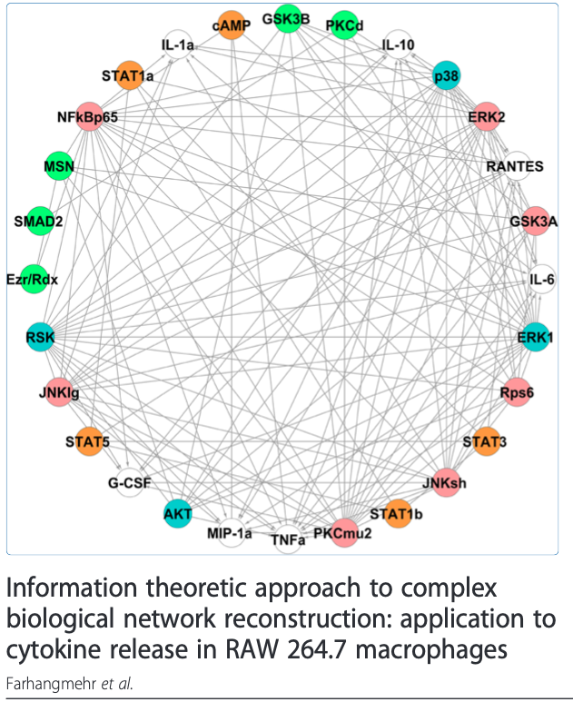
Anticipated Challenges &
Alternative Strategies
Null findings
What do cytokines really tell us?
Other methods of measuring cellular stress
Notes:
Based on my past experiences looking at biomarkers, I know there is a potential that we get null findings… perhaps these markers will change over the 8 week intervention. I know from experience that biomarker-behavioral relationships are often non-linear so if I do not initially find any changes or relationships, I will utilize non-parametric analyses to address the research questions
What do cytokine concentrations really tell us?? I have struggled with interpretation of biomarker concentrations from the beginning… if conceptually I am interested in a disruption in the inflammatory system, then how can individual cytokine levels answer this question? I’m beginning to look at cytokines using network analyses rather than individual concentrations.
There may be alternative ways for measuring cellular stress such as looking at mitochondria dysfunction and allostatic load.. So keeping that in mind during the data analyses and next steps….

Slide 8
Acknowledgements
Team
  Heather Becker
  Michelle Harrison
  Brandon Fico
  Shelli Kesler
  Kelly Inselmann
  Helen Schafer
  Garrett Bourne
Funding
  Center for Transdisciplinary Collaborative Research in Self-Management Science (TCRSS) and the St. David's Center for Health Promotion and Disease Prevention Research (CHPR)

Slide 9
THANK YOU

