Slide 1


February 27, 2019
An exploratory study of allostatic load and its impact on response to an 8-week self-management program for multiple sclerosis
Dr. Nicole (Nico) Osier
Assistant Professor at School of Nursing, and Dell Medical School
Research reported here was supported by the National Institute of Nursing Research of the National Institutes of Health under Award Number P30NR015335. The content is solely the responsibility of the authors and does not necessarily represent the official views of the National Institutes of Health.

Slide 2
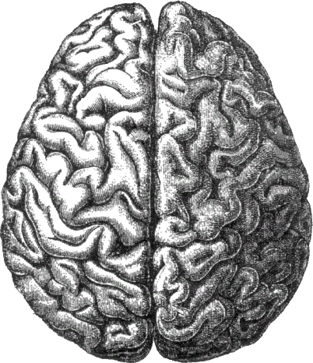
Goal of the Study
Evaluate the complex role of stress in MS
Create a composite measure of allostatic load

Slide 3



Aims
Examine the association between biomarkers (IL-15, IL-23, melatonin) & PSS score while controlling for confounders (e.g. age, inflammatory comorbidities).
Determine the degree to which biomarkers (IL-15, IL-23, melatonin) are predictive of responsiveness to a self-management + acupuncture intervention.
Combine novel biomarker analysis with other biomarkers and self-reported data to create a composite measure of allostatic load for further evaluation.

Slide 4
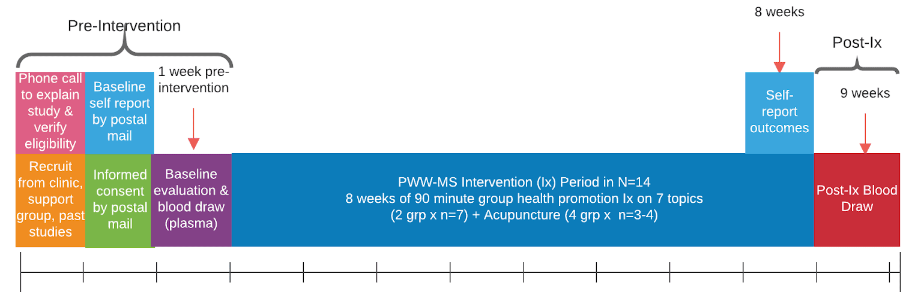
Parent Study: PWW-MS

Slide 5
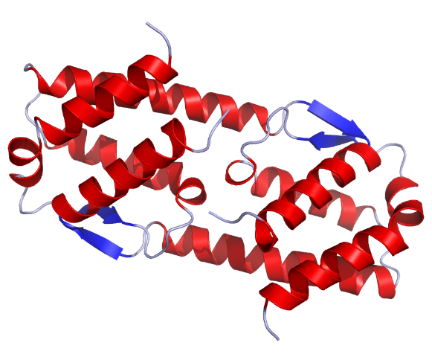
Analysis Processes
Quantify biomarker levels and examine potential associations with self-reported symptoms
Determine which biomarkers predict response to self-management and acupuncture interventions
IL-5 Structure

Slide 6



The Study “Pipeline”
Quantify Biomarker Levels
Customized IL kits
SMCxPro system
Statistical Analysis
Regression analysis
Examine Relationships
Amend and contribute to knowledge of biomarker relationships
Collinearity, correlations and confounders

Slide 7

Our Progress & Next Steps
Quantified serum levels for each participant
Training laboratory staff
Pursuing larger sample for further evaluation

Slide 8
THANK YOU

