Slide 1

February 27, 2019
Digital Game Intervention for Heart Failure Self-management
Kavita Radhakrishnan, PhD, MSEE, RN
Assistant Professor
Research reported here was supported by the National Institute of Nursing Research of the National Institutes of Health under Award Number P30NR015335. The content is solely the responsibility of the authors and does not necessarily represent the official views of the National Institutes of Health.
Notes:
Thank you for the introduction, Karen. Hello all, my name is Kavita Radhakrishnan, I am an Assistant Professor at The University of Texas Austin School of Nursing. Today I will be talking about my study which was funded as the inaugural pilot project of our P30 Center that was funded in 2015. I will also be talking about my experiences and challenges faced while conducting the study

Slide 2
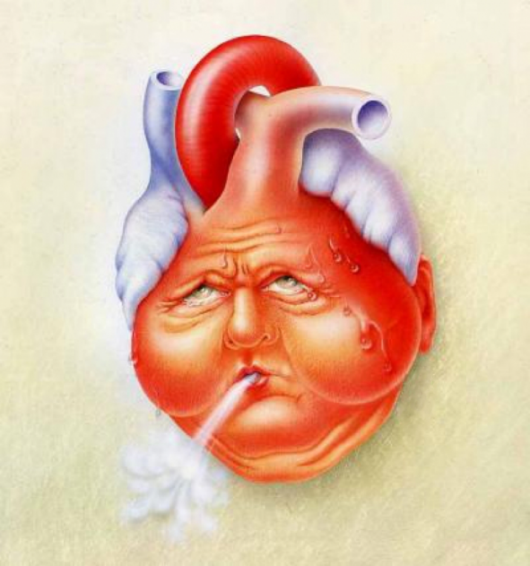
Heart failure
I
Low adherence to HF self-management by older adults – High healthcare burden and suffering
II
A unique and promising approach:
Digital Game for HF self-management
III
How can digital games help?
Help frail patients avoid travel
Accessible learning and habit-forming medium
Bridge gap between provider appointments
Help alleviate healthcare provider shortage
Image Credit: http://audrageras.com/about-us/
Notes:
Easily change photo. Please click on the small icon in the center of the holder and choose an image on your computer.

Slide 3


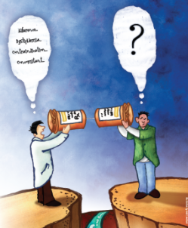
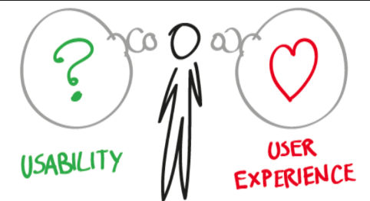

Transdisciplinary Team Members
Kavita Radhakrishnan & Miyong Kim (Nursing experts)
Paul Toprac & Matt O’Hair (UT SAGA Lab - Digital game experts)
Randolph Bias (Usability expert – School of Information)
Michael Mackert (Communication expert –Advertising
Notes:
How trans-disciplinary aspect helped to construct a vision for the study
HF self-management by older adults in their homes
Industry contacts to obtain an off-the-shelf game to re-use
Design doc to insert educational material within game format
Protocol to conduct usability testing of the game with older adults – can they play?
Tailor content and communication to literacy level of participants

Slide 4
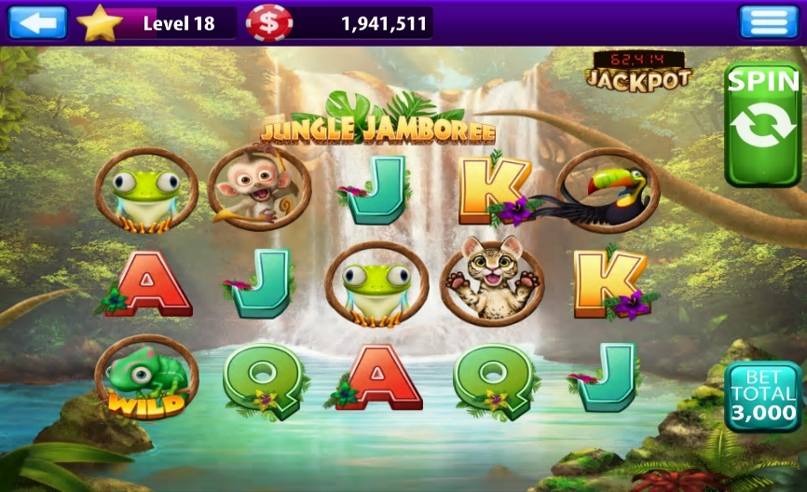
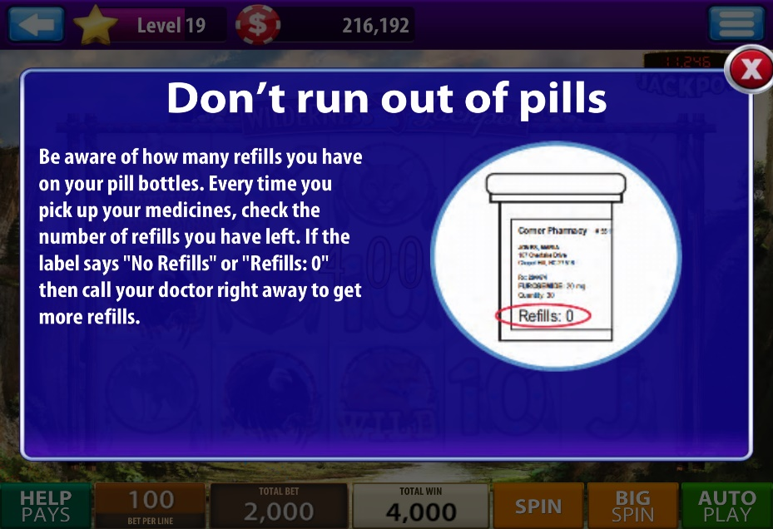
Pre/Post-test Study: Digital Game for Heart Failure Self-management by 19 older adults
Off-the-shelf casino slot game
Insert content tailored to low literacy level
Notes:
Examples of how we delivered knowledge and provided game challenges related to knowledge. Knowledge was provided in small chunks that was tailored to low literacy levels. Later during playing the game, players had to answer questions. If they got it right, they would earn coins to play in their slot machine. So the slot coins was used as an incentive to engage with the content

Slide 5
Critical Findings (n = 19)
Knowledge
Significant increase from 4 week pretest to posttest (p = 0.007)
Self-management
No difference in scores on self-report surveys
Acceptability
90%: Game interesting, enjoyable and/or easy to play
Preference for games over other medium significantly higher among participants with lower education level (p=0.02)
80%: Game motivated diet, symptom monitoring, physical activity & medication adherence related behavior change

Slide 6
Strengths Limitations
Established feasibility to conduct a digital game intervention with older adults with trans-disciplinary team members
Failure to improve self-management scores. So next steps include:
Sensors to incorporate objective data on HF self-management behaviors within the game format
Notes:
Because we did not detect any changes in the self-reported self-management surveys, our next step was to use objective behavior data to trigger game features such as incentives and game progress to motivate behavior changes

Slide 7
Challenges for team science and lessons
Shoe-string pilot study budget – No resources for effort allocation for co-investigators
  Acknowledge contribution at every dissemination event
Evolution of technology and innovation and consequently
evolution of research vision
  Finding team members with relevant skills to adapt to evolving research direction and technology changes
  Show history of collaboration with the new team members for funding to continue program of research
Notes:
Technology kept changing, such as the technology becoming more robust and integration of data with apps much more seamless.
Because we realized that objective behavior data highly enhanced the value of the gaming approach to motivate behavior changes, we had to seek team members who were qualified and had experience integrating sensor data with mobile devices.
Also the structure of our game development team changed and the main person who helped develop our P30 funded game started his own company. So we had to adapt to those changes??

Slide 8

Good news – R21 Funding for Next Steps
Current Funding - R21NR018229
Title: A pilot digital-game intervention with real-time behavior tracking to motivate self-management behaviors in older adults with heart failure
Funding Agency: National Institute of Nursing Research (NINR)
Benefits of lessons learnt in the pilot study
Notes:
The great news is our next evolution of the gaming approach is finally funded through the R21 mechanism. It took 2 years from the finish of the P30 study to get funded. Delays were mainly because we had to show history of collaboration with the new team members Also given the tight funding scenario, this was our third attempt on the R21 grant that finally got funded.
Already I am finding the benefits of having conducting the P30 study first, because I have been able to avoid several mis-steps especially related to recruitment. To be honest, I feel much more confident to pull through this R21 grant, in matters related to communicating with team members, training my GRA and recruitment all because of the initial experience afforded by the P30 pilot study.
Thank you all for your interest. I can take any questions now.

Slide 9
THANK YOU

