Slide 1
IEEE PES
3rd GENERAL MEETING
SIGN IN HERE: tinyurl.com/pes2019gm3

Slide 2
PAY ATTENTION FOR THE EOY QUIZ

Slide 3
ATTEND EVENTS
GET SWAG
Every GM, Social, and Tech Talk will get you 1 Point.
Every Project Meeting will get you ½ Point.
Enough Points Will Earn You IEEE PES Swag!

Slide 4
Looking for Leadership Experience?
Come talk to Forest/Jeffrey after the general meeting today!

Slide 5
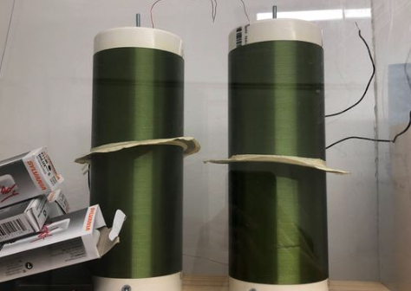
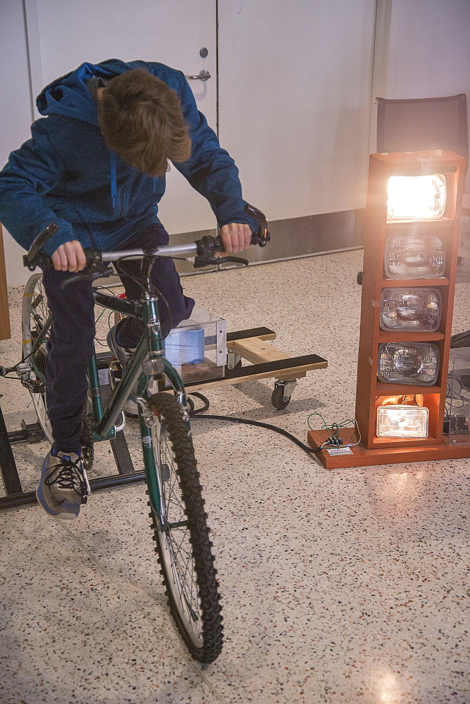
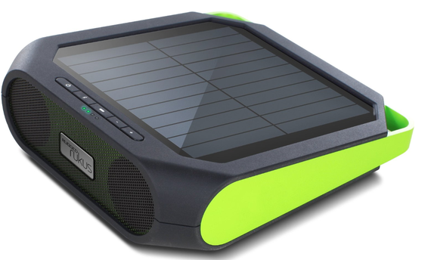
Projects Meeting Times
Located at EER 0.820.
Times: Wed 4:30 - 6:30pm, Fri 4:00 - 6:00pm
Interested in building / modifying projects centered around circuits / hardware / power electronics and power generation? Stop by a project meeting! Projects help in getting experience, internships, etc.
Contact: projects.ut.ieeepes@gmail.com

Slide 6
Want Up To Date Announcements?
Join Our Slack!
tinyurl.com/powerslack

Slide 7
Want Event-Specific Updates? Join Our Facebook Group!
tinyurl.com/facepower

Slide 8
AUSTIN’S CHAPTER OF PES IS CALLED PI²
This is a group of energy systems and renewables professionals in the austin area. This is a great way to get involved with networking, getting experience, and internships!

Slide 9
Upcoming Events:
L3 Harris Info Session: 6:30PM to 8:00PM October 3rd, 2019 at RLM 4.102

Slide 10
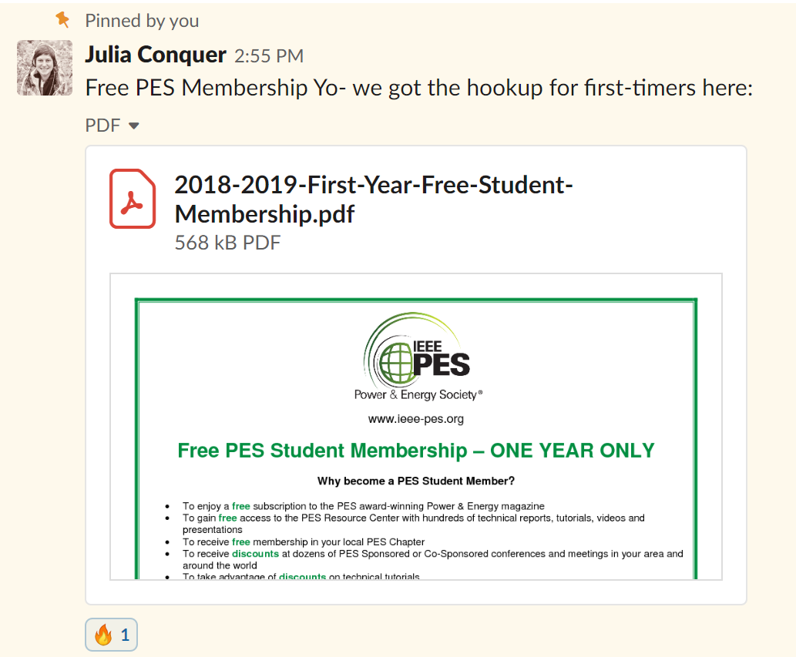
IEEE PES Membership for Students
Go to the PES slack.
Go to #announcements.
Look for a pinned message on September 28th, 2018 from Julia at 2:55pm.
Read the attachment to learn how to get a free one-year PES official membership for students.

Slide 11
Today’s Educational Fun Time of the DAyyy!!
Y’all may already know about em, but if you don’t, strap in your seatbelts and get ready to learn about the spicy science behind RELAYS

Slide 12
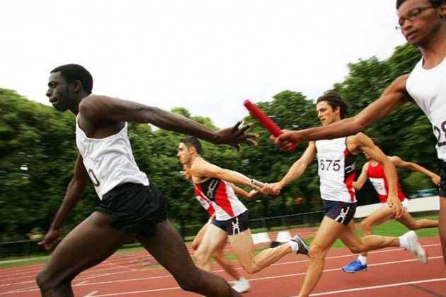
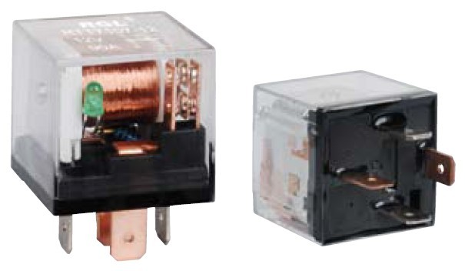
Who is this “Relay” fellow?
Ah, I’m glad you asked!
A relay is an electromagnetic switch operated by a relatively small electric current, which can turn on/off a much larger current

Slide 13
Time for some short educational films:-)
https://www.youtube.com/watch?v=Ca20ktPygY8
https://www.youtube.com/watch?v=D7HVs0neQrk
https://www.youtube.com/watch?v=Pi1dbXcaGEA

Slide 14
Questions about relays?
We shall try our best to answer even though we also just learned this material today, other members are welcome to pitch in knowledge!

Slide 15
Final Remarks
Sign In: tinyurl.com/pes2019gm3
Projects: W- 4:30-6:30pm F- 4:00-6:00pm EER 0.820
Slack: tinyurl.com/powerslack
Facebook: tinyurl.com/facepower

