Slide 1
IEEE PES
5th GENERAL MEETING
SIGN IN HERE: tinyurl.com/pes2019gm5

Slide 2
JACK-O-LANTERN TIME
Top Winners Get Prizes!

Slide 3
PAY ATTENTION FOR THE EOY QUIZ

Slide 4
ATTEND EVENTS
GET SWAG
Every GM, Social, and Tech Talk will get you 1 Point.
Every Project Meeting will get you ½ Point.
Getting 4 Points Will Earn You IEEE PES Swag!

Slide 5
PES SWAG WINNERS
Landon Fox 7 Points
Devin Shoemaker 6.5 Points
John(JJ) Gomez 4.5 Points
Nisha Gowda 4 Points
Manthan Upadhyaya 4 Points
Felipe Palacios II 4 Points

Slide 6
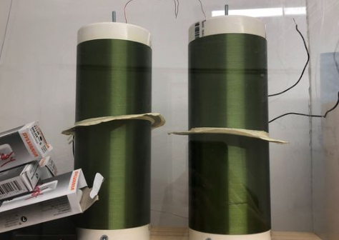
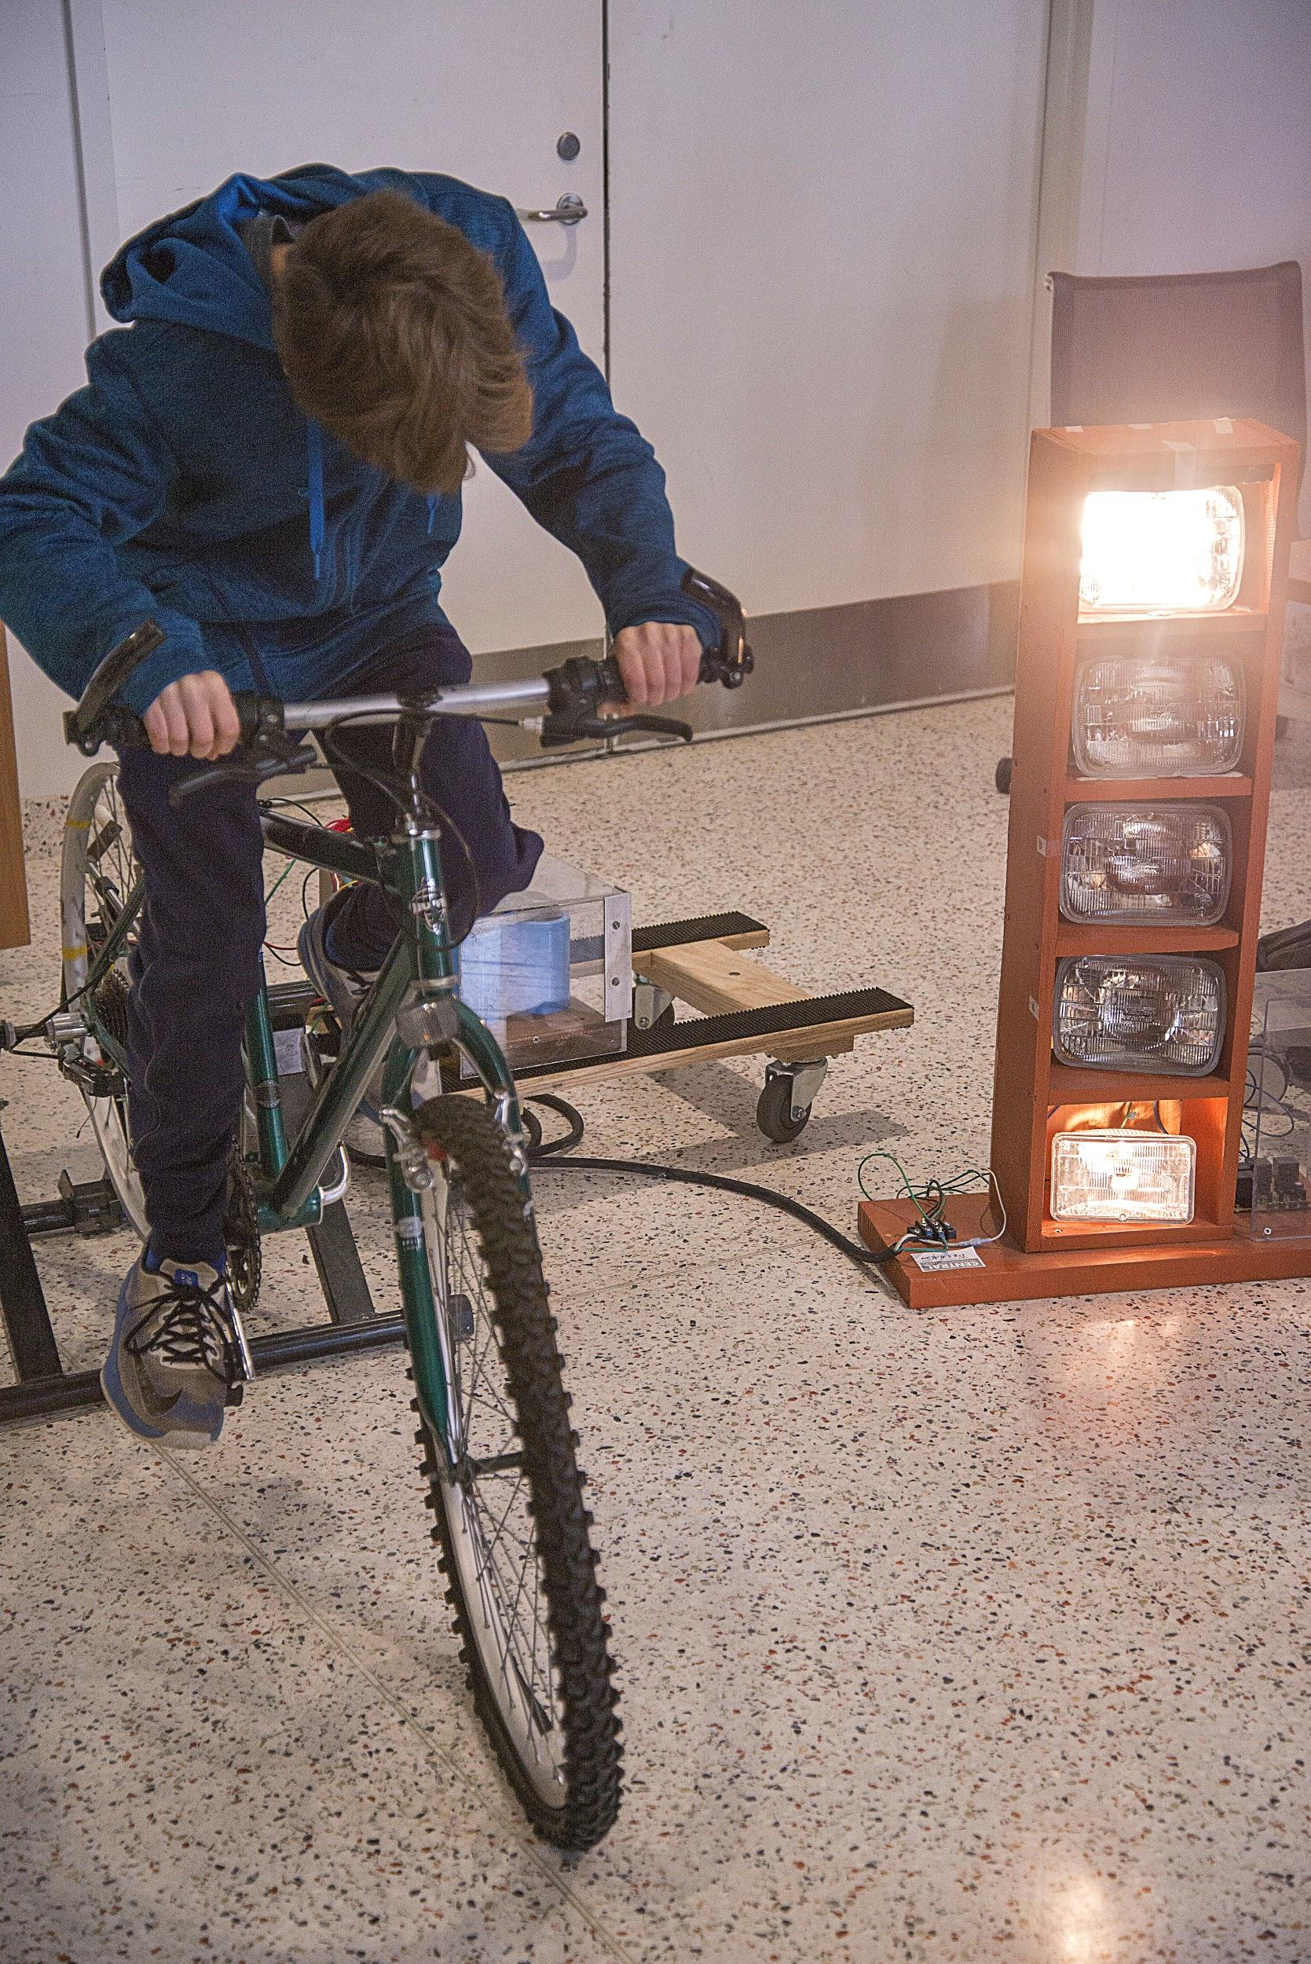
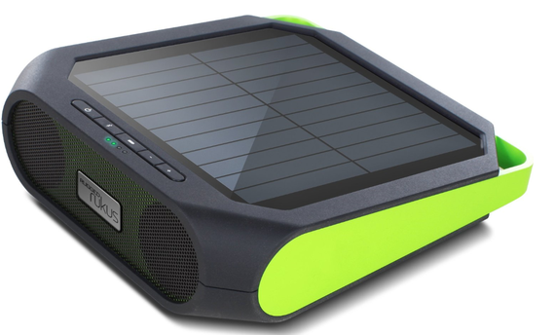
Projects Meeting Times
Located at EER 0.820.
Times: Wed 4:30 - 6:30pm, Fri 4:00 - 6:00pm
Interested in building / modifying projects centered around circuits / hardware / power electronics and power generation? Stop by a project meeting! Projects help in getting experience, internships, etc.
In-depth project discussion today!
Contact: projects.ut.ieeepes@gmail.com

Slide 7
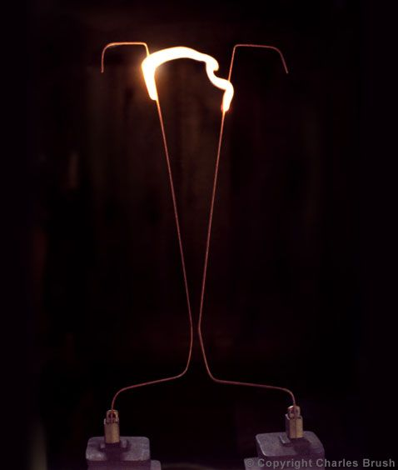
Ladder of POWER
You touch it with a nail and it goes sparky sparky boom boom.
The Ladder of POWER (commonly called a Jacob’s Ladder) is one of our most ambitious projects this year. It utilizes a breakdown between two extremely high energy prongs to create a voltage “arc”.
Typically operates at 3 - 8kV

Slide 8
Want Up To Date Announcements?
Join Our Slack!
tinyurl.com/pesslack2019

Slide 9
Want Event-Specific Updates? Join Our Facebook Group!
tinyurl.com/facepower

Slide 10
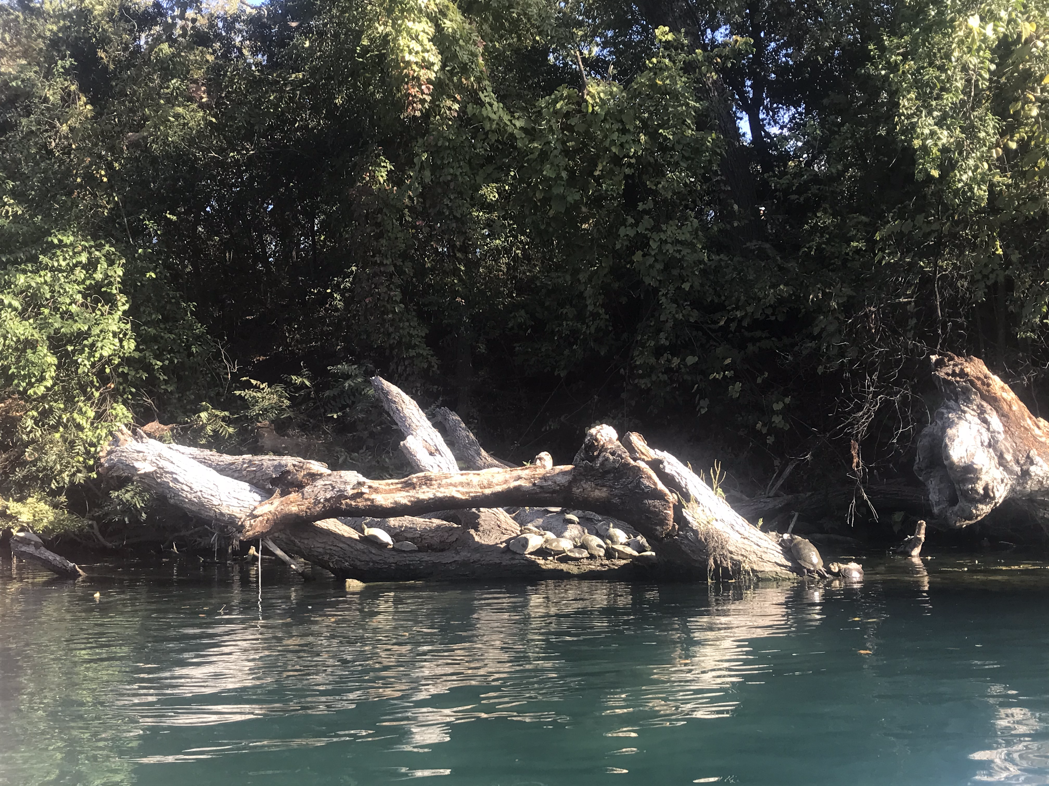
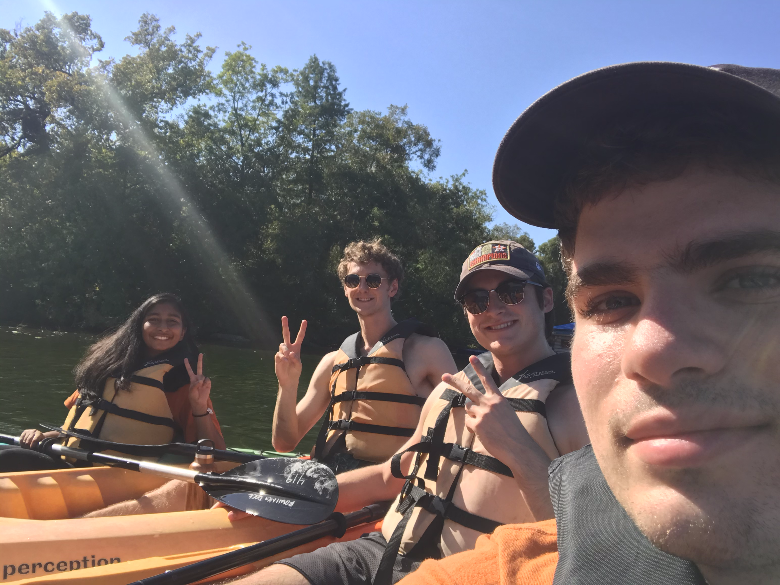
Kayak Social
Got Ideas for Socials?
Let Us Know!

Slide 11
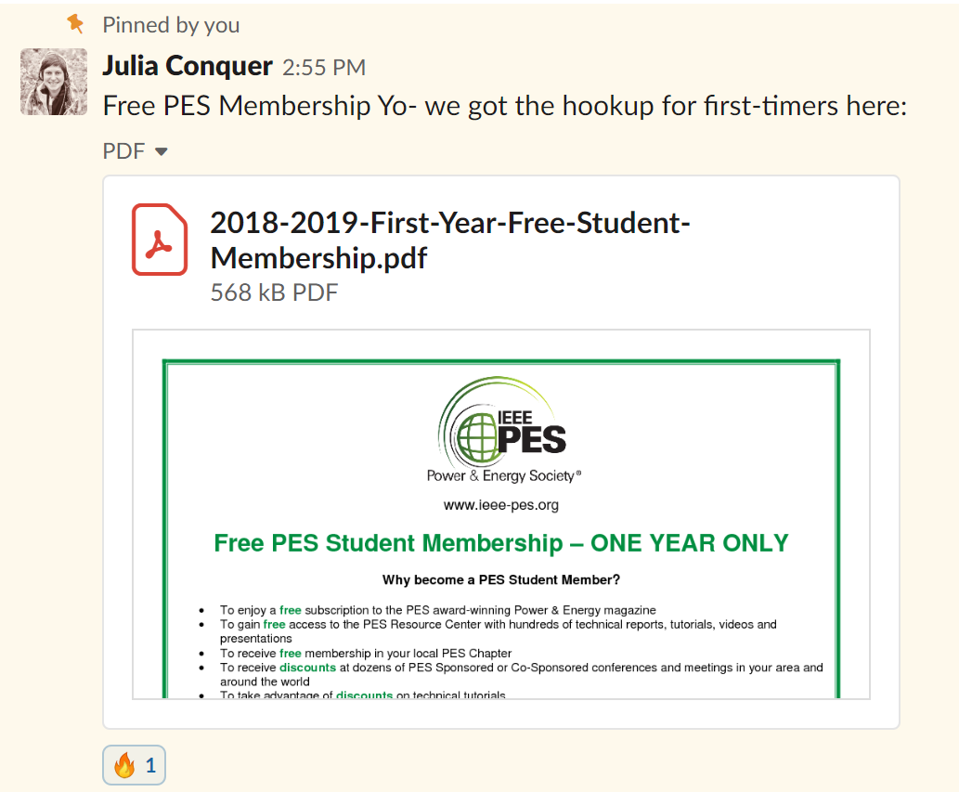
IEEE PES Membership for Students
Go to the PES slack.
Go to #announcements.
Look for a pinned message on September 28th, 2018 from Julia at 2:55pm.
Read the attachment to learn how to get a free one-year PES official membership for students.

Slide 12
IEEE PES WEBINAR
Deep Learning and its Application to Power System Analysis
http://resourcecenter.ieee-pes.org/education/webinars/PESVIDWEBRAG300.html?source=IBP
An Energy IoT Platform for Real-time Production and Delivery of Wind Power Generation Forecasts
http://resourcecenter.ieee-pes.org/education/webinars/PESVIDWEBRAG240.html?source=IBP

Slide 13
Final Remarks
Sign In: tinyurl.com/pes2019gm5
Projects: W- 4:30-6:30pm F- 4:00-6:00pm EER 0.820
Slack: tinyurl.com/pesslack2019
Facebook: tinyurl.com/facepower

