Slide 1
Project Robert’s Rules of ^ Order
Designing an Efficient Workflow for Research Teams
Robert Reynolds

Slide 2
Why bother?
Reproducibility
Collaboration
Efficiency
Human fallibility

Slide 3
Who benefits?
Team
Reviewers
Auditors
Science

Slide 5
Ground rules
This is an ongoing conversation
I want to hear your experiences, successes, failures, frustrations (maybe not all during this hour)
I want to hear what makes sense to you, what seems impossible, what seems wrong-headed
Warning: examples are Stata-centric
Notes:
I believe in teams and want to make it easier for them to be efficient.
I’ll try to balance talking about principles with talking about implementation. But this will bounce around from seemingly trivial detail to grandiose ideals.
Also, warning, nothing here is new.

Slide 6
Principle: Turn source data directly into final output
Identify your source data
Automate code execution
To produce your full paper

Slide 7
Handling source data
Define source data in a single, shared project file
Data files, not data directories
Reference these definitions in all other code
External data (source data you don’t control)
Document where it came from, when and how you got it
Should be retained as a snapshot
All source data files are read-only
Notes:
So you have a single place to modify when a new data version comes in.
Snapshot saves you if the holder of the data changes it.

Slide 8
Handling source data
Data organization?
Document! Document! Document!
One document describing the source data, updated every time a file is added or updated.
Or at least one known starting point that points to other documents.
Notes:
Data organization: personal/project preference? More idiosyncratic than code.
Documentation can make up for a lot of organizational challenges

Slide 9
Handling source data – one idea
One directory for source data
File names never change
When there is a new version of data
Create a new directory using yyyymmdd (SourceData_20180517, SourceData_20180927)
Use symbolic links to files that have not changed
Change one macro

Slide 10
Automate code execution
Master do file
(I wish we could) run only what’s needed
Run it frequently

Slide 11
Produce your paper
Still aspirational, an ideal
Getting better
Come back in October
BUT for now AT LEAST produce each table in its entirety.
No cut and paste of individual cells
No editing of labels
Notes:
Introduce the stats consultants – did you know you have them? They are interested in helping improve our processes, too.

Slide 12
Principle: Code should be portable, robust, and readable
If it’s easy to run …
If the data changes in unexpected ways …
Or you just made a mistake …
If it’s easy to read …

Slide 13
Portable code
File paths are the most frequent problem
So, make all paths relative with the full paths defined in a single place
We already have macros for full paths to our data files
Add paths to important directories, such as Logs, Temp, …
Also, if you require an unusual package, document it and test for its presence

Slide 14
Robust code
Test invariants
Why /* N = 1,649 */
And not : assert (`r(N)’ == 1649)
Check the environment
capture confirmdir
But watch out! capture findfile first, maybe
Becomes part of the boilerplate
Notes:
Using exact numbers can cause publishability problems for restricted data. I have some ideas how to handle this for asserts, but not for comments.
If the comment isn’t really important it will still remain there and be wrong. The assert with break and you’ll fix it or remove it.
It may be annoying and take some time to figure this out once, but then it becomes part of your boilerplate you carry with you.

Slide 15
Readable code
Your code should read like a paper
Introduction
Sections
Introductory paragraphs
Our languages should make this easier, but some ideas :
Separate do files with a master do file
programs (which the entire rest of the planet calls subroutines or functions)
Clearly identifiable comment hierarchy, with searchable keywords (//=======, //*** SECTION:, //*** PURPOSE: )
Good variable names and labels. Sigh.

Slide 16
Readable code
Whatever you do, be consistent
Parentheses
Horizontal and vertical spacing
Indentation
Notes:
Difference between horizontal and vertical spacing and indentation.
Space versus tab
This is trivial stuff that isn’t trivial for a reader.

Slide 17
Principle: Embrace human error
We’ve already seen several examples
Automate logging, including recording the environment
Record project history
Don’t accidentally overwrite your files ($replace)
Use the variable you intend to use (turn off varabbrev)
Reuse code, but not by copying it
Communicate!
Notes:
Assert, confirmdir, findfile, centralized definition of file location, good variable names
Logging is partly for your own protection: audit of your results
Record project history: partly by the earlier idea of documenting your source files, and changes to them.

Slide 18
Version control system for code
Like git or Mercurial
Helps record project history
Helps share code w/o copying
Merging facilities for simultaneous development of code
I prefer to keep logs and output files separate from code, but it’s not necessary
Requires support sometimes
Another sharing mechanism: libraries
Notes:
Project history: evolution of code; and you can make meaningful comments on why you made a change.
By sharing a repository: don’t have to ask for the latest copy from whoever you think has it; bug fixes and updates are automatically available
So, this also help project communication.
Code reuse: copies – how do you fix a bug in a copy your forgot about or don’t even know about?

Slide 19
Communicate!
Team personality
Email chains with haphazard collections of participants …
… work better than keeping the information to yourself …
… most of the time
Slack
Listserve (utlists.utexas.edu)
What has worked for you?

Slide 20
Project setup file
global childhh_base_code "`c(pwd)'”
global replace "”
do setup_`c(username)’
if ("$logdir" == "") {
global SIPP2008 "$boxdir/SIPP/data/SIPP2008"
Also, some fancy code to identify your home directory, independent of OS

Slide 21
Personal setup file
global replace "replace”
set rmsg on, permanently
set varabbrev off, permanently
global logdir "$homedir/TempChildHH/logs"
global tempdir "$homedir/TempChildHH/temp"
global boxdir "$homedir/Box Sync"
Notes:
Can reset homedir if the OS default isn’t what you want to call home.

Slide 22
Execution wrapper
Idea: execute_do my_do_file
Practice: do "$childhh_base_code/execute_do" "$sipp2008_code" "$sipp2008_logs" merge_waves
Notes:
Can reset homedir if the OS default isn’t what you want to call home.

Slide 23
Execution wrapper
args codedir logdir fname
capture log close
log using "`logdir'/`fname'", text $replace
display "Starting random number generator state"
display "`c(rngstate)'”
macro list
pwd
do "`codedir'/`fname'”
display "Ending random number generator state"
display "`c(rngstate)'"
log close
Notes:
Note the forward slash
Can reset homedir if the OS default isn’t what you want to call home.

Slide 24
Resources
Scott Long’s workflow book
Many blogs
Open Science Framework
https://wikis.utexas.edu/display/RobertsRules/Robert%27s+Rules+of+Project+Order
There’s going to be a blog, I promise
Notes:
Assert, confirmdir, findfile, centralized definition of file location, good variable names
Source code control as part of recording project history
Logging is partly for your own protection: audit of your results
But also, keep a log of source data versions with/near the source data
Code reuse: libraries versus copies – how do you fix a bug in a copy your forgot about or don’t even know about?

Slide 25
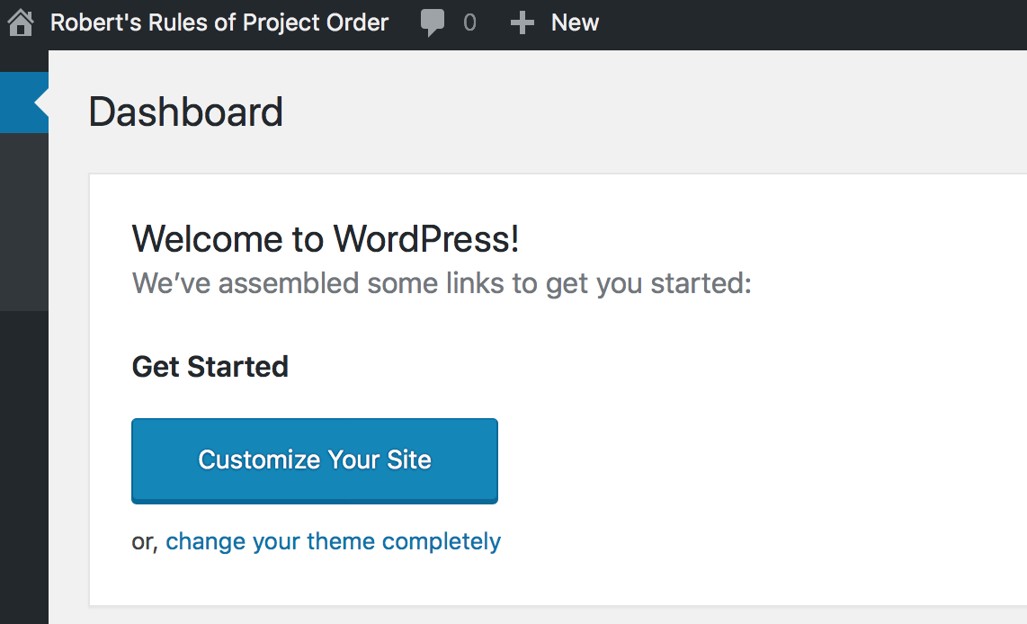
Notes:
Assert, confirmdir, findfile, centralized definition of file location, good variable names
Source code control as part of recording project history
Logging is partly for your own protection: audit of your results
But also, keep a log of source data versions with/near the source data
Code reuse: libraries versus copies – how do you fix a bug in a copy your forgot about or don’t even know about?

Slide 26
Thank you for listening!!!
Don’t forget your stats consultants
roberts-rules@utlists.utexas.edu
Notes:
Response maybe slow – volunteer effort

