Slide 1
Stata Tips and Tricks: Loops and Macros
Haley Stritzel, PhD Candidate in Sociology
PRC Statistical Consultant
haley-stritzel@utexas.edu

Slide 2
What are macros?
A short string of characters (macroname) that stands for another string of characters (macrocontents)
You can think of a macro as a shortcut or as shorthand

Slide 3
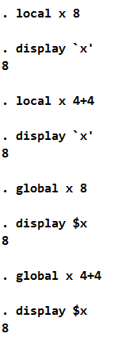
A very silly example
Syntax is:
local macroname macrocontents
Or
global macroname macrocontents
You probably wouldn’t store a single number

Slide 4
But you might use macros for…
Long lists of variables
File paths
Saved model results
A sequence of numbers

Slide 5
Why use macros?
Better reproducibility
Fewer user errors
Cleaner code
Fewer headaches
Foundation for creating custom programs

Slide 6
Two types of macros
Local macros
Specific to a do-file or a Stata session
Disappears when you come to the end of a do-file or your Stata session
Global macros
Exists forever, across do-files, across sessions (until you overwrite it)

Slide 7
Two types of macros
Local macros
Type macro name within ` ’ (single quotes) to tell Stata you are referring to a local macro
Global macros
Type $ before macro name to tell Stata you are referring to a global macro

Slide 8
Less silly examples
Stata will open "D:\Users\maslowsky\Natality\Recodes\natl_full.dta"
This is useful because if I ever re-organize my files, all I have to do is change macros at the beginning of the do file

Slide 9
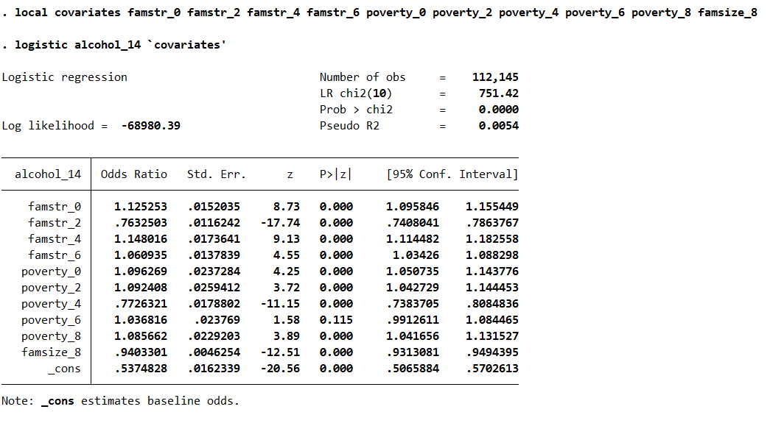
Use a local macro to define a list of covariates

Slide 10
What are loops?
A way to execute the same chunk of code for a series of numbers or variables
Like macros, loops make your code more efficient, easier to read, and less prone to error
Loops are especially helpful for cleaning data

Slide 11
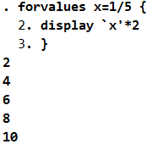
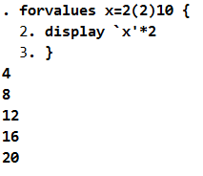
Another silly example
Syntax is:
forvalues x=range {
command `x’
}
Where range is a range of numbers, e.g.
1/5: 1, 2, 3, 4, 5
2(2)10: 2, 4, 6, 8, 10
And command is a Stata command (generate, replace, regress, etc.)

Slide 12
forvalues or foreach?
forvalues only works with numbers
foreach is more flexible:
foreach x of numlist 1/5 {
foreach var of varlist x y z {
You can also refer to a previous macro
foreach var of local covariates {
foreach var of global covariates {
Note: “x” and “var” are arbitrary names – you could name these elements whatever you want

Slide 13
Less silly examples
Create a variable for grandparent in the household at every year
A little more tricky example with a longitudinal dataset with youth at different ages – create a variable for drinking at age 14 by looping through years until the year is equal to the year in which the youth was 14

Slide 14
Less silly examples
Perform the same regression model with different outcome variables
“eststo” saves the model results, which can then be exported

Slide 15
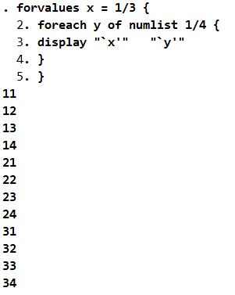
Nested loops – loops within loops
Can get very complicated very fast
Recommend no more than 3 nested loops
Every loop must begin with a { and end with a } on a separate line

Slide 16
Combining loops AND macros
Predicting time spent with parent based on household variables at ages 0, 2, 4, 6, and 8
Equivalent to writing
(helpful when you have to repeat the same model with slightly different specifications)

Slide 17
Where to get help?
In Stata, type into command line:
help macro
help foreach
help forvalues
Send us an email or set up an appointment with us!
consultants@prc.utexas.edu

