Slide 1
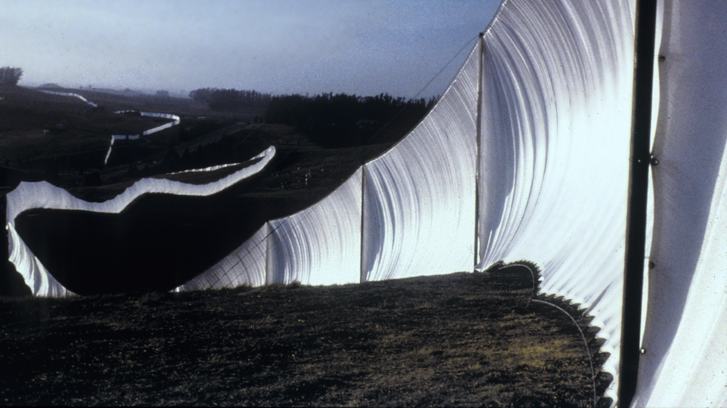
Fall 2022
Colloquium Workshop
John R. Clarke, Graduate Advisor and
Graduate Student Art History Association

Slide 2
The Process
Spring
Meet with your primary advisor to discuss your planned topic.
Register for colloquium hours during advising.
Summer
Take this time to familiarize yourself with your topic and narrow in on your primary questions.
Assemble a bibliography and read widely in the secondary literature.
If applying for PhD programs in the fall, it is best to have a draft of prospectus done by end of summer. This helps with writing your statement of purpose.
Fall
Check in with your advisor. Set a schedule and work through drafts of your prospectus. Get a sense of when you will be ready for the colloquium (earlier is better—you get feedback and move onto writing or exams).
even if you aren’t ready to schedule your colloquium at the beginning of the fall, email everyone and ask about their travel plans for the semester, then note that you will follow up. It is your responsibility to schedule the colloquium.
Assemble your committee, set a date for colloquium (use a Doodle poll, this may take more than one try). PhD committees must have 1 out-of-department faculty member.
When a colloquium date is set, confirm with Graduate Advisor (John Clarke), your committee, and the Grad Coordinator (Clare Thoman). To reserve DFA 2.506 for your colloquium, email stefanie.donley@austin.utexas.edu
Distribute an electronic (PDF) copy of the prospectus and a physical copy to the entire committee one week before your colloquium.

Slide 3
Committees
MA
The Thesis Colloquium is attended by five faculty members:
Graduate Adviser for Art History (Clarke)
Student’s thesis adviser
Second reader for the thesis
Two additional faculty members chosen by the student in consultation with the thesis adviser
One faculty member can be from out-of-department.
If the Graduate Adviser is also the thesis adviser, only three additional faculty are needed
PhD
The Dissertation Colloquium is attended by six faculty members:
Art History Graduate Adviser
Five faculty members who will be on the dissertation committee.
PhD committees must have 1 out-of-department faculty member.
If the Graduate Adviser is also the dissertation adviser, only four additional faculty members are required.
All committee members are physically present at the colloquium. However, when a member of the committee is unable to attend in person, it is possible for that committee member to attend by Zoom or speaker phone/conference call.

Slide 4
The Prospectus
MA
Single spaced, Times New Roman 12pt, 1” margins
Title, even if tentative
Statement of the Problem (i.e. intro to topic, primary questions, chapter outline),
State of the Literature (i.e. state of literature on your topic and “adjacent topics”),
Outline (1 page),
Bibliography (2 pages maximum).
No more than 1500 words total
PhD
Single space, Times New Roman 12 pt, 1” margins
Title, even if tentative
Statement of the Problem (i.e. intro to topic, primary questions, chapter outline),
State of the Literature (i.e. state of literature on your topic and “adjacent topics”),
Outline,
Bibliography.
No more than 2500 words total
Sample Prospectuses: https://utexas.box.com/s/luzqghox9cws4n521tf8d7qxofzci2ej

Slide 7
The Colloquium
In DFA 2.506 (Art History conference room) and will last about 40 minutes for the MA, about an hour for the PhD.
Begin with a brief presentation: show and briefly describe images of the works you have referenced in the prospectus, discuss the origins of the project, acknowledge areas that need to be addressed. This portion will vary from student to student, discuss with your advisor their expectations.
Questions from each committee member (order and structure will vary):
  Questions could be about any aspect of the project or prospectus.
  It is OKAY not to know the answers yet—and to admit this.
  Anticipate tough questions, stay calm and confident.
  Be ready to frame your project and discuss.
You will be asked to leave the room while the committee discusses whether or not you pass.
Colloquia are public! Invite a colleague to yours to take notes and provide support, and also try to attend a colleague’s colloquium (if they invite you) to get a sense of what it’s like.
For doctoral students: begin discussions with your committee about what your exam topics/questions will be, and pass those on to the Graduate Advisor (John Clarke) before the colloquium. The four questions will be discussed and set by the end of your colloquium.

Slide 8
Searching UT libraries:
https://repositories.lib.utexas.edu/ > UT Electronic Thesis and Dissertations: https://repositories.lib.utexas.edu/handle/2152/4 > This Community: Departments https://repositories.lib.utexas.edu/handle/2152/4/browse?type=department > Art History.
The Art History link can be found directly HERE: https://repositories.lib.utexas.edu/handle/2152/4/browse?type=department&value=Art+History. Updated through 2021.
Sample Prospectuses: https://utexas.box.com/s/luzqghox9cws4n521tf8d7qxofzci2ej

