Slide 1
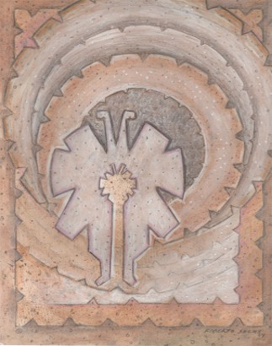

2025 International Conference on Aging in the Americas
IICAA Logo
Aging in the Americas: Growing Burdens and Emerging Solutions
Jaqueline L. Angel, Ph.D.
The University of Texas at Austin
La Monarrca
Byy Roberrtto Saallaass

Slide 2
Thank

Slide 3


















Collaborators

Slide 4



Purpose and Goals of this Conference
Promote interdisciplinary collaboration
across various fields related to aging and health.
Exchange ideas and foster collaborative efforts
that address key issues affecting the health of aging Hispanics.
Lead the conference annually with support from sponsors, grantees, and
partners.
Foster emerging scholar careers, providing them with opportunities to engage with expert researchers through a mentoring program.
0

Slide 5

Timeline
Since 2001, the ICAA has held conferences on healthful aging.
Future Installments (2025-2029): NIA R13 grant application was awarded five new conferences.

Slide 6

Conference Components
The ICAA Includes:
Keynote addresses from experts
Invited presentations on health and aging in Mexico-United States
Emerging scholars & early career investigator programs
Speed mentoring
Mentor-Mentee publications
Poster Awards, Reception and dinner
Steve Wallace Juried Poster Session
Data and Grant workshop
Publications in peer-review scholarly journals

Slide 7




How the Conference is Organized
The ICAA is guided by:
ICAA Advisory Group
ICAA planning team and local organizers
ICAA Champions that promote the event and its goals

Slide 8
Publications
Journal of Aging and Health Special issue “Aging in the Americas: Growing Burdens and Emerging Solutions,” 2025 ICAA
Hispanic Journal of Behavioral Sciences: “Living with Dementia among Latinos” 2024 ICAA, Feb 2025)
The Gerontologist: Special issue “Hispanic/Latinx Healthy Aging,” 2023 ICAA
2024 ICAA Bridging Conferences held in Mexico City (2013, 2019, 2024) and UT Austin
NIA (2024) NIA R13 conference grant application for continued funding (2009-2023)

Slide 9

Agendas of Upcoming ICAA Conferences
2025: University of Miami, Coral Gables, FL
2026: University of I l l inois- Chicago
2027 : Cornell University, Ithaca, NY
2028: University of Southern California, Los Angeles, CA
2029: UTMB Galveston, TX

Slide 10
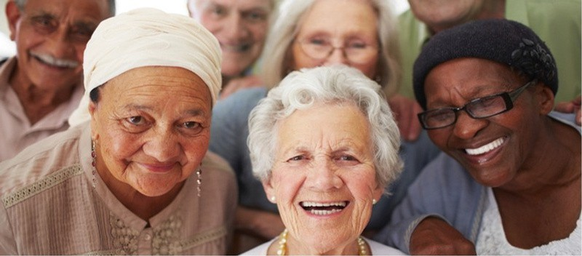
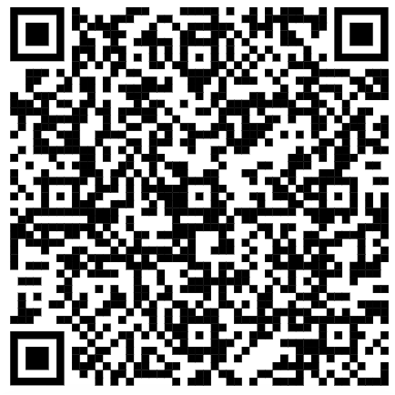
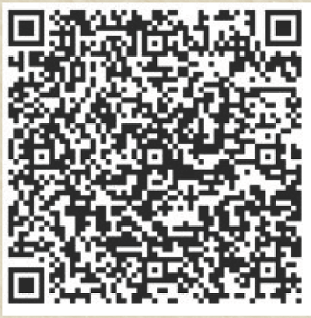
Thank You!
I2025 ICAA Prrogrram
IICAA,, Confferrenciia IIntterrnaciionall sobrre ell Envejjeciimiientto en llas Amérriicas
QR code for 2026 “Call for Abstracts” Emerging Scholars and Program

Slide 11
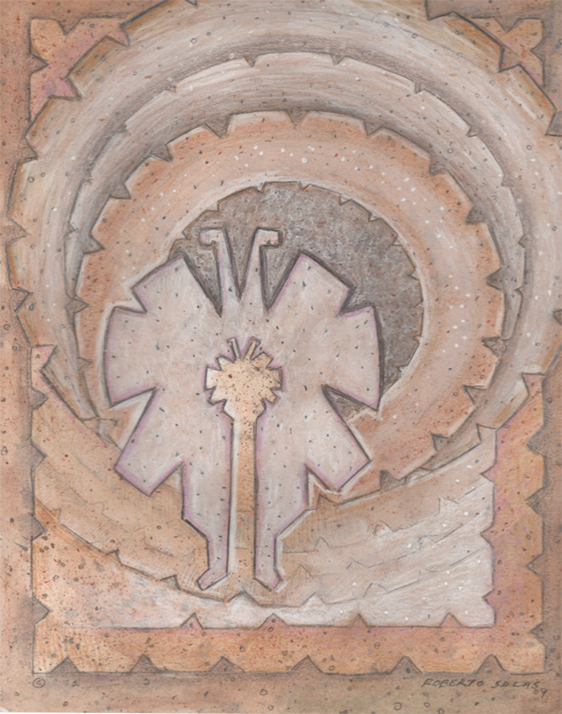

Welcome to the 2025 ICAA
QR code for 2026 “Call for Abstracts” for Emerging Scholars and Program Schedule

Slide 12
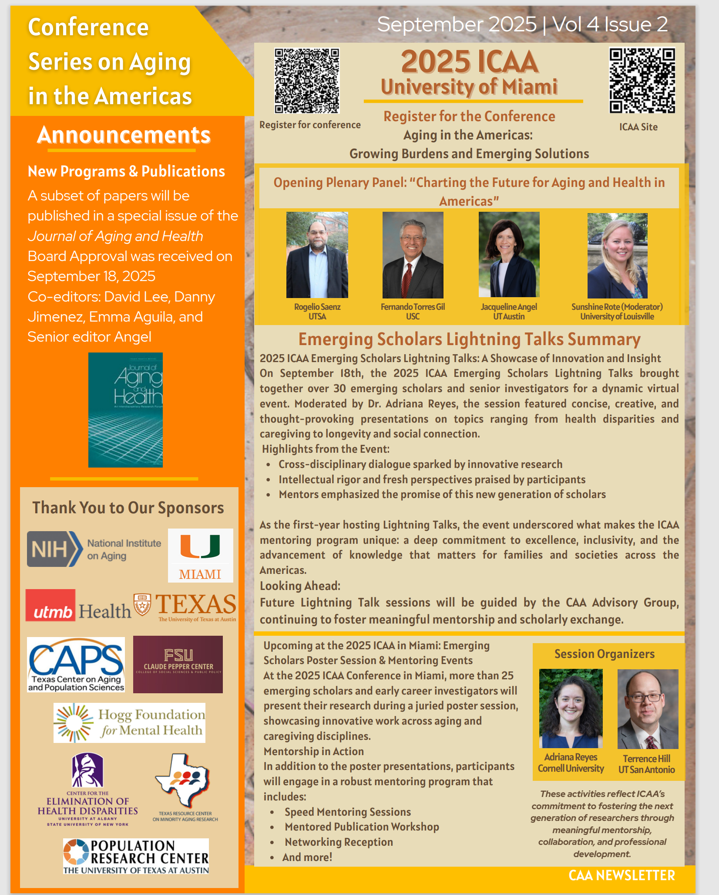
CAA Website:https://sites.utexas.edu/caa/
For more information contact: jangel@austin.utexas.edu

