Slide 1


February 27, 2019
Peer Support for Post Intensive Care Syndrome (PS-PICS)
Valerie Danesh, PhD, RN
Research reported here was supported by the National Institute of Nursing Research of the National Institutes of Health under Award Number P30NR015335. The content is solely the responsibility of the authors and does not necessarily represent the official views of the National Institutes of Health.

Slide 2
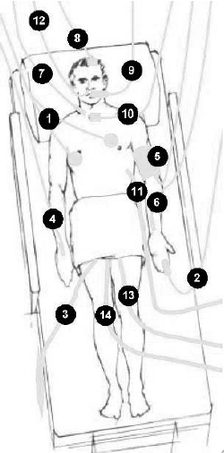
Background
5M adults to Intensive Care Units in the US annually. And climbing.
Noxious stimuli & physiological
Post-hospitalization deficits
    Mechanical ventilation
    Delirium during hospitalization
Pre-hospital ≠ Post-hospital
Post Intensive Care Syndrome (PICS)
Notes:
Background and Rationale for the study

Slide 3
Post-Intensive Care Syndrome
Post-Hospitalization Syndrome
Hospitalization-Associated Disability
Needham 2012 CCMED
Notes:
Many ICU survivors are unable to return to physically or cognitively demanding jobs due to the “after effects” of critical illness^{7,14}, and are particularly vulnerable to post-hospitalization difficulties affecting both survivors and families, including transportation barriers¹⁵, paying for food¹⁶ and housing^{15,16} and/or medical causes of bankruptcy^{17,18}. Social isolation is a recurrent and problematic theme in ICU survivorship¹⁹⁻²¹, but effective interventions are lacking. Risks for social isolation stem from the health issues, disabilities and trauma associated with critical illness survivorship, and are compounded by insufficient community infrastructure that is not yet conducive to recovery and rehabilitation needs. Both social isolation and new onset PICS-related chronic conditions (e.g., depression) are substantial public health concerns with a need for self-management interventions, including social integration solutions, that target post-hospitalization sequelae in ICU survivors.
Needham, D. M., et al. (2012). Improving long-term outcomes after discharge from intensive care unit: Report from a stakeholders' conference. Critical Care Medicine, 40(2), 502-509.

Slide 4
Intervention & Team
Motivational Interviewing techniques
Family Members
Chaplains Nurse Managers
Physician Trainees
Peer Mentors
ICU Nursing | Psychiatric ARNP | Medicine | Population Health | Sociology
Notes:
Background and Rationale for the study
Research Team: Dr. Danesh (PI), Dr. Jimenez and Dr. Arroliga have worked together on several previous studies that required patient recruitment from hospital nursing units for recruitment, and have a research and clinical practice collaboration history of more than a decade. Dr. Jimenez is the System Vice President of Critical Care Integration at Baylor Scott & White Health Memorial Hospital (BSW) and a practicing intensivist with extensive experience managing critically ill patients and interdepartmental collaborations. Dr. Arroliga contributes substantial healthcare administration expertise as the Chairman of the Board of Directors and Chief of Staff at BSW and he is a practicing pulmonologist with experience managing care for ICU survivors. Donna Rolin, PhD, PMHNP will contribute content expertise as a Psychiatric Advanced Practice Registered Nurse with more than 20 years of experience in cognitive behavioral, group and family psychotherapies, as well as psychiatric evaluation and pharmacotherapy for persons with mental illness and cognitive disorders in inpatient and outpatient settings. Sociologist Debra Umberson will advise and mentor Dr. Danesh in measures of social relationships and population health. Population Health expert Miyong Kim and gerontologist Alan Stevens will advise and mentor Dr. Danesh in community-based population health intervention delivery and evaluation. Dr. Umberson, Dr. Kim, and Dr. Stevens are established mentors for Dr. Danesh.

Slide 5
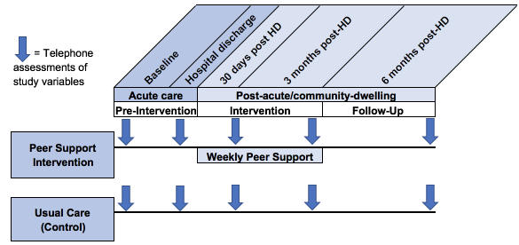
Study Design and Population
18-64 years;
ICU >8 days or longer;
ICU survival
>2 chronic conditions
HD = Hospital Discharge
Notes:
Study Design and Population – with an emphasis on study theme
Exclusion criteria are: 1) death prior to hospital discharge; 2) enrollment in Hospice services at the time of hospital discharge; 3) non-communicative; 4) no access to telephone; and/or 5) incarcerated .

Slide 6
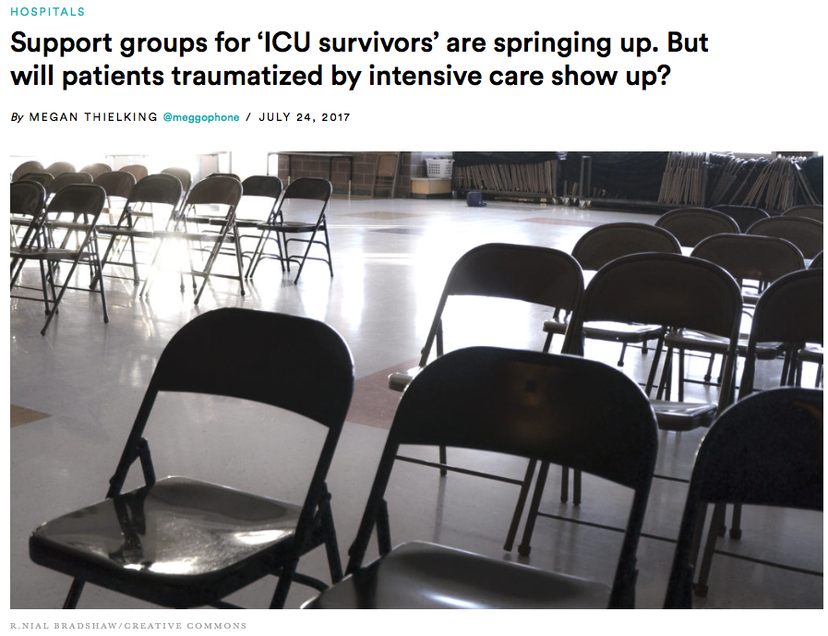

Challenges & Alternative Strategies
Study start-up
Patient screening
Consent
Research team
Distance
Feasibility goals
Notes:
Lessons Learned: Thus far or Anticipated

Slide 7
THANK YOU

