Slide 1


February 27, 2019
Bridging the Gap: Patient Access to health information during hospitalization
Marge Benham-Hutchins PhD, RN; Nancy Staggers PhD, RN; Michael Mackert PhD; Alisha Johnson MSN, RN;
Dave deBronkart, SB
This research was supported by the National Institute of Nursing Research of the National Institutes of Health under award number P30NR015335. The content is solely the responsibility of the authors and does not necessarily represent the official views of the National Institutes of Health. University of Texas IRB Protocol: 2015-06-0016

Slide 2
Background and Purpose
Patient self-management of chronic disease often requires the patient to bridge the gap between multiple care settings and providers. Hospitalizations have the potential to disrupt established self-management routines.
Access to medical information during hospitalization has the potential to improve self-management as well as promote informed decision making during and after hospitalization.
The purpose of this pilot study was to determine how an inpatient hospitalization influences chronic disease self-management and to examine patient perspectives on facilitators and barriers to shared decision making during hospitalization and participation in bedside nursing handoff and medical rounds.

Slide 3
Significance and Innovation
Explores patient identified information needs that support self-management transitions between care settings.
Includes cancer survivors, a growing group of patients that are faced with self-management of a chronic disease.
Transdisciplinary research team: broad range of experiences, including patient engagement, health literacy, academic research, methodological experts, nursing practice, informatics, and the unique perspective and expertise of a cancer survivor and patient participation movement leader.

Slide 4
Methods
Convenience and social media snowball sampling was used to recruit participants (n = 34) through online patient support groups, email invitations, listservs, blogs, and social media.
The questionnaire consisted of three components: (1) demographics, (2) the Patient Activation Measurement Survey¹ (PAM®) and (3) limited choice and open-ended questions about patients’ hospital experiences (developed by the transdisciplinary research team).
Notes:
Developed questions
Qualitative Analysis
Shared Perspectives

Slide 5
Findings
The sample was highly educated, with 29% (n=10) having some college or technical school, 32% (n=11) were college graduates and 32% (n=11) had some graduate school or an advanced degree. The remaining participants (n=2) indicated they were high school graduates.
Hospitals in all four geographical regions of the United States as well as urban, rural, and suburban settings were represented.
The results of the PAM® survey revealed a highly activated sample: Level 1 (0); Level 2 (3); Level 3 (21) and Level 4 (10).
Chronic diseases: Cancer (15); Type 1 Diabetes (3); Gastrointestinal (6); Lupus (2); Pulmonary (2); Musculoskeletal (3); Integumentary (2) and Hematologic (1).

Slide 6
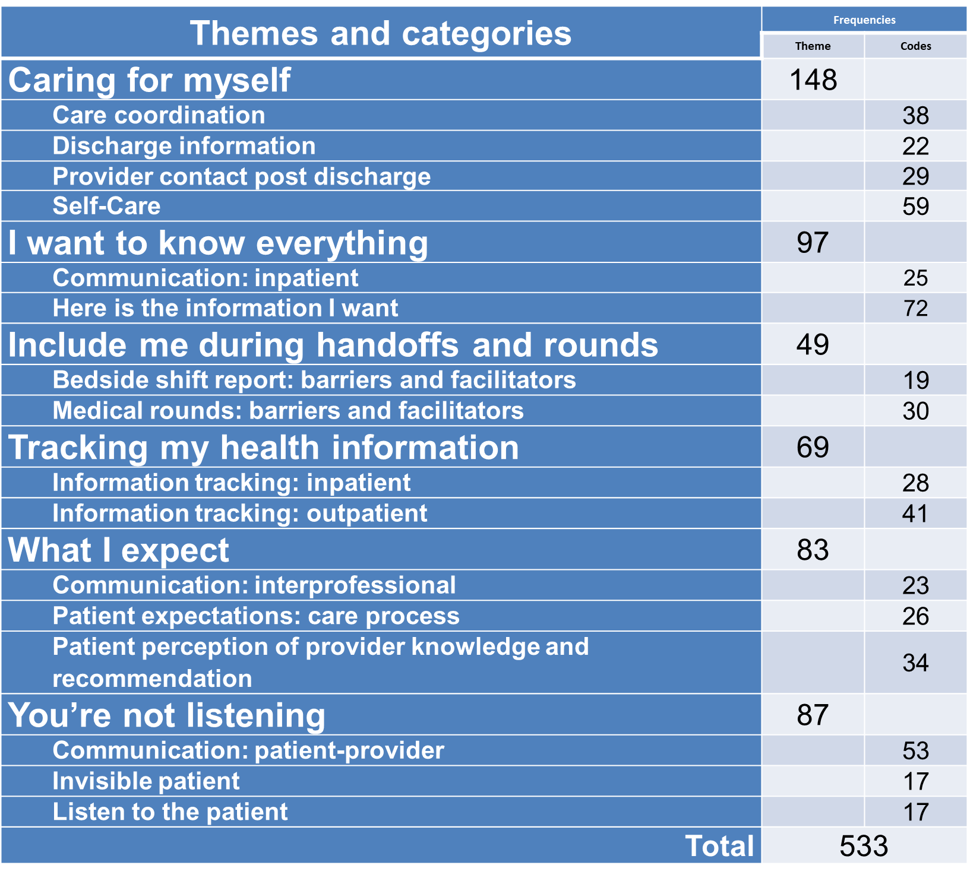
Findings
Analysis of open ended questions was supported through the use of Atlas ti™ and followed the steps of conventional qualitative content analysis.
Notes:
Analysis of open ended questions was supported through the use of Atlas ti™ and followed the steps of conventional qualitative content analysis.

Slide 7
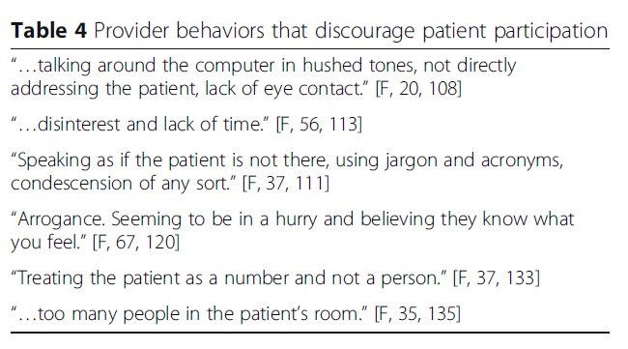
Findings

Slide 8
More information
¹Hibbard, J. H., Mahoney, E. R., Stockard, J., & Tusler, M. (2005). Development and testing of a short form of the patient activation measure (PAM). Health Service Research, 40(6 Pt 1), 1918-1930. doi:10.1111/j.1475-6773.2005.00438.x
Benham-Hutchins, M., Staggers, N., Mackert, M., Johnson, A. H., & deBronkart, D. (2017). “I want to know everything”: a qualitative study of perspectives from patients with chronic diseases on sharing health information during hospitalization. BMC Health Services Research, 17(1), 529. https://doi.org/10.1186/s12913-017-2487-6

Slide 9
THANK YOU

