Slide 1

Class 8 Truck Efficiencies: 2018:2025 and the Impact on Metropolitan, Regional and Megaregional Truck Freight Distribution and Highway Funding
Report: CM2 2017-3
Robert Harrison (CTR), Dr. Ron Matthews, Colton Voorhis and Sean Mason (UT Mech. Eng.)

Slide 2

Context
The report focuses on a key element of the success of any urban imaginary—efficient, safe and clean freight transportation.
Little economic or freight discussions in current literature
Transportation systems serve various urban forms, including large metropolitan urban areas, including the multistate, regional urban forms.
Positive impact from including them in all urban forms.

Slide 3
U.S. Trucking
The U.S relies on efficient trucking use of federal, state and county highways to move commodities, semi-finished and finished goods by truck, multimodal systems and distribution gateways. Large metropolitan and megaregional urban forms critically depend on truck services.
Trucks account for around 70 percent of the U.S ton-miles moved by transportation modes and Class 8 vehicles dominate long distance highway truck freight flows.

Slide 4
Historical Impacts on Current U.S. Freight System
Interstate Highway Program 1960 - 1980
Deregulation of all modes 1980
Fuel Taxes and registration fees to pay for highway maintenance, upgrades and replacement, fuel taxes raised after size and weight increase 1980-84
Strict EPA diesel truck emissions passed in the 2002 – 2010 period

Slide 5
U.S. Federal Heavy Truck Emission Standards (g/bhp-hr.)
Year CO HC NOx P
1985 15.5 1.3 10.7 0.62
1991 15.5 1.3 5.0 0.25
1998 15.5 1.3 4.0 0.10
2007 15.5 0.14 0.2 0.01

Slide 6
SuperTruck Phase 1
Downsizing the heavy-duty turbocharged diesel truck engines:
a. Improving smaller turbocharged engine designs, recirculating lost energy from exhaust
b. decreasing the “auxiliary loads” on the engine, termed “parasitic losses”,
c. reducing the tractor and/or tractor-trailer unladen (“tare”) weight through lighter engine and transmission components.
d. downspeeding the engine to maintain the tractor-trailer cruising speed—typically 65 mph—within high torque ranges, rather than high power ranges.

Slide 7
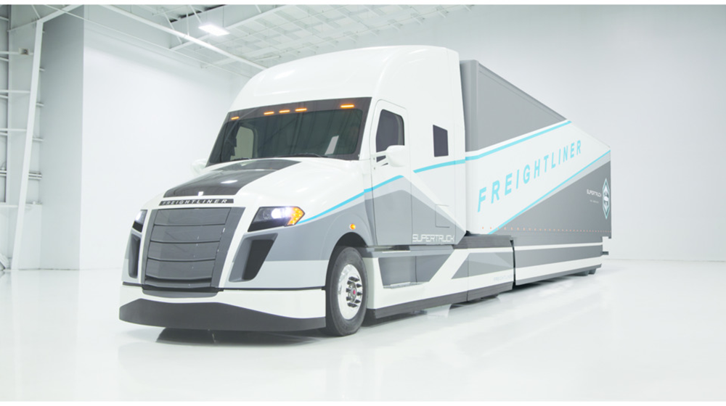
Daimler SuperTruck 1: Freight Efficiency 115%

Slide 9
DOE SuperTruck Program
Phase 1 2010
DOE matched research funds with 4 trucking consortia to achieve significant improvements in efficiency and fuel consumption
Phase 2 2016
Extended the research to further improve safety and fuel efficiencies
Highly successful – many patents and potential elements in future OEM model year trucks. Study highlights 2018, 2021, and 2025.

Slide 10
Urban Deliveries
Hub and spoke – traditional model
Diesel engines, although some electric will be tested
If companies making urban electric powered trucks show comparable life cycles and cheaper operating costs than diesel, E-truck share could grow
MPO planners leave distribution center (hubs) choice to private sector which miss opportunities to improve freight flows
Pricing options for electric vehicles

Slide 11
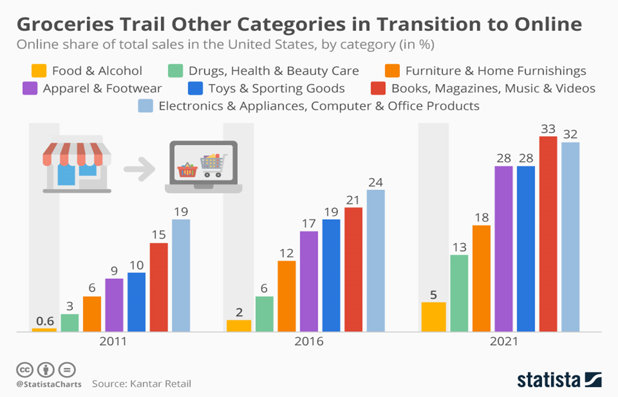

Slide 12
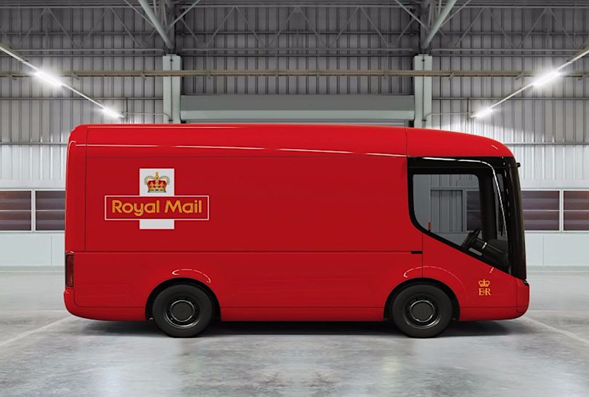
UK Royal Mail Electric Truck – London 2018

Slide 13
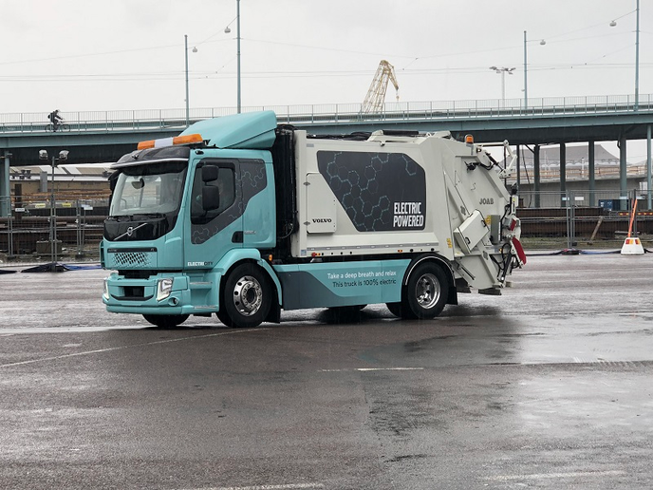
Volvo FE Urban Electric Truck

Slide 14
Main Tier 1 CM2 Freight Planning Conclusions
MPOs should actively identify and promote freight ports
In 2025, 60 percent of the diesel truck vehicle miles of travel will be undertaken by cleaner and safer tractors, bringing societal benefits
U.S gasoline and diesel demand will peak with diesel technologies, hybrid, e-trucks/buses and LNG tractors on both corridor and urban networks
Funding highways though fuel taxes will fail to meet needs
Autonomous truck research can supply the data needed – location, load and time – for more equitable and efficient pricing

