Slide 1




A Northeast Megaregion Travel Demand & Investment Model:
Project Overview
John Landis, PI
Mohammed Arif Khan, Ruochang Huang, Yuting Sun, Yipeng Peng, Mengting Yu, Dhruvi Khothari
University Transportation Center for
Cooperative Mobility for Competitive Megaregions (CM2)

Slide 2
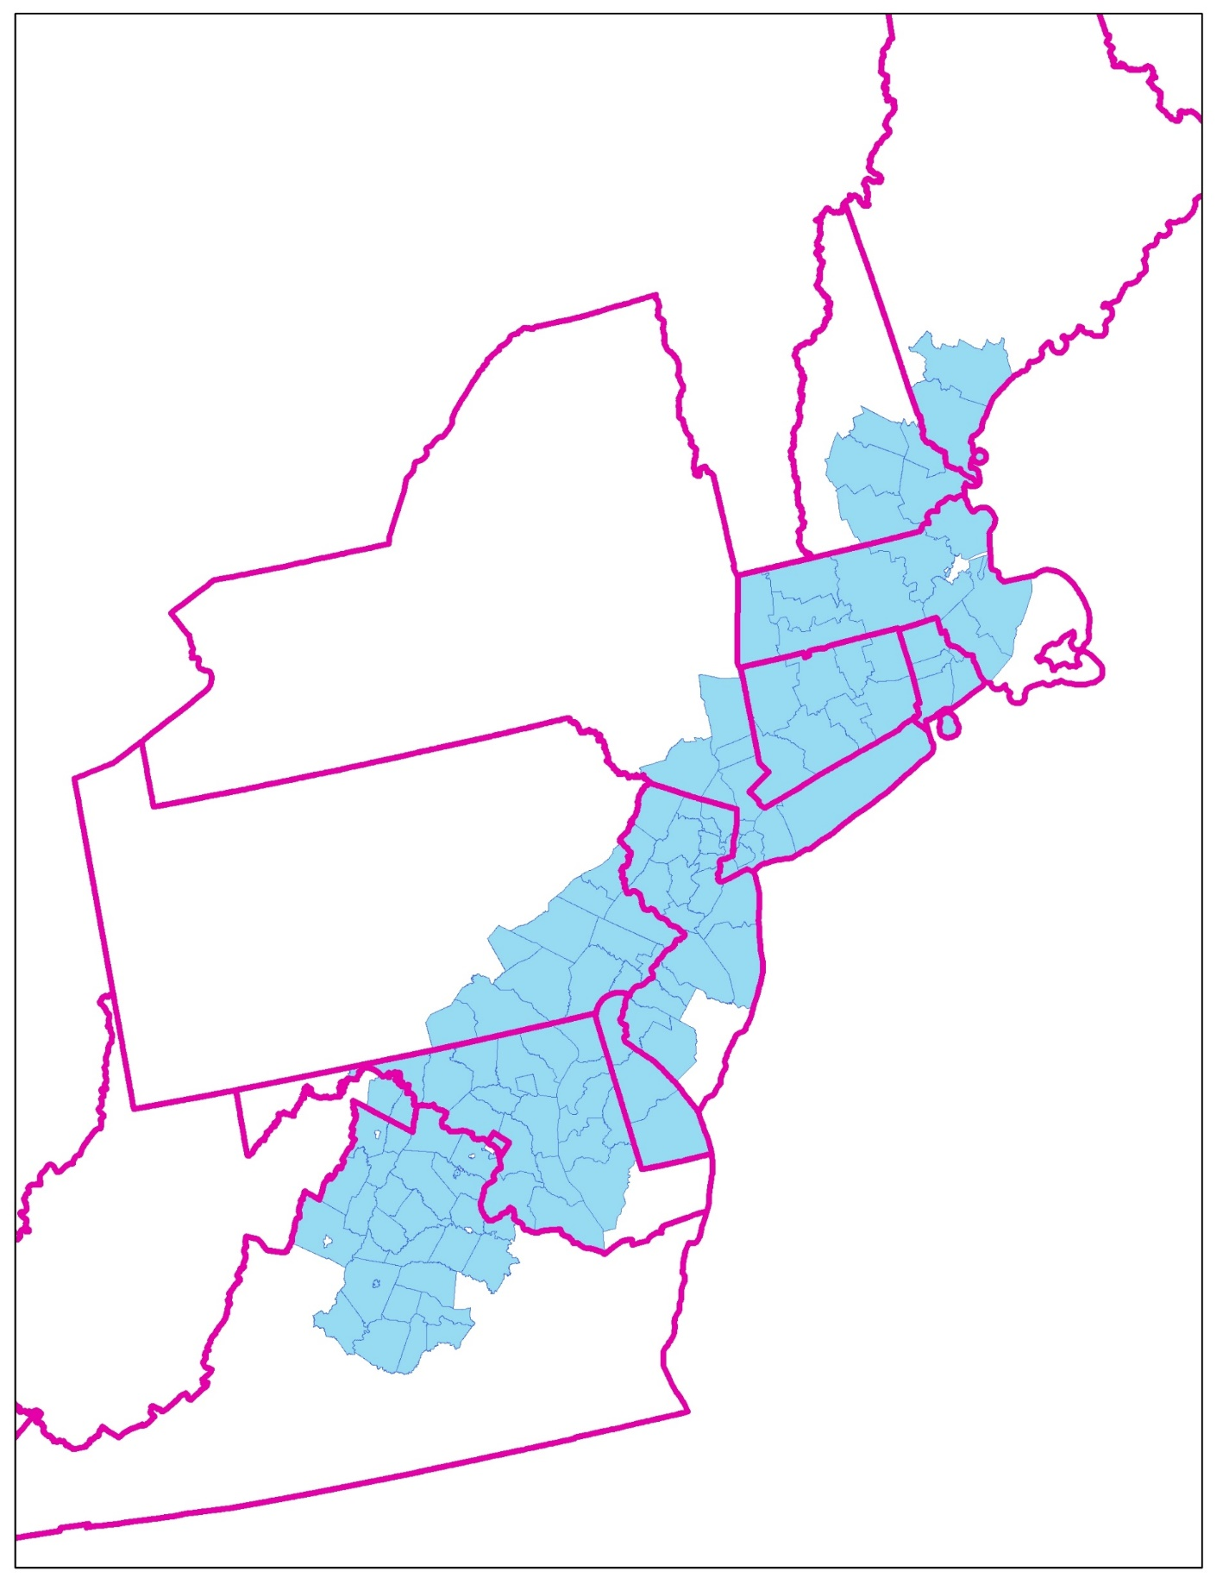
The Context
A Critical but Fragmented Transportation Planning Landscape
13 States & DC
39 Metros
130 Counties
50 million residents (15% of US total in 2016)
25 million jobs (14% of US total)
38 MPOs (most with their own planning and travel demand models)

Slide 3
Help Wanted
Help Wanted: A behaviorally-based, multi-metro (megaregional) transportation planning, impact assessment, and financing model capable of:
Analyzing and comparing multi-modal and public-private investment alternatives.
Incorporating freight and air transport modes.
Exploring the linkages between transportation investments and real estate and economic development.
Cumulative cost, benefit, impact, and equity assessment capabilities across neighboring MPOs and operating agencies.
Considering the possible roles of / pathways for new technologies, especially vehicle automation.

Slide 4
Agenda
Three Challenges
Model Design Issues
Selected Baseline Results
Projections & Alternatives
Development Feedback Loops
Reflections

Slide 5
A. Three Challenges

Slide 6
Three Challenges
Institutional & Political Challenges
  38 MPOs!
  States that don’t always work well with each other, MPOs and service providers.
  Declining federal leadership & funding for transportation.
Modeling Challenges
  Making the best use of very limited data.
  Modeling external trips.
  Mixing passenger and freight flows.
  How much geographic detail?
  Unique or parallel approach across modeling geographies?
Futures Challenges
  Planning horizon ►► 2030
  Future project mix?
  Growth & development feedback loops.

Slide 7
B. Model Design Issues

Slide 8
Model Design Issues & Questions
General principles
Choice of modeling platform?
Multiple scales, geographies, and modes
Unique or parallel approaches?
How to couple passenger & freight route assignment
Incorporating congestion effects
Feedback to growth & development
Scripting the future

Slide 9
Modeling Principles
KISS: Simple & general-use models beat complicated and context-specific models.
Strive for a consistency approach across geographies and scales.
Cross-check the results to MPO studies and model results.
Get the best data (household-based, good coverage, current, high spatial accuracy ) we can.
Local Expertise: Use existing state- and MPO-based projections where possible.
“Ball-park” Accuracy: It is better to be roughly right than precisely wrong.
Proportionality: A small change in an parameter value should not generate an out-of-scale outcome.
Realistic: Must be capable of simulating the likely effects of real projects.

Slide 10
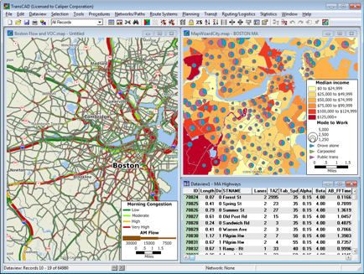
Modeling Platform: TransCAD
Integrated GIS, travel demand modeling, and facility-assignment procedures at multiple scales.
Already used by many MPOs.
Extensive data included. Excellent technical support.
Strong visualization tools.
Imports and exports a wide variety of data formats. Macro- and script-friendly.
https://www.caliper.com/transcad/mapping.htm

Slide 11
Three Geographies (1-4-1)
1 Inter-metropolitan multi-modal travel demand model for modeling passenger trips greater than 25 miles. 162 county-based zones, based in part on survey data from the 2017 National Household Travel Survey (NHTS) data. Modes: Highway, Amtrak, commuter rail, inter-city bus, air.
4 Intra-metropolitan travel demand models (Boston-Providence-Worcester, Greater New York, Greater Philadelphia, Baltimore-Washington-Richmond) for modeling passenger trips greater than 3 miles (and less than 25) 916 zip code-based zones using drawing on ACS & CBP data. Modes: Highway, commuter rail subway & light rail, metro bus, other.
1 National scale freight commodity flow model for modeling truck & rail, freight flows (tons and value) in and out of major metropolitan areas in the Northeast Megaregion. Based on FHWA’s Freight Analysis Framework (FAF) flow data. Modes: Truck and rail

Slide 12
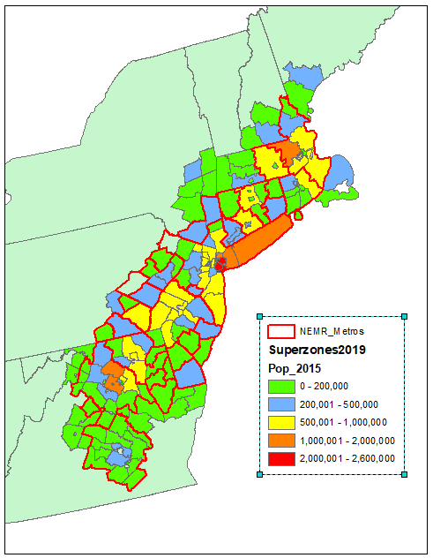
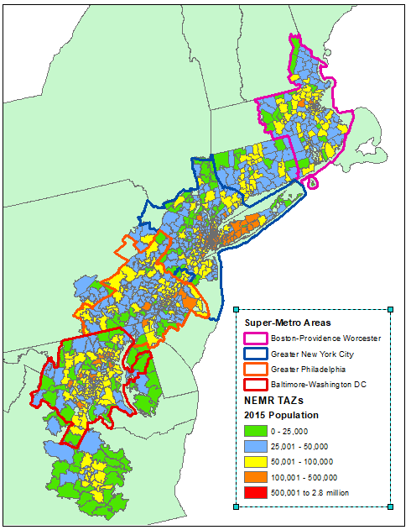
Three Modeling Geographies
Megaregional Superzones (n=162)
Super-metro TAZs (n=916)
For Inter-metropolitan Trips
For Intra-metropolitan Trips

Slide 13
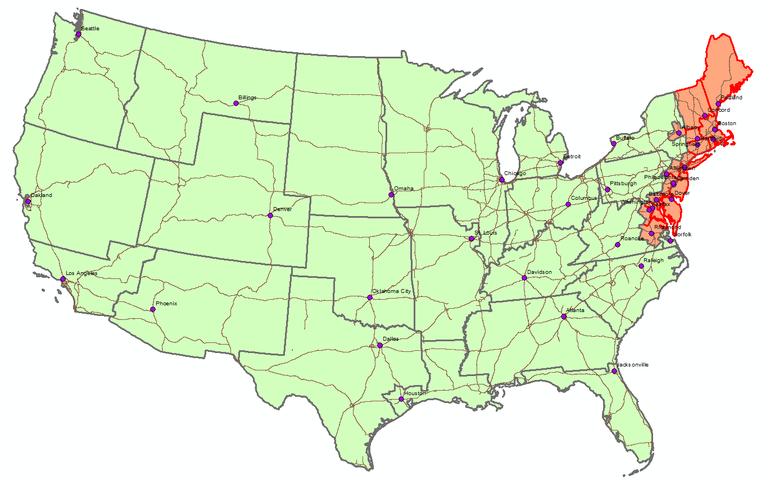
Three Modeling Geographies
Modified FAF Zones (16/39)

Slide 14
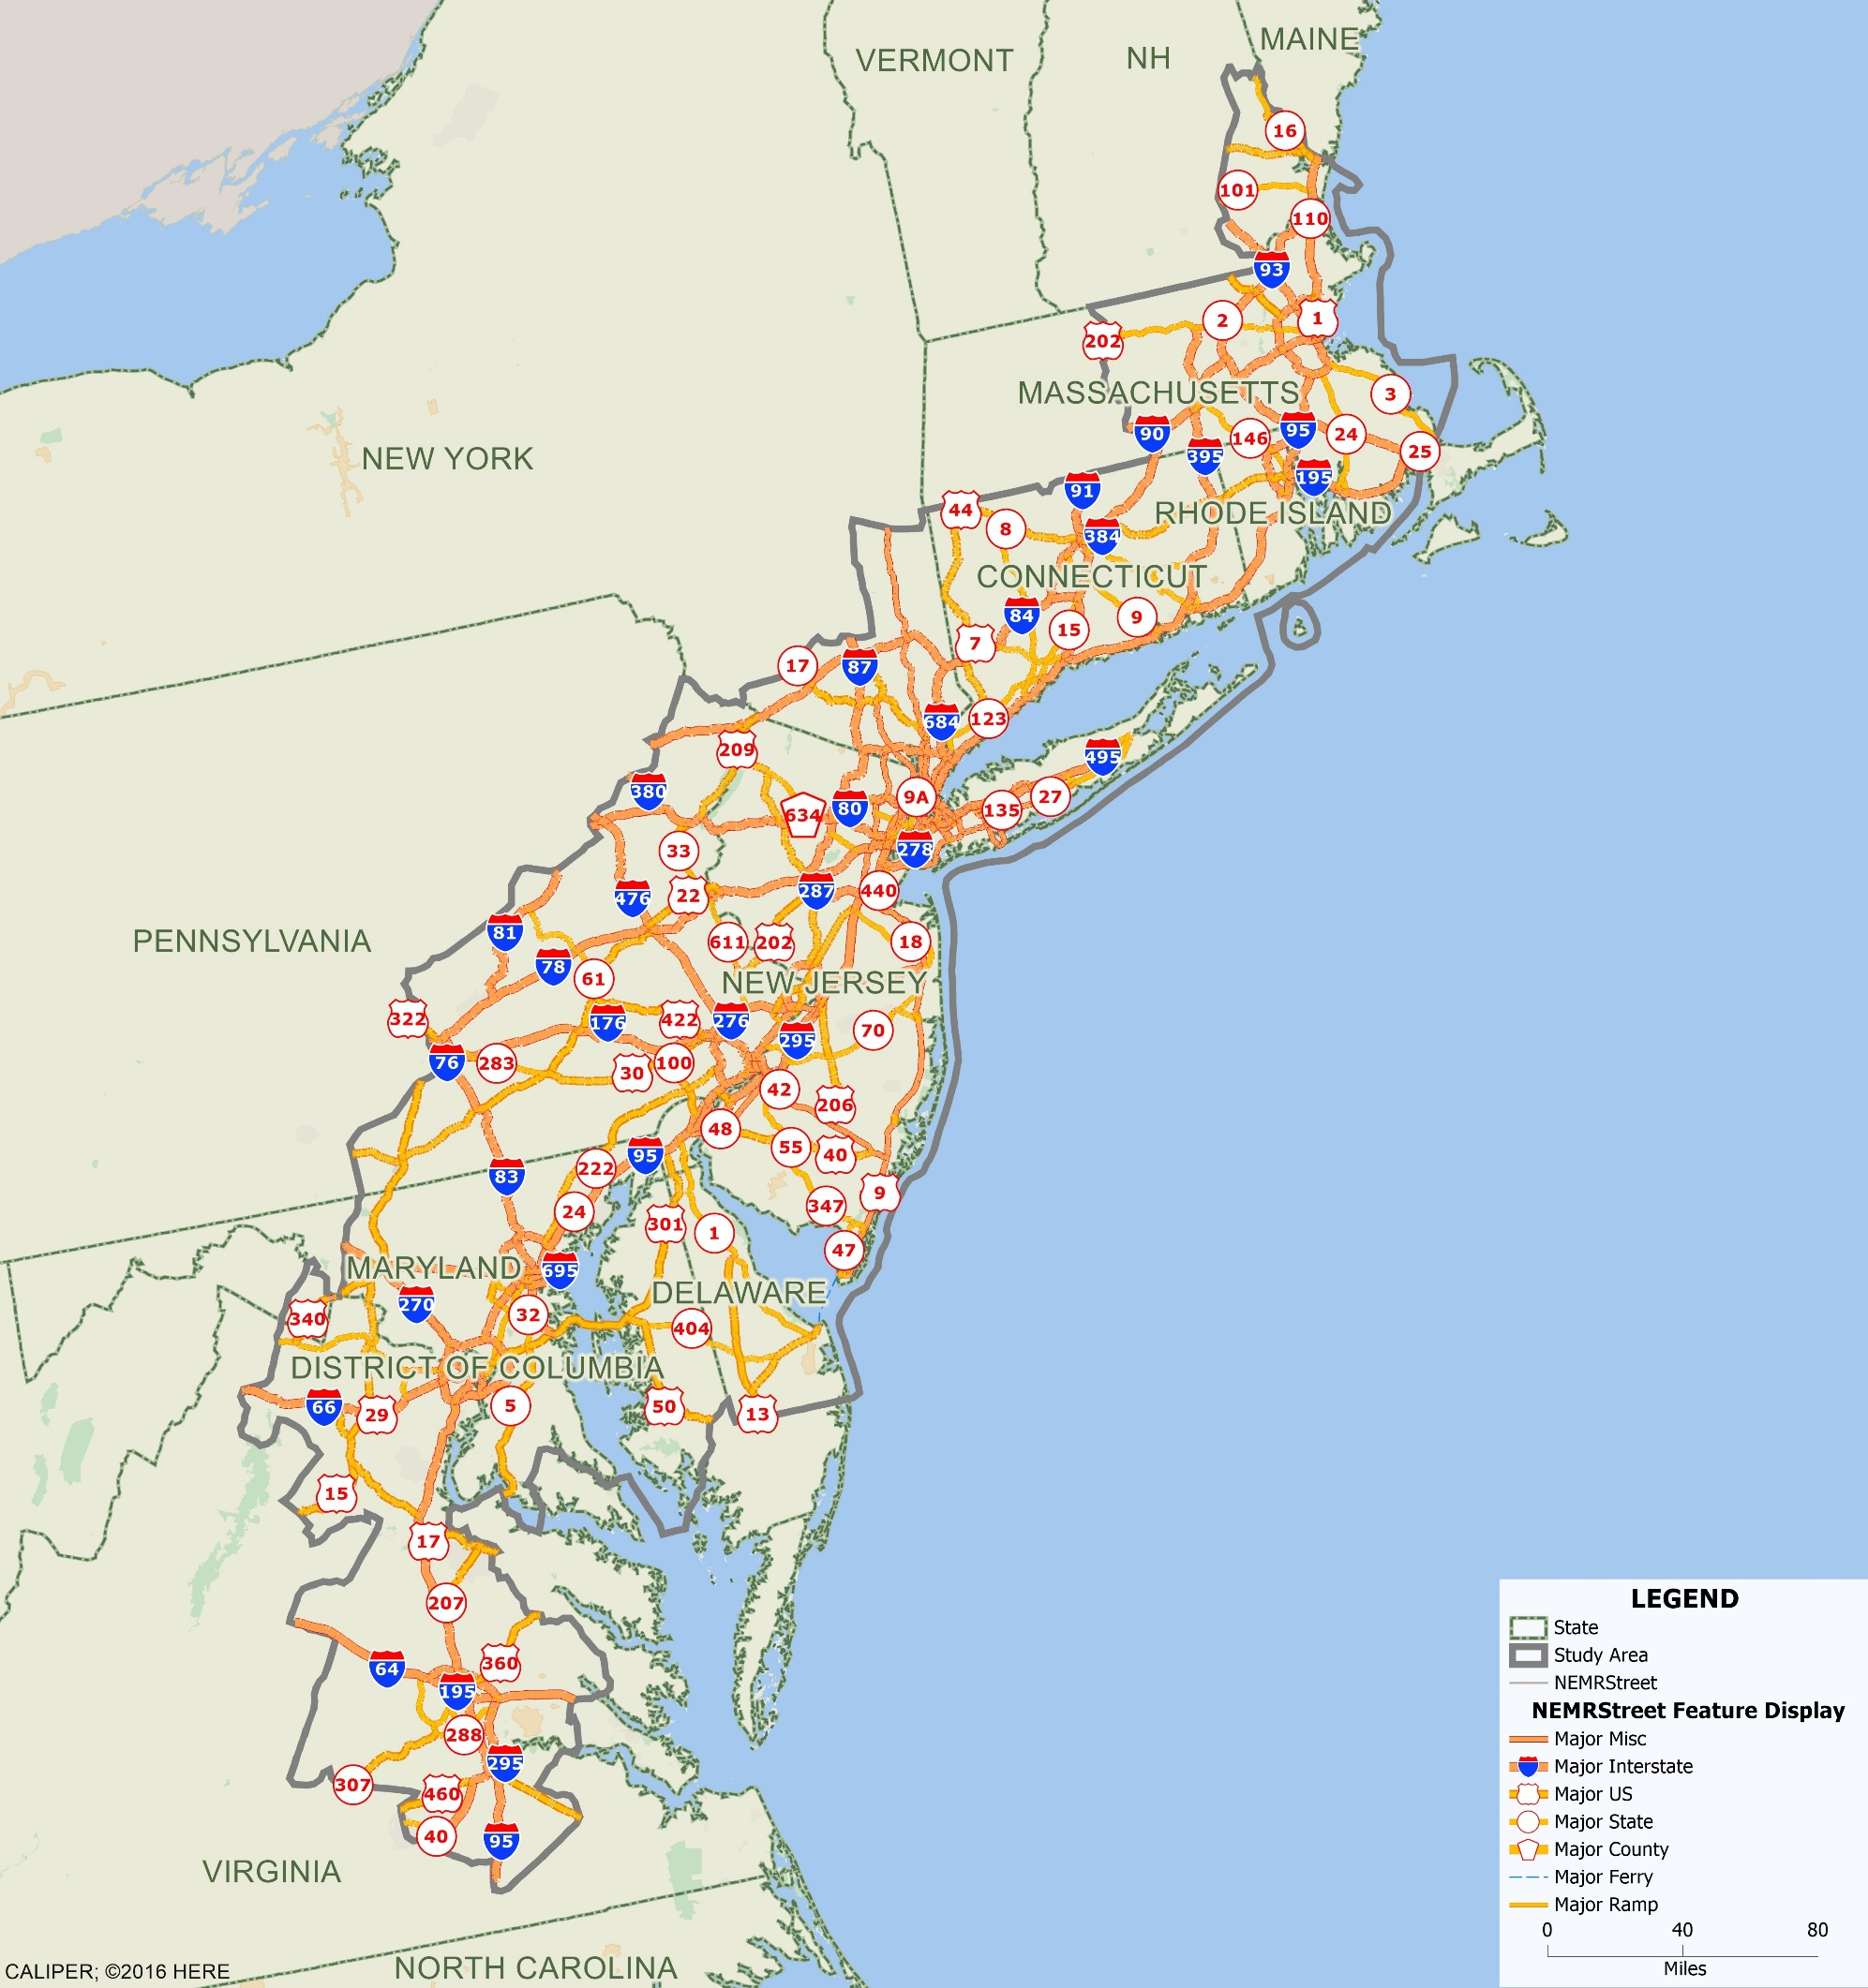
Our
Highway Network:
3.3
Million(!)
Limited Access, Arterial, & Major Street Road
Links

Slide 15
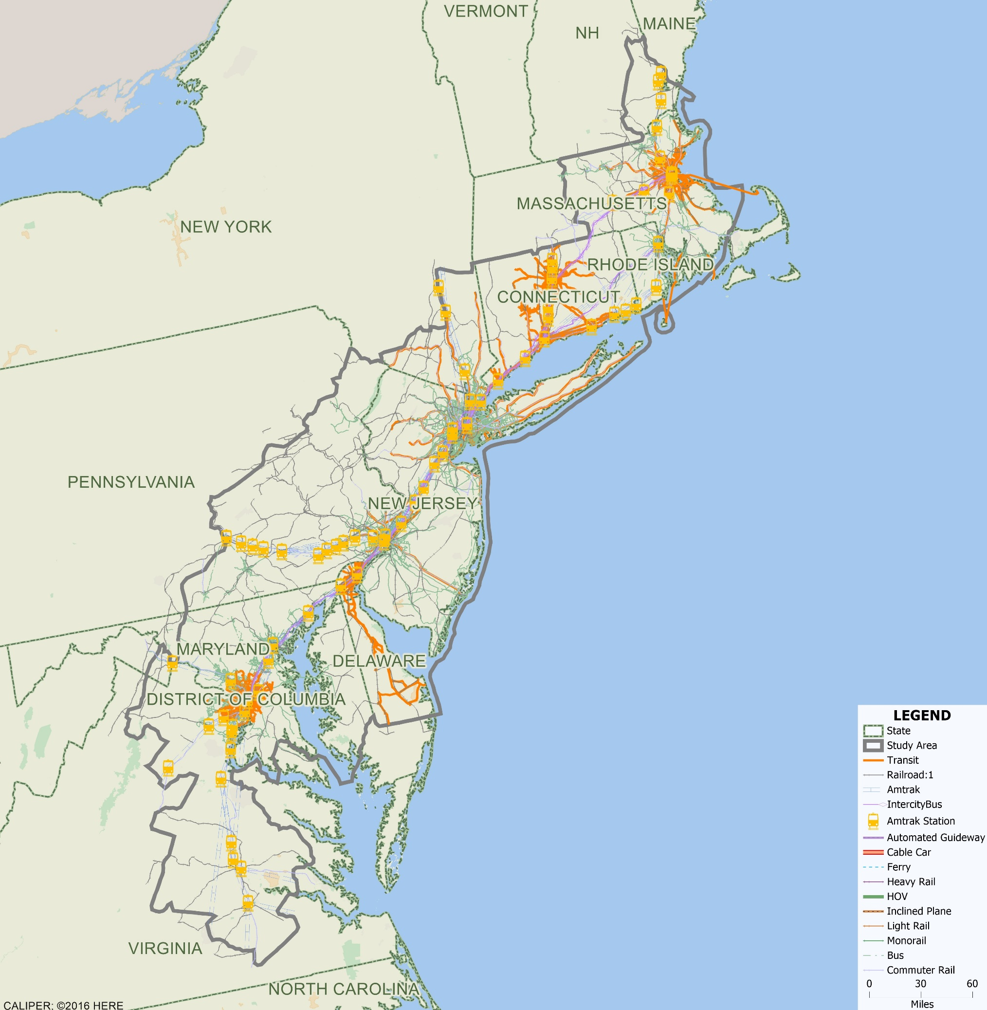
Our
Transit Systems:
25+
Major Transit Systems;
6 Rail &
Bus Transit
Modes

Slide 16
Parallel TD&IM Approaches
 | 1 Megaregional Model | 4 Super-metro Models (Boston, NYC, Philly, Balt./DC/Richmond) | 1 Freight Model
System Elements | Zones: 162 (county-based) Purposes: HBW,HBO, NHB Modes: Highway, Amtrak, commuter rail, inter-city bus, air | Zones: 162 (zipcode-based) Purposes: HBW,HBO, NHB Modes: Highway, commuter rail, subway & LRT, local bus, bike-ped. | Zones: 39 (16 in NEMR) 27 commodity types Modes: Truck and rail (and air and pipeline).
1. Trip Generation | Uses NCHRP 365 method to estimate zone-based Productions and Attractions for HBW, HBO, NHB trips based on HH demographics, auto ownership, and total and retail employment. |  | Updates 2012 FAF commodity flows based on 2% annual GDP growth and projected population growth at destination zones.
2. Trip Distribution | Single gravity model for each trip purpose. | Separate gravity models for each trip purpose and super-metro.
3. Mode Share | Regression models of mode shares (as reported in 2017 NHTS) for Amtrak and commuter rail, bus, and air; based on origin zone location and characteristics and trip length category. | Uses DVRPC survey data to calibrate a Philadelphia-based mode share or mode choice model based on origin zone location and characteristics, and trip length category. | Most commodities types are tied to a single mode. For those that are not, regression models of mode shares based on origin zone location and trip length.
4. Route Assignment | All-or-nothing by mode and trip purpose based on fastest time. | All-or-nothing by mode and trip purpose based on fastest time (one transit transfer allowed). | All-or-nothing based on fastest time (truck) and shortest path (rail).

Slide 17
Parallel TD&IM Approaches
 | Megaregional Model | Super-metro Models (Boston, NYC, Philly, Balt./DC/Richmond) | Freight Model
Projections and Alternatives | (i) Alternative state and county-based population and job growth projections; (ii) Add new links and nodes as needed to represent new services; (iii) Change LOS levels for particular modes. | (i) Alternative zone-based population and job growth projections; (ii) Add new links and nodes as needed to represent new services; (iii) Change LOS levels for particular modes. | (i) Alternative destination-based population growth projections; (ii) Add new links and nodes as needed to represent new services.
Remaining Issues | How to incorporate pricing and congestion sensitivity into mode choice/share model? | Can the results of the Philadelphia mode share model be extended to the other super-metros? | How to parse truck-based freight flows into discrete truck trips?

Slide 18
C. Selected Baseline Results and Findings

Slide 19
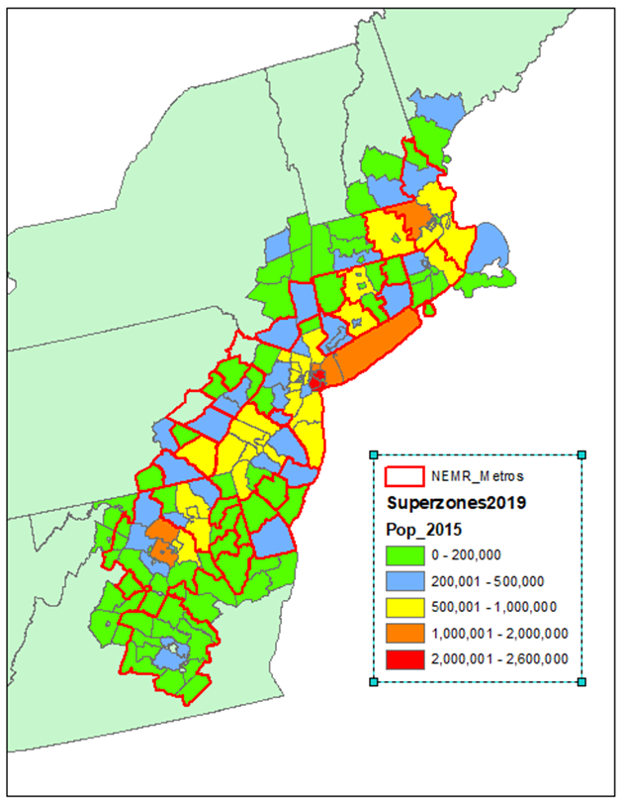
C1: The Megaregional Model:
Long-Distance Mode Share Analysis:
Non-auto mode share (from 2017 NHTS survey tabulations)
= f (Origin MSA, trip distance, trip purpose, LOS compared to car)

Slide 20
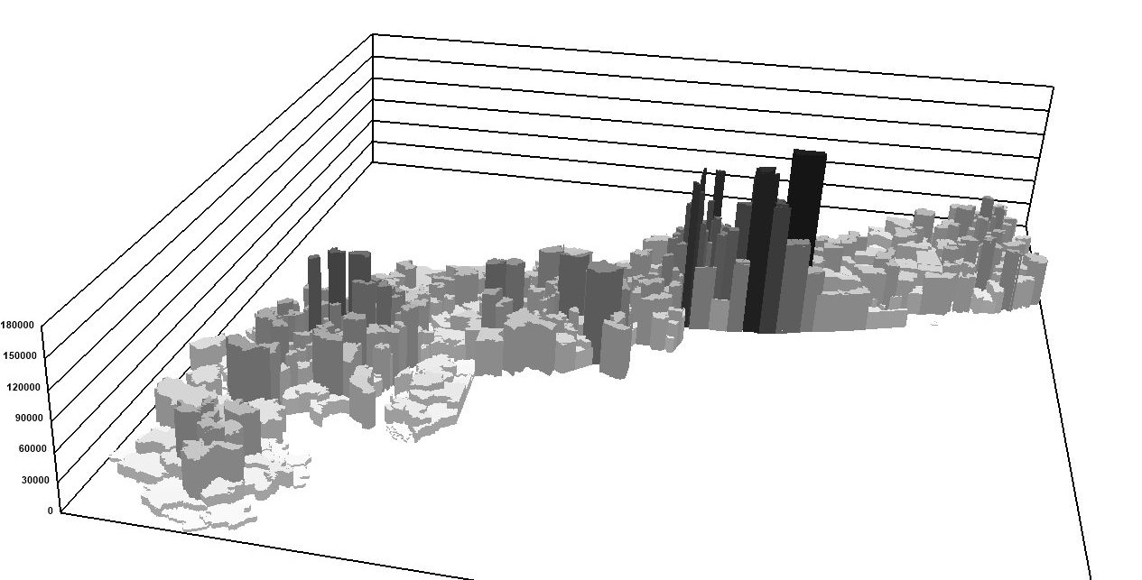
C2: Four Super-Metro Models: Estimated 2015 HBW Trip Generation by Superzone

Slide 21
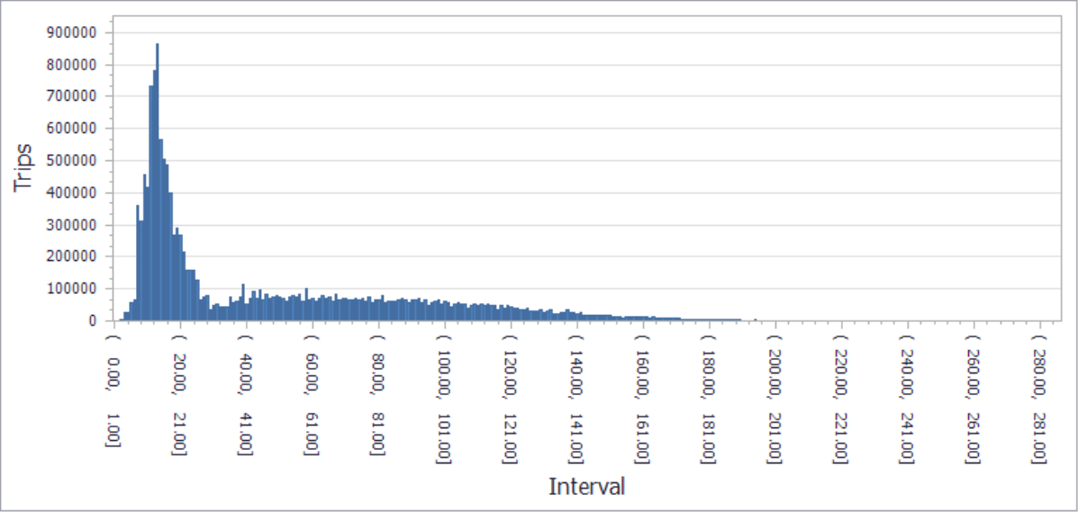
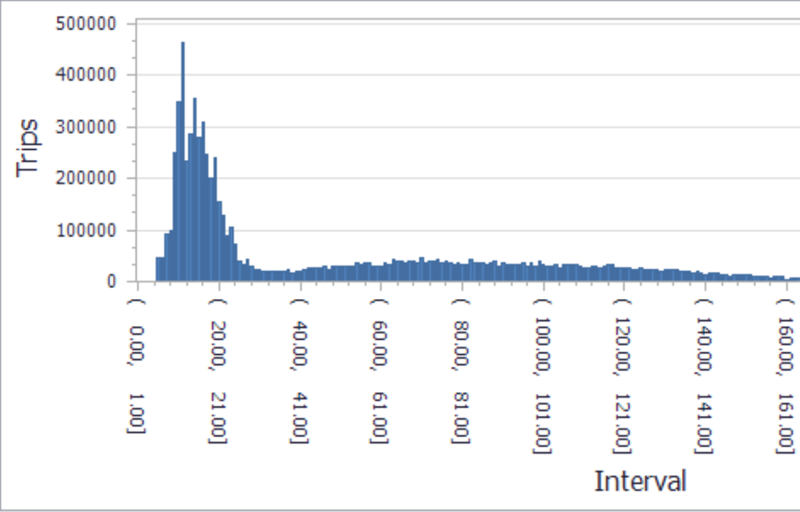
C2: Super-Metro Models:
Gravity Model-Based Trip Length Frequency Distributions: New York and Philadelphia; Home-based Work

Slide 22
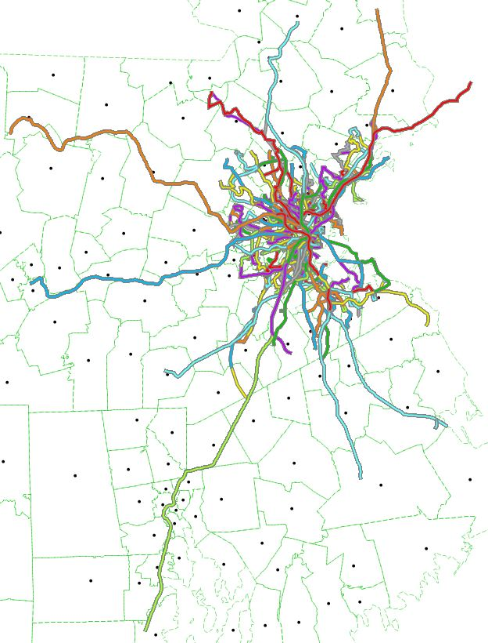
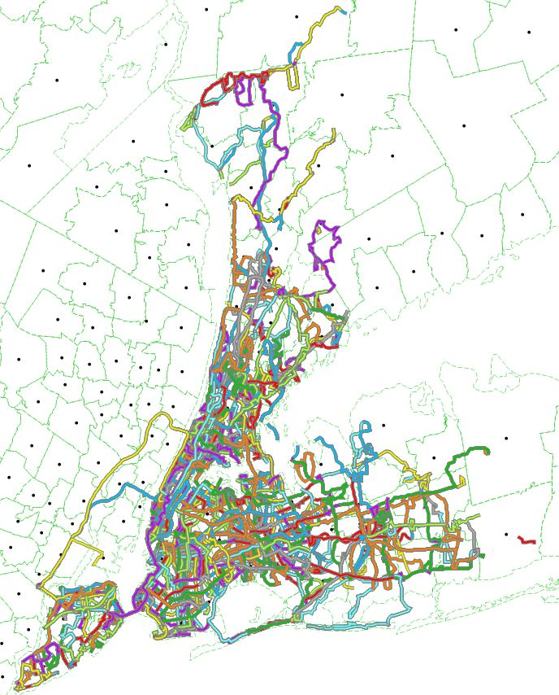
C2: Super-Metro Models:
Building Regional Transit Networks
Boston Bus
Network
NYC Bus
Network
Assembled from GTFS Data
Assembled from GTFS Data

Slide 23
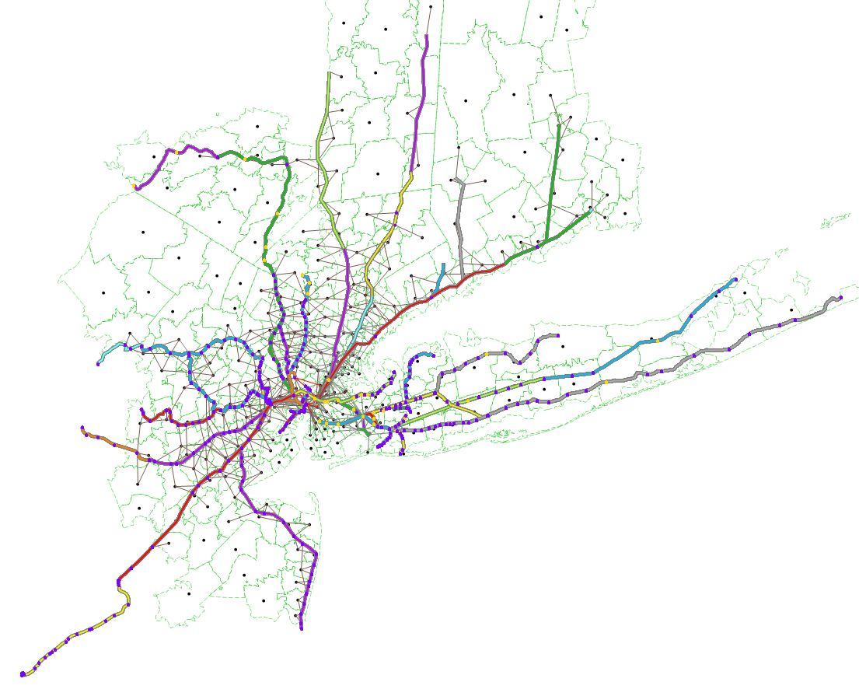
C2: Super-Metro Models:
Building Regional Transit Networks
NYC Commuter
Rail Network
Assembled from GTFS Data

Slide 24
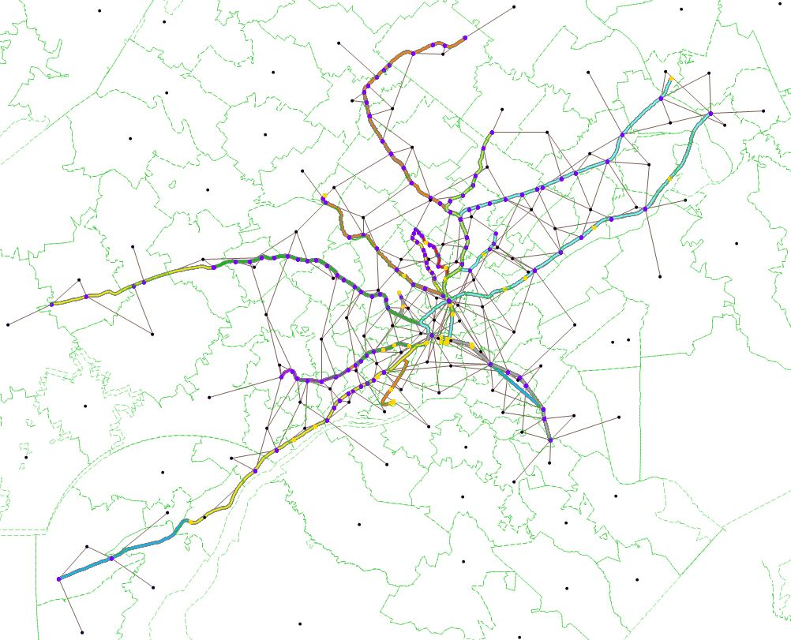
C2: Super-Metro Models:
Building Regional Transit Networks
Philadelphia Commuter
Rail Network
Assembled from GTFS Data

Slide 25
C2: Super-Metro Models:
Comparing Average (Uncongested) Travel Times by Mode

Slide 26


Slide 27
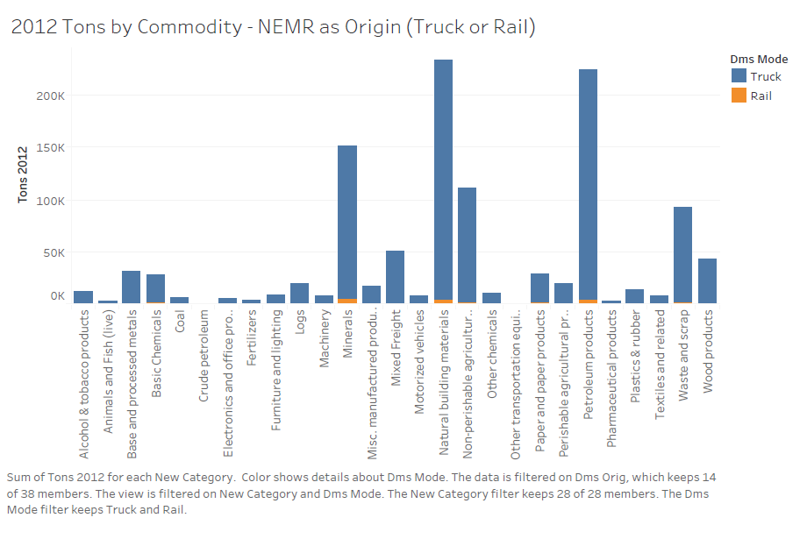
C3: Freight Models:
Baseline Commodity Flows From the NEM Region

Slide 28
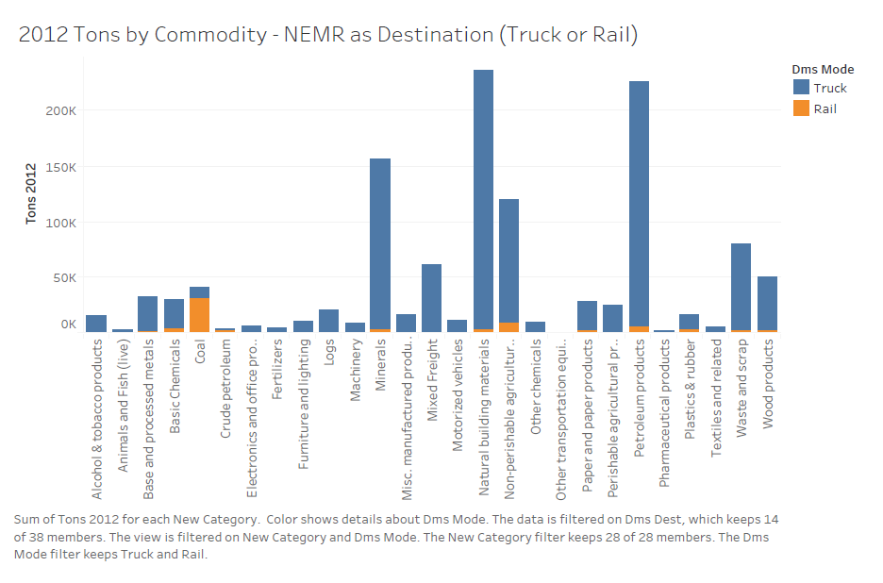
C3: Freight Models:
Baseline Commodity Flows To the NEM Region

Slide 29
D. Projections and Alternatives

Slide 30
D. Projections and Alternatives
Baseline Forecast: Current Systems with 2030 Population and Job Projections
Alternatives (using 2030 Population and Job Projections)
  Inter-metropolitan
    High-speed rail service from Washington DC to Boston
    Amtrak and NJ Transit Gateway Tunnel under the Hudson River
  Intra-metropolitan
    Connect Boston's North and South Stations by rail
    Improve commuter rail service in and around Providence and Baltimore;
    High-speed rail connectors to NY City airports;
    New HOT and freight lanes on selected highways.
  Freight
    New truck/freight facilities connecting the Lehigh Valley and the New York City regions; and connecting Richmond and Washington, DC

Slide 31
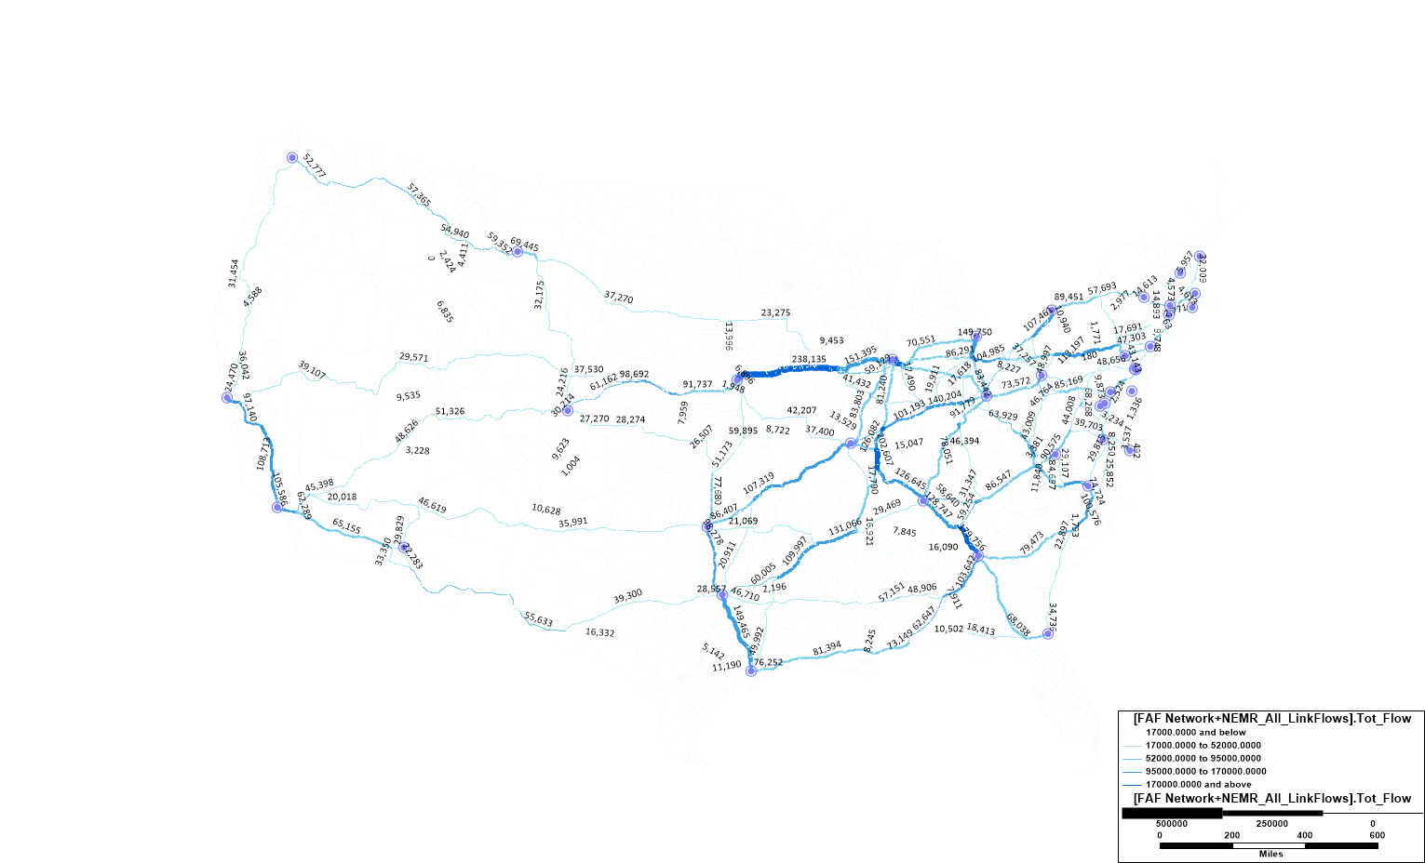
D1: Baseline 2030 Projections:
2030 Truck Freight Flows (tons) using NEMR Flow Projections

Slide 32
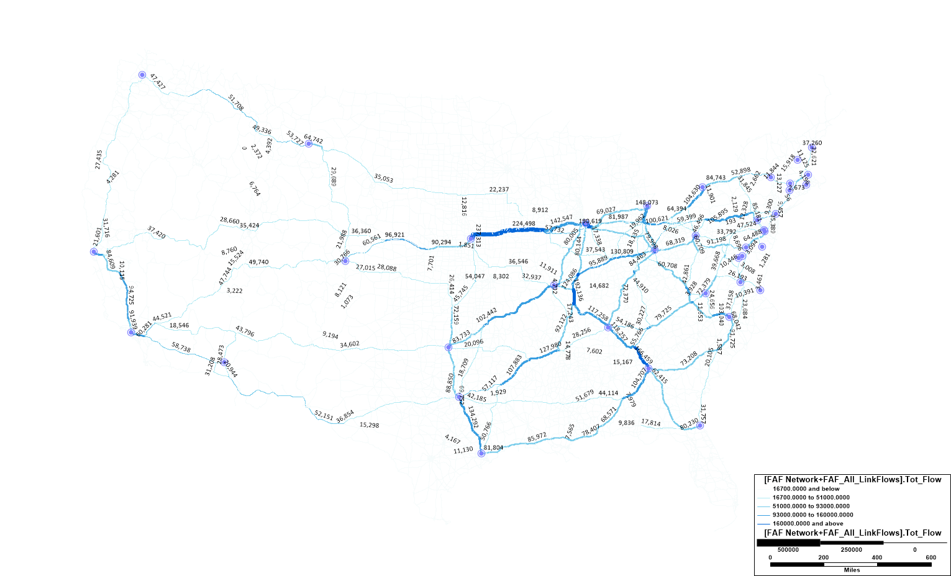
D1: Baseline 2030 Projections:
2030 Truck Freight Flows (tons) using FAF Projections

Slide 33
E. Development Feedback Loops
Transportation investments typically feedback into private development and investment decisions in three ways:
  Real Estate Capitalization Effects: Improved accessibility is capitalized into local real estate prices and property values. This is typically a short-term and anticipatory effect. Note that without a concomitant increase in zoning, this may actually inhibit development or redevelopment. We will not model this effect.
  Increased Productivity: Higher travel speeds and faster commute and freight shipment times boost productivity, making local businesses more competitive. We will probably not model this effect.
  Differential Congestion Relief: Differential congestion relief will make some locations more advantageous to both households and businesses, prompting a spatial resorting of those activities towards reduced congestion locations. We may selectively model this effect.
  Residential and Commercial Market Expansion: Improved accessibility expands the market attractiveness (to development) of previously low-accessibility/under-developed sites. This is typically a longer-term effect. We will calibrate a series of state-by-state logit models of land use change (e.g., undeveloped > residential) between 1992 and 2011 as a function of proximity to highways and transit lines (as well as other site and spatial characteristics).

Slide 34
F. Tentative Reflections
  The value of megaregions for general purpose transportation planning is as yet unclear.
  But, there IS great value in applying common modeling approaches and parameters across adjacent MPOs (Not the least of which involves external trips).
  Our common-model/nested scale approach is probably the way to go.
  The Northeast needs more extensive and collaborative corridor-based planning and modeling capacity, as well as travel surveys.
  The lack of coordinated freight and passenger transportation planning models and tools is problematic, especially in larger urban centers with multi-modal freight facilities.
  As more people move (back) to urban neighborhoods, long-standing transit capacity, connectivity and service disparities are becoming more problematic.
  Shared-ride services such as Uber and Lyft really are different modes, and need to be modeled as such.

