Slide 1


Slide 2
September Brown Bag 2020 Agenda
3:30 pm: Welcome & Introductions Sandra Ciarletta
3:30 – 4:00 pm: Pedestrian Crash Fatality Analysis Max Bernhardt
Q&A
4:00 – 4:30 pm: Capital Metro’s Project Connect Lonny Stern
Q&A

Slide 3




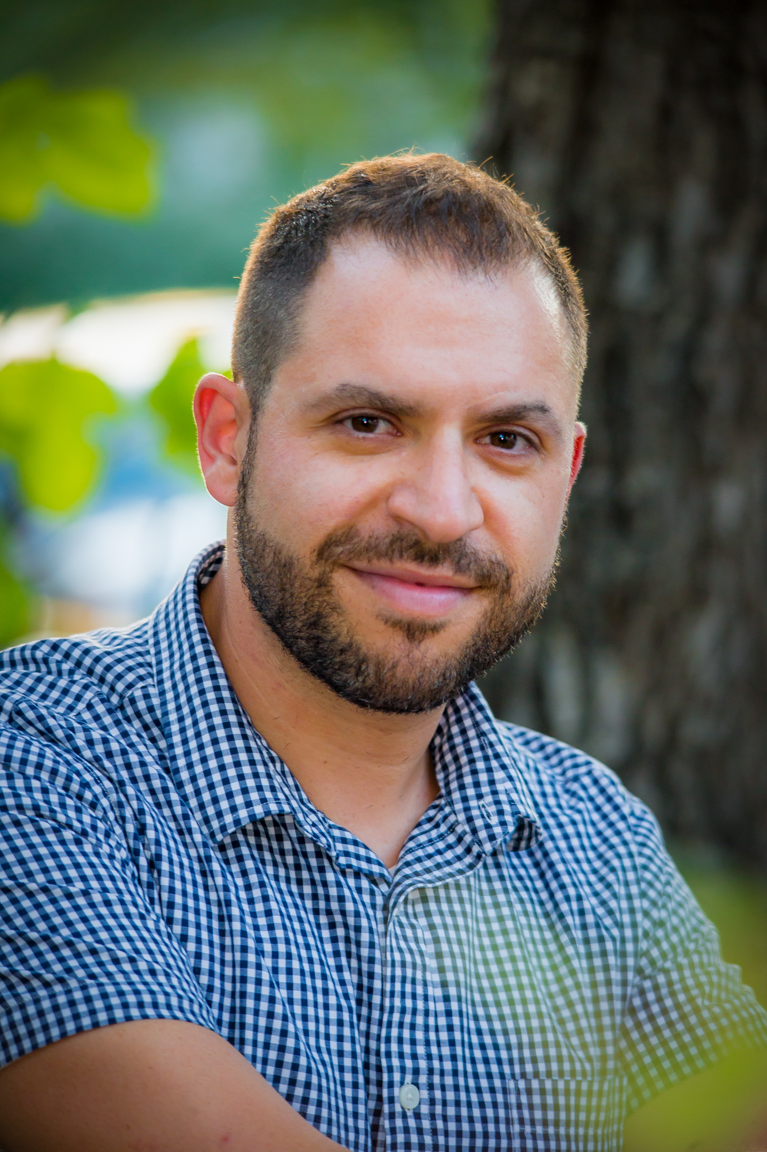
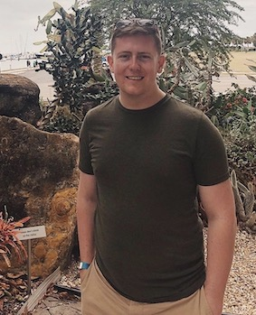
Max Bernhardt is in his second year of a Masters in Community and Regional Planning. A native of Las Vegas and longtime resident of Austin, Max received his BA in Government from UT Austin in 2018 and worked in renewable energy before returning to graduate school, focusing on sustainability in transportation and housing. He is working with Dr. Kockelman on a Pedestrian Crash Fatality Analysis for TxDOT to identify factors that lead to pedestrian crashes, as well as countermeasures to reduce pedestrian fatalities through design, planning and other improvements.
Max's research focuses on issues of pedestrian safety, an important topic as pedestrian-vehicle collisions and fatalities have increased across the United States over the past decade. As part of an Innovative Research Project for the Texas Department of Transportation (TxDOT), Max has analyzed the salience of a variety of crash factors including meteorological data, demographic variables and roadway design variables in the context of vehicle miles travelled (VMT), as well as walk miles travelled (WMT) at the county level for the 254 counties of Texas. His work focused on issues of pedestrian safety that go beyond road design, such as the enhanced risks posed to marginalized communities including persons experiencing homelessness, as well as the role of vehicle size and design in pedestrian safety.
September Brownbag
September 15, 2020 @3:30pm
https://utexas.zoom.us/j/99141577369
Lonny Stern, CapMetro
Max Bernhardt, UT Austin
CM2 invites you for a conversation about Project Connect, Capital Metro’s plan to improve and expand transit in the region. The plan includes a transition to an all-electric fleet and adding new light rail, commuter rail, neighborhood circulators, MetroRapid, and park & ride services across the region. Join us for a lively discussion about the unanimously approved System Plan, including project features, timelines, funding, and how this investment could impact our city for generations to come.
Lonny is an enterprising Austinist focused on the economic development of Central Texas. He currently works as a Community Engagement Administrator at Capital Metro, Austin's regional transportation provider. A recipient of an Austin Under 40 Award for Community Service & Non-Profits in 2015, Lonny has worked in a variety of roles before Capital Metro, including as a Senior Director at Skillpoint Alliance; Outreach Director at Every Texan (formerly CPPP); Communications Director at Hope Street Group and 91.7 FM KO-OP Radio; Research Analyst at the Texas Legislature; and Executive Director of aGLIFF. He earned a Bachelors at Florida State University and a Masters at the LBJ School of Public Affairs at UT-Austin. https://twitter.com/lonnystern
https://linkedin.com/in/lonnystern

