Slide 1
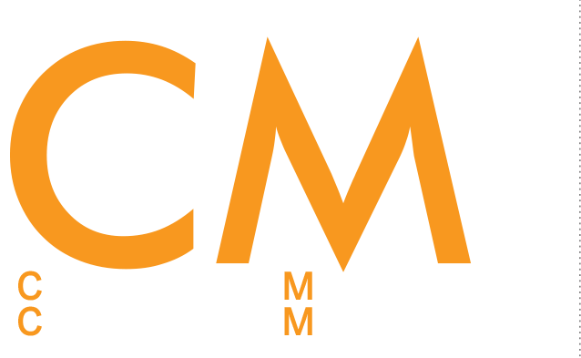
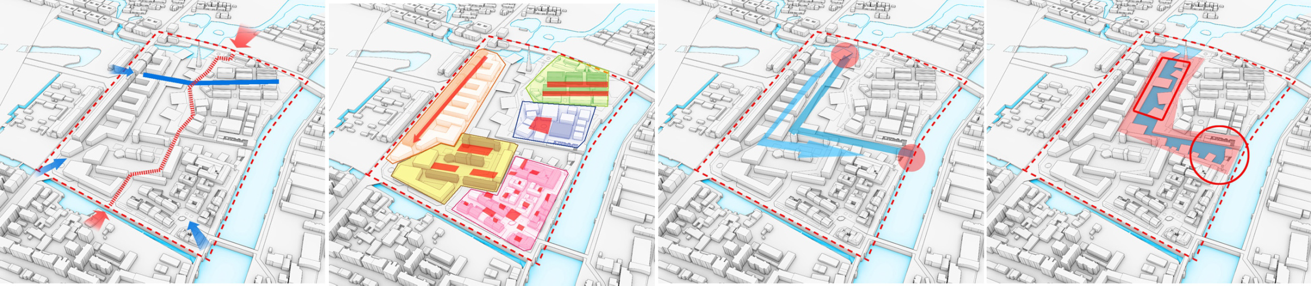
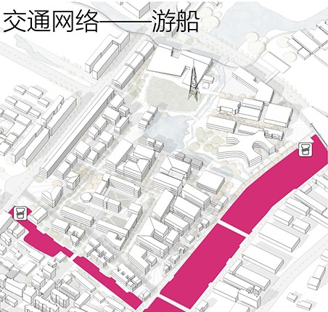
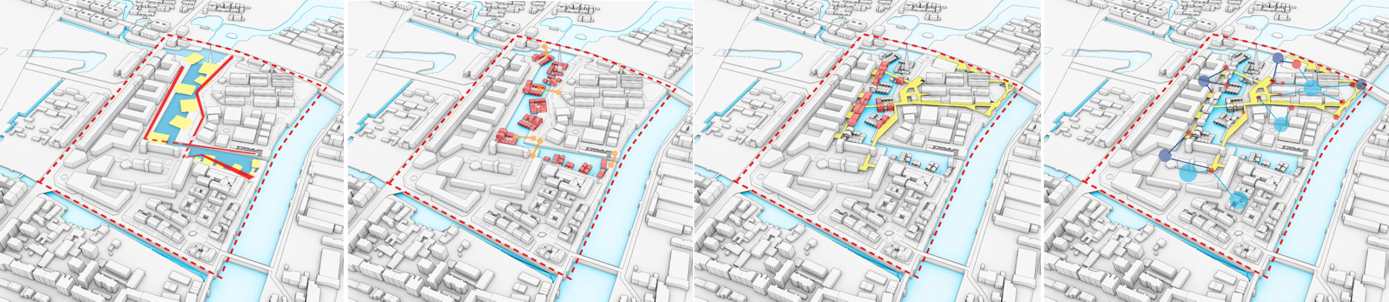
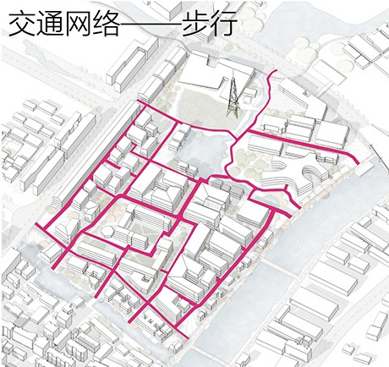
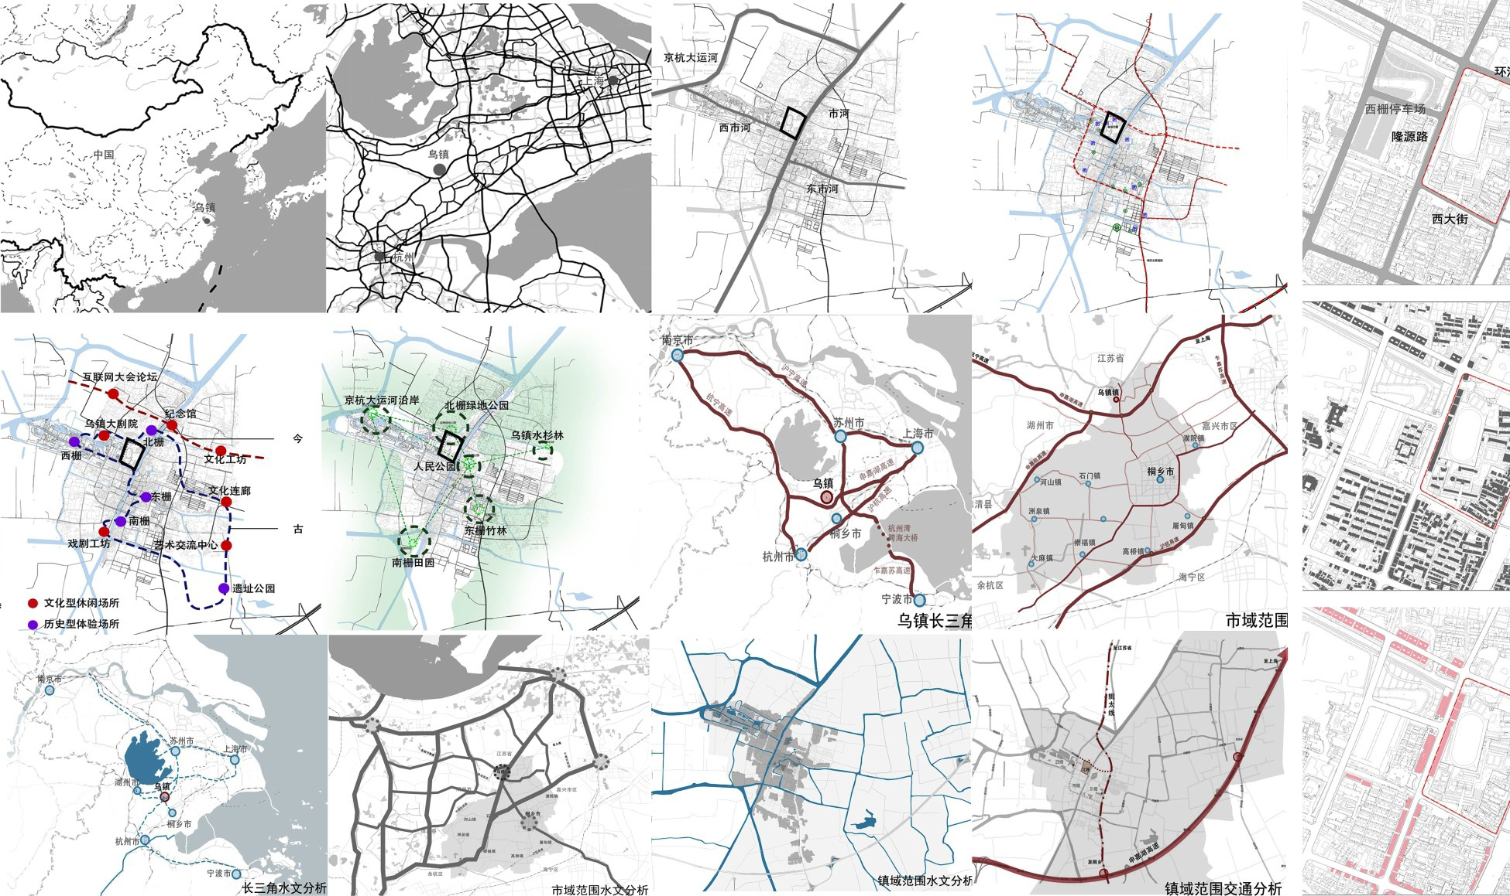
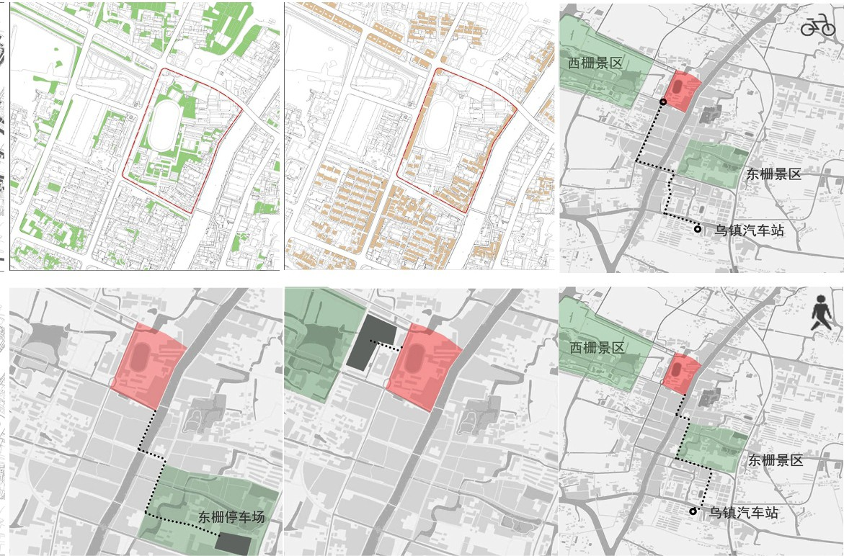
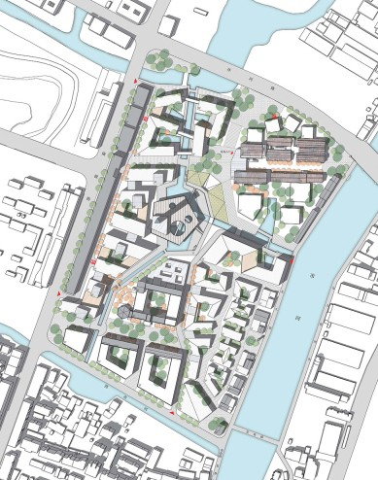
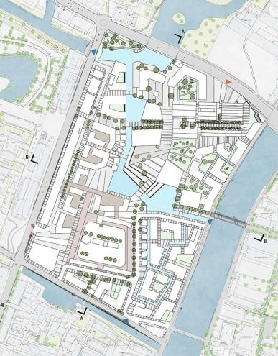
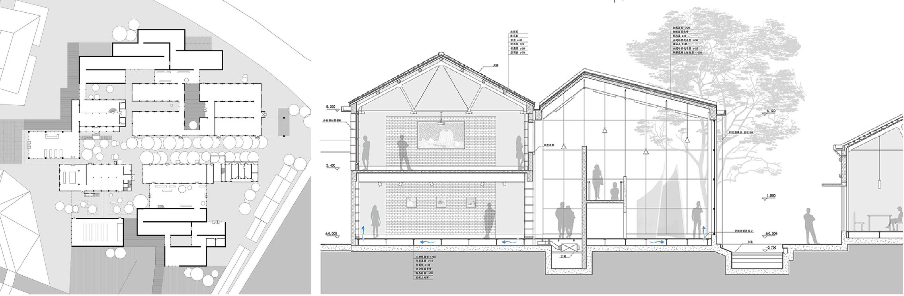
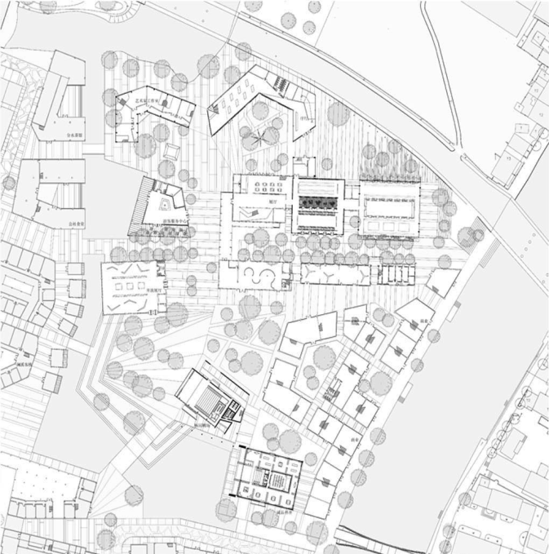
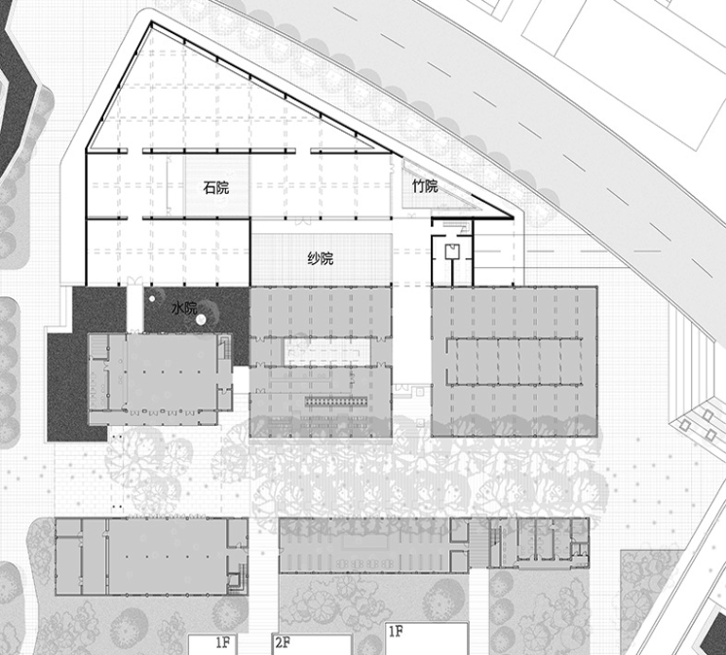
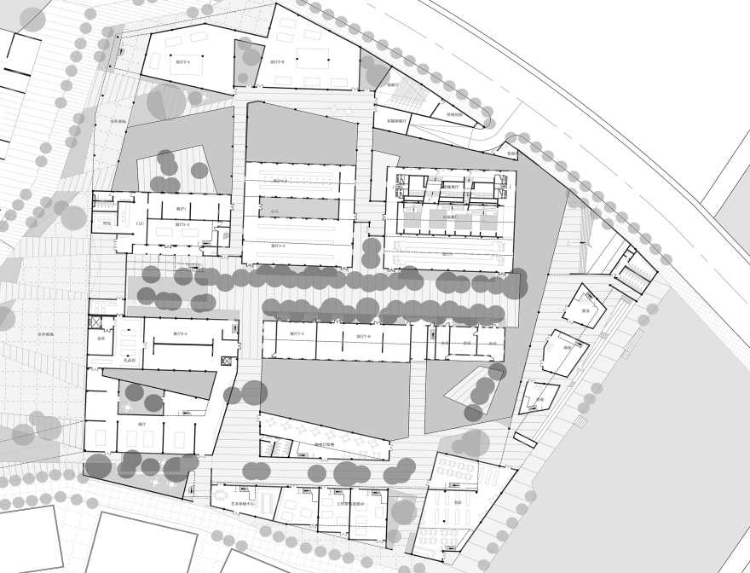

2021 Fall Exhibition
UNIVERSITY NAME
PI(s): First and Last Name(s)
GRA(s): First and Last Name(s)
Project
Title
RESEARCH AGENDA
1. BACKGROUND
America’s metropolitan regions are expanding at a rapid pace. As these regions grow, they connect and overlap with their neighboring regions until the boundaries between regions are no longer clear.
Already, one may find it challenging to draw a boundary between the New York and Philadelphia metropolitan regions, or between the San Diego and Los Angeles metropolitan regions. This new scale of geography is known as the megaregion.
The coordination of planning for megaregions challenges established planning practices by disregarding boundaries of governance. Not only do megaregions encompass multiple cities
3. RESEARCH CONTENTS
America’s metropolitan regions are expanding at a rapid pace. As these regions grow, they connect and overlap with their neighboring regions until the boundaries between regions are no longer clear.
Already, one may find it challenging to draw a boundary between the New York and Philadelphia metropolitan regions, or between the San Diego and Los Angeles metropolitan
5. ROADMAP
America’s metropolitan regions are expanding at a rapid pace. As these regions grow, they connect and overlap with their neighboring regions until the boundaries between regions are no longer clear. Already, one may find it challenging to draw a boundary between the New York and Philadelphia metropolitan regions, or between the San Diego and Los Angeles metropolitan regions.
This new scale of geography is known as
the megaregion. The coordination of planning for megaregions challenges established planning practices by disregarding boundaries of governance. Not only do megaregions encompass multiple cities and counties, but
4.RESEARCH FRAMEWORK
America’s metropolitan regions are expanding at a rapid pace. As these regions grow, they connect and overlap with their neighboring regions until the boundaries between regions are no longer clear. Already, one may find it challenging to draw a boundary between the New York and Philadelphia metropolitan regions, or between the San Diego and Los Angeles metropolitan regions.
This new scale of geography is known as
the megaregion. The coordination of planning for megaregions challenges established planning practices by disregarding boundaries of governance. Not only do megaregions encompass multiple cities and counties, but
2.RESEARCH QUESTIONS
America’s metropolitan regions are expanding at a rapid pace. As these regions grow, they connect and overlap with their neighboring regions until the boundaries between regions are no longer clear. Already, one may find it challenging to draw a boundary between the New York and Philadelphia metropolitan regions, or between the San Diego and Los Angeles metropolitan regions. This new scale of
6.TIMETABLE
America’s metropolitan regions are expanding at a rapid pace. As these regions grow, they connect and overlap with their neighboring regions until the boundaries between regions are no longer clear. Already, one may find it challenging to draw a boundary between the New York and Philadelphia metropolitan regions, or between the San Diego and Los Angeles metropolitan regions. This new scale of
ACHIEVEMENTS
1.Transit Desert in NYC
America’s metropolitan regions are expanding at a rapid pace. As these regions grow, they connect and overlap with their neighboring regions until the boundaries between regions are no longer clear.
Already, one may find it challenging to draw a boundary between the New York and Philadelphia metropolitan regions, or between the San Diego and Los Angeles metropolitan regions.
2. Bike Sharing in NYC and Chicago
This new scale of geography is known as
the megaregion. The coordination of planning for megaregions challenges established planning practices by disregarding boundaries of governance. Not only do megaregions encompass multiple cities and counties, but many also encompass several states, all of which must work collectively to manage a competitive megaregion.
The Tier 1 United States Department of Transportation (USDOT) University Transportation Center (UTC) for Cooperative Mobility for Competitive Megaregions (CM2) aims to foster cooperative, research-driven coordination of
3.Transit Desert and TNC
America’s metropolitan regions are expanding at a rapid pace. As these regions grow, they connect and overlap with their neighboring regions until the boundaries between regions are no longer clear.
Already, one may find it challenging to draw a boundary between the New York and Philadelphia metropolitan regions, or between the San Diego and Los Angeles metropolitan regions.
Additional space for pictures or text

