Slide 1
Transmission Planning in ERCOT- Overview
Nemica Kadel
System Planning Engineer
September 12, 2017

Slide 2
Talk Outline
ERCOT Quick Facts
Regional Transmission Planning
Long Term System Assessment
Project Identification and Justification

Slide 3
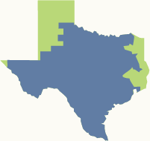
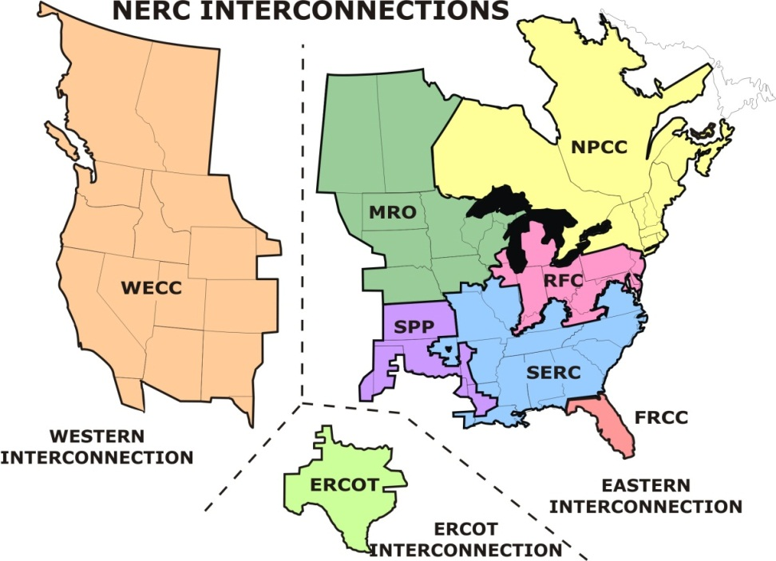
ERCOT Quick Facts
75% of Texas land
90% of Texas load – 24 million consumers
More than 46,500 miles of transmission lines
570+ generation units
Notes:
Source: ERCOT Quick Facts: http://www.ercot.com/about/profile

Slide 4
ERCOT Quick Facts
>77,000 MW peak capacity
71,110 MW record peak demand (set August 11, 2016)
Physical assets owned by transmission providers and generators
No synchronous connections with other grids
Notes:
Source: ERCOT Quick Facts: http://www.ercot.com/about/profile

Slide 5
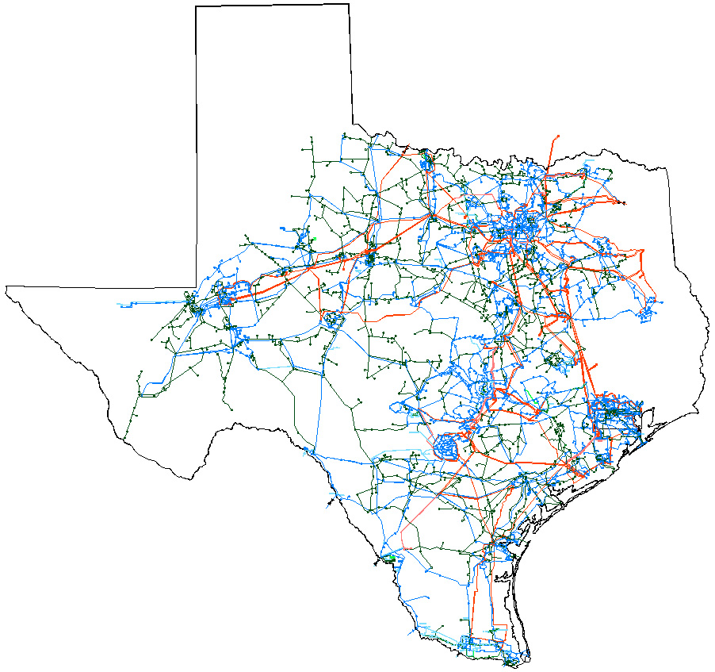
ERCOT Quick Facts
1,256 MW power transfers from non-synchronous ties
DC North (with SPP), at Oklaunion – 220 MW
DC East at Monticello (with SPP) – 600 MW
DC South at Eagle Pass (with CFE) – 36 MW
SPP: Southwest Power Pool
CFE: Comisión Federal de Electricidad
DC Ties: Direct Current ties – Asynchronous connections with neighboring grids
VFT: Variable Frequency Transformer
DC Laredo; VFT (with CFE) – 100 MW
DC Railroad at McAllen; Sharyland Utilities (with CFE) – 300 MW

Slide 6
ERCOT Quick Facts
Notes:
Source: ERCOT Quick Facts: http://www.ercot.com/about/profile

Slide 7
Reliability
ERCOT’s primary responsibility is to ensure the reliability of the grid.
Match generation with system demand.
Ensure the transmission system is operated within established limits.

Slide 8
Reliability: Energy and Capacity
ERCOT dispatches energy to meet system demand.
ERCOT must also ensure there is enough capacity on-line to meet forecasted demand.
Forecast
Capacity
Generation Output
System Demand

Slide 9
Reliability: Capacity Reserves
ERCOT must also ensure the system can respond to sudden changes in demand.
This is accomplished through additional capacity beyond the forecasted load
Called Ancillary Services
Reserved
Ancillary Service
Capacities
Forecast
System Capacity
System Demand

Slide 10
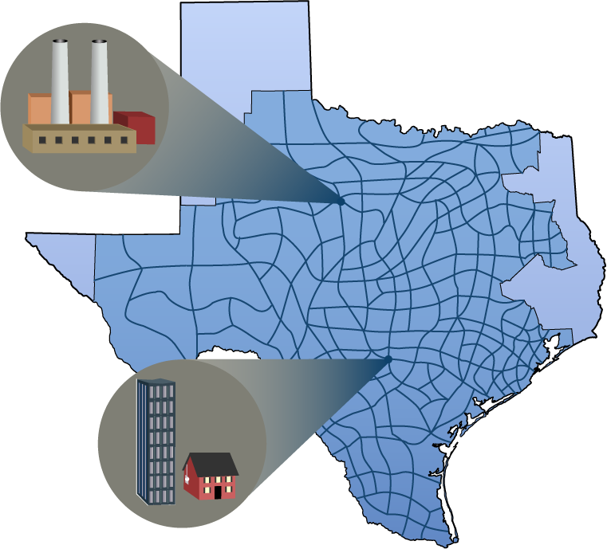
Reliability: Transmission Congestion
Generation and loads separated by physical distances connected by transmission lines
Lines have ratings that cannot be exceeded
ERCOT is responsible for adjusting generation levels to mitigate congestion on the transmission system

Slide 11
Transmission Planning at ERCOT
Transmission Planning Assessment
Regional Transmission Plan (RTP)
Long Term System Assessment (LTSA)
Dynamics Studies Group
Ad-hoc System Stability Assessments
Annual NERC stability assessments
Subsynchronous Resonance Studies (SSR)
Support Operations on stability issues
System Development Group
RPG Independent Reviews and Special Studies
Quarterly Stability Assessment Screening Studies
Screening Studies

Slide 12
Regional Transmission Planning
Identify transmission projects to meet ERCOT System needs per ERCOT Planning Guide and NERC TPL-001-4 reliability standards.
Annual Assessment for near-term needs for six years planning horizon.
Coordinated planning process performed by ERCOT with extensive review and input by NERC registered Transmission Planners (TPs), Transmission Owners (Tos) and stakeholders.

Slide 13
Regional Transmission Planning Study Method
Case Conditioning
Future transmission and generation review and update
Transmission Outages, Dispatch of variable generators and limit monitoring settings
Basecase Reliability Analysis
N-1 SCOPF
Additional Reliability Analysis
Multiple element outage analysis and extreme event analysis
Sensitivity analysis for at least 2 summer peak cases and 1 off-peak case
Load review and adjustment
Generator and Transformer outage analysis
Add or improve transmission projects to mitigate overloads
Long-lead time equipment analysis
Short circuit analysis
Economic Analysis
Perform economic analysis
Add or improve transmission projects that meet the economic criteria
Contingency Analysis for certain EHV contingencies

Slide 14
Long Term System Assessment
Biennial evaluation of the potential needs of ERCOT’s extra-high voltage (345-kV) system in the 10 to 15 year planning horizon.
Identify long-term transmission needs by analyzing the reliability and efficiency of the ERCOT system under various scenarios.

Slide 15
Long Term System Assessment Study Method
LTSA

Slide 16
Challenges in Transmission Planning
Load Forecast
Generation Resource Mix
New and Emerging Technologies
Economic and Financial Constraints
R-O-W Limitations
Regulatory Uncertainty
Various Uncertainties and Risks

Slide 17
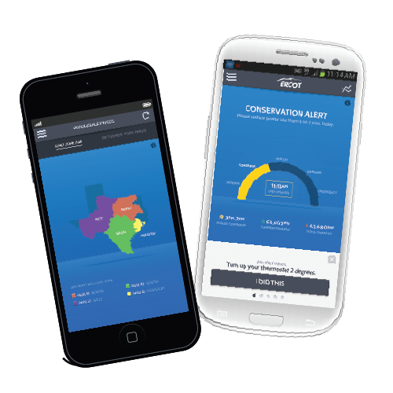
ERCOT on Social Media
iPhone and Android apps
Provide alerts through push notifications
Load curve, conservation tips, wholesale prices, general info
More than 10,000 downloads
Social Media
Focus on timely information with frequent updates
Twitter: Over 4,000 followers
Facebook: Over 1,200 followers

Slide 18
Questions?

