Slide 1
IEEE PES
2nd GENERAL MEETING
SIGN IN HERE: tinyurl.com/pes2019gm2

Slide 2
PAY ATTENTION FOR THE EOY QUIZ

Slide 3
ATTEND EVENTS
GET SWAG
Every GM, Social, and Tech Talk will get you 1 Point.
Every Project Meeting will get you ½ Point.
Enough Points Will Earn You IEEE PES Swag!

Slide 4
Looking for Leadership Experience?
Come talk to Filipe after the general meeting today!

Slide 5
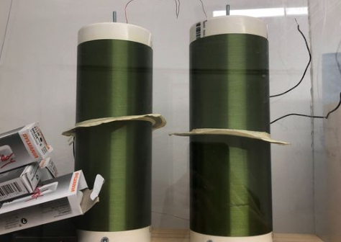
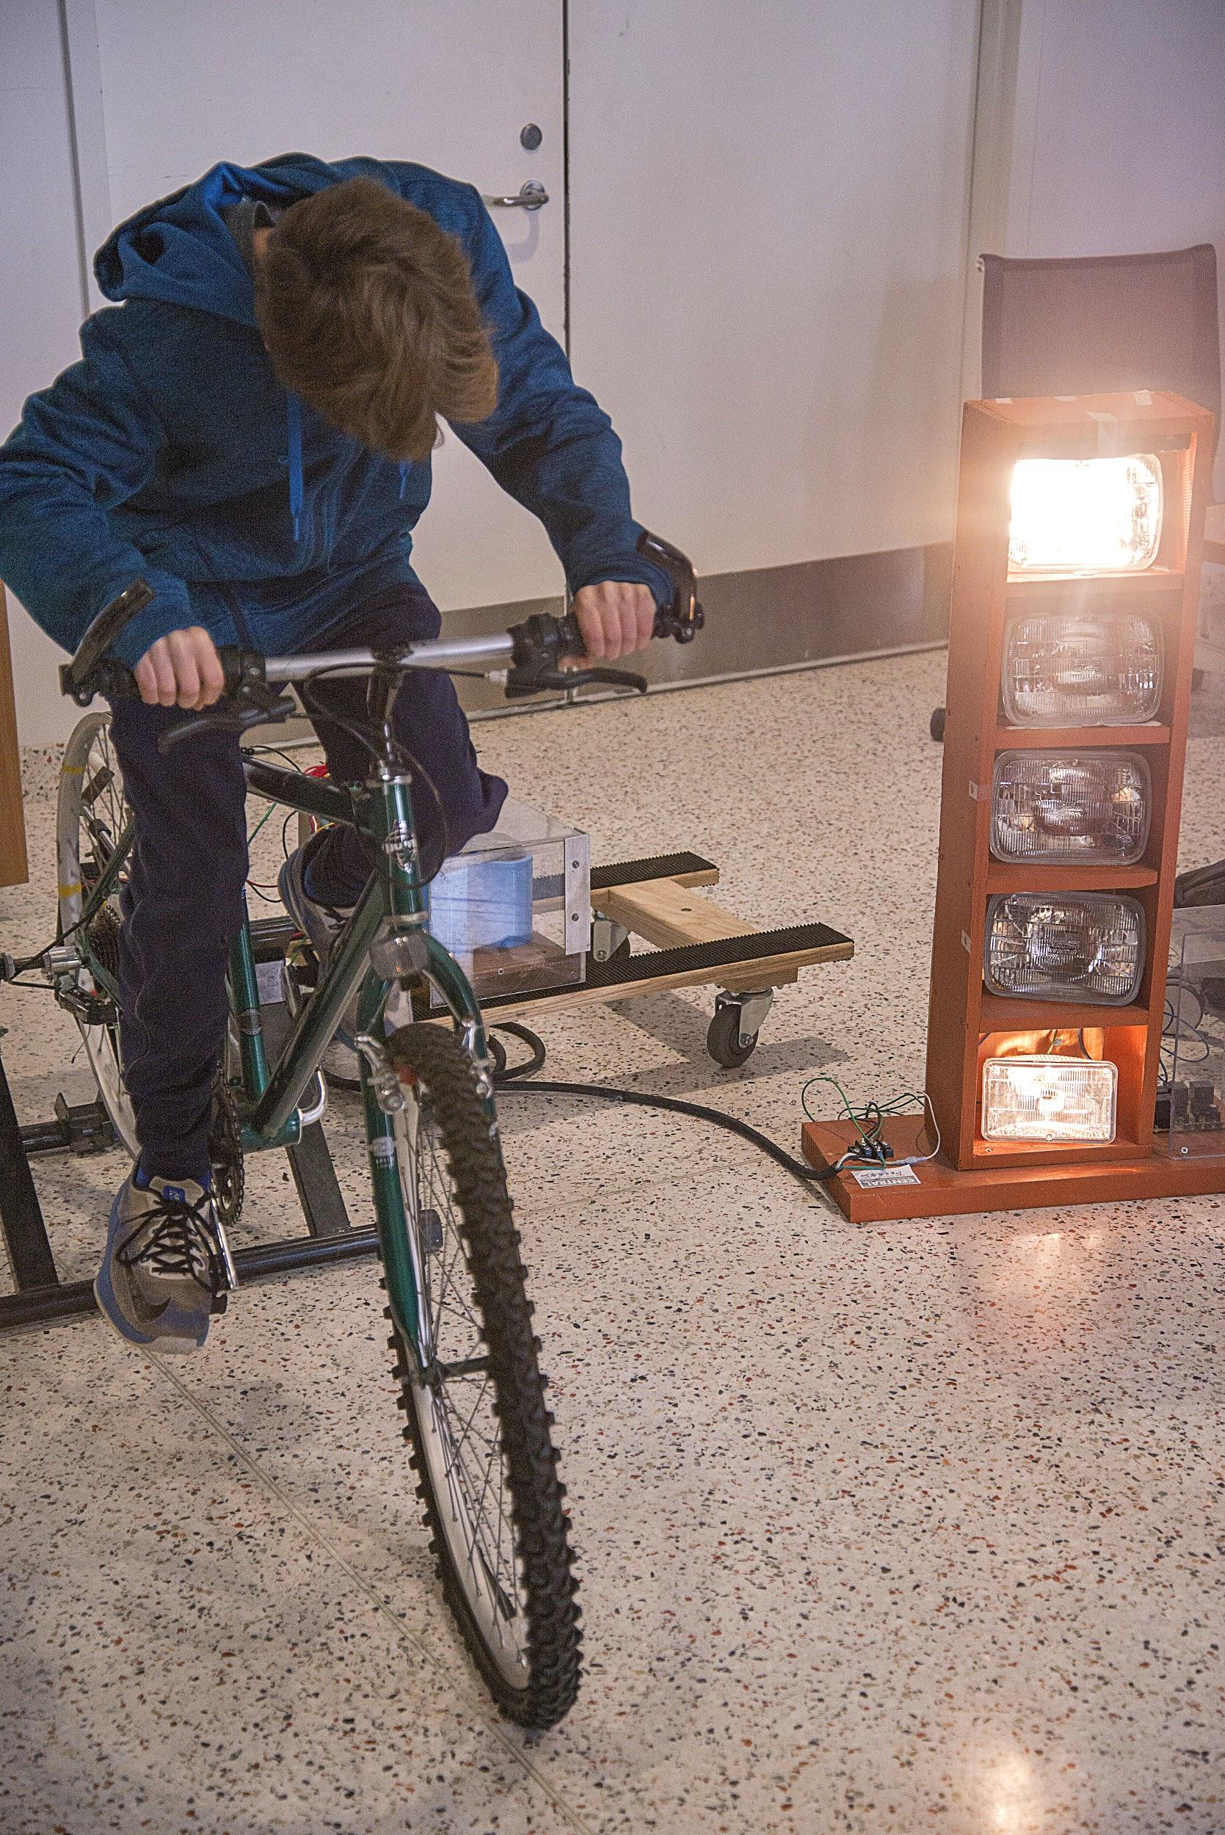
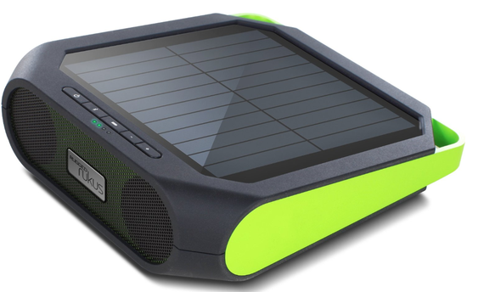
Projects Meeting Times
Located at EER 0.820.
Times: Wed 4:30 - 6:30pm, Fri 4:00 - 6:00pm
Interested in building / modifying projects centered around circuits / hardware / power electronics and power generation? Stop by a project meeting! Projects help in getting experience, internships, etc.
Contact: projects.ut.ieeepes@gmail.com

Slide 6
Want Up To Date Announcements?
Join Our Slack!
tinyurl.com/powerslack

Slide 7
Want Event-Specific Updates? Join Our Facebook Group!
tinyurl.com/facepower

Slide 8
AUSTIN’S CHAPTER OF PES IS CALLED PI²
This is a group of energy systems and renewables professionals in the austin area. This is a great way to get involved with networking, getting experience, and internships!

Slide 9
Upcoming Events:
TECH TALK
September 23rd
7:00-8:00pm
EER 1.518
ECE Open House
September 25rd
5:00-7:00pm
EER Atrium

Slide 10
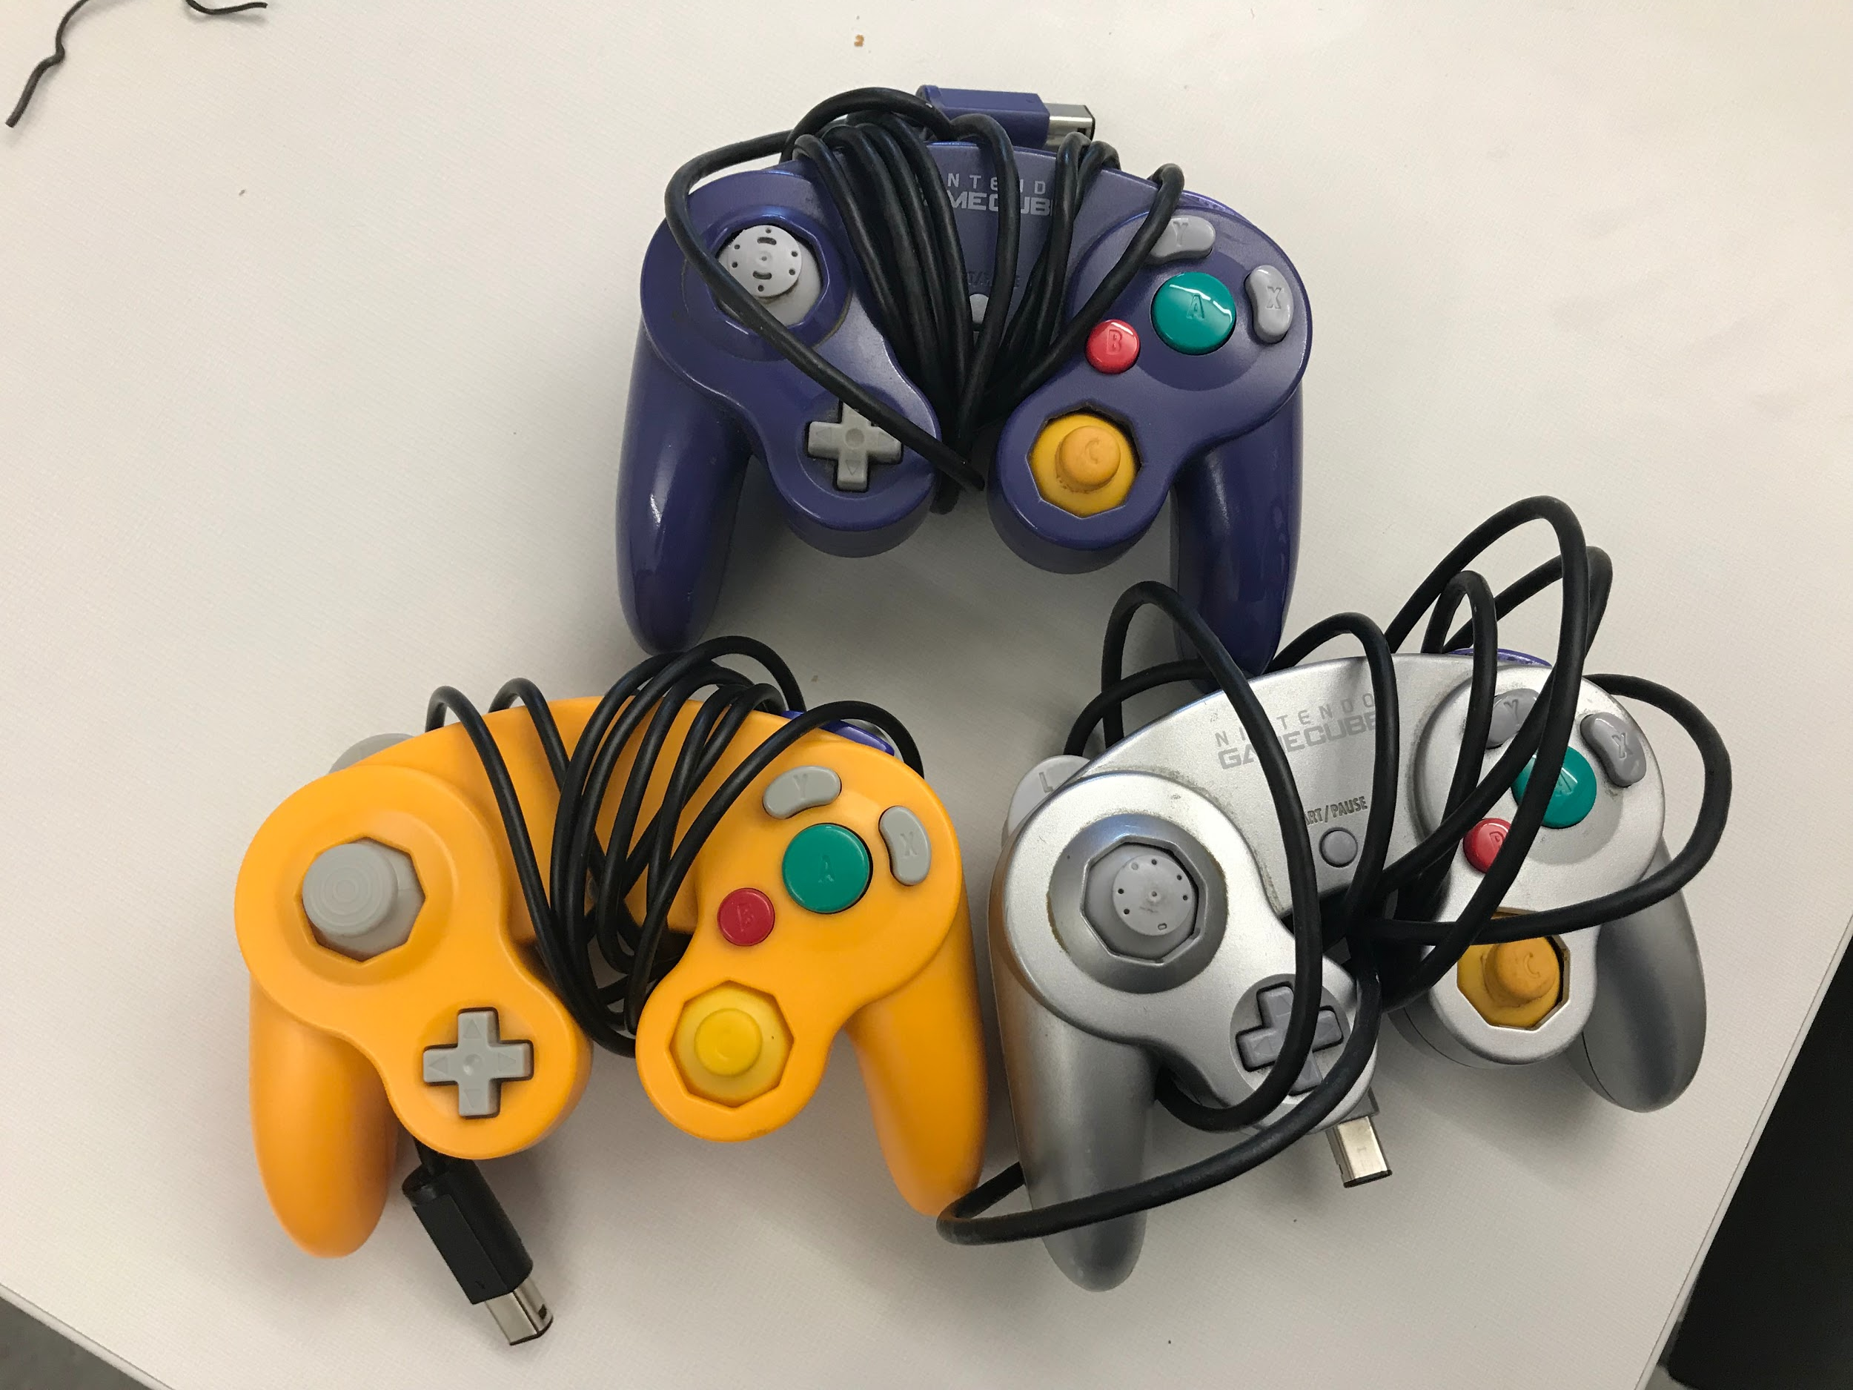
Upcoming Events:
SMASH SOCIAL
9/20/19 2:00pm-4:00pm EER 0.820

Slide 11
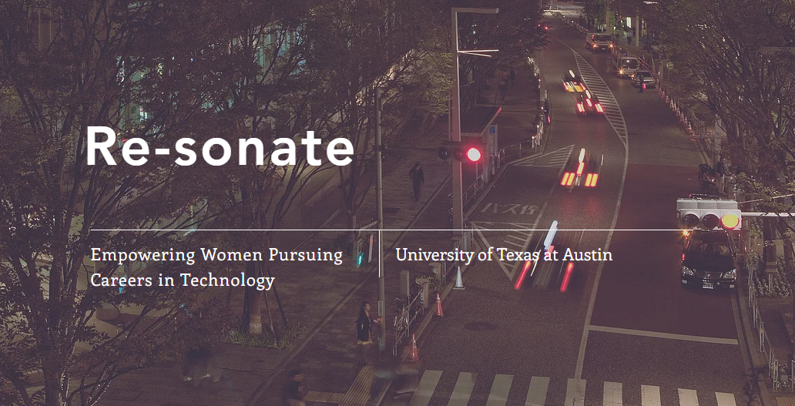
“How to Create Your Personal Project”
Nov 4. 2019
GDC/EER

Slide 12
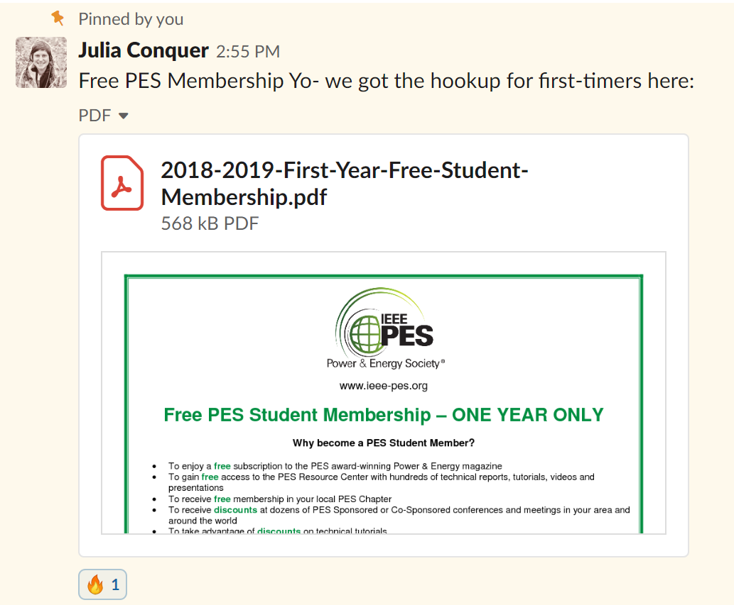
IEEE PES Membership for Students
Go to the PES slack.
Go to #announcements.
Look for a pinned message on September 28th, 2018 from Julia at 2:55pm.
Read the attachment to learn how to get a free one-year PES official membership for students.

Slide 14
General Meeting: 10/02/19 7:00-8:00pm ECJ 1.222
Tech Talk: Performance Contracting Inc.
September 23rd 7:00-8:00pm EER 1.518
Smash Social 9/20/19 2:00pm-4:00pm EER 0.820

Slide 15
Final Remarks
Sign In: tinyurl.com/pes2019gm2
Projects: W- 4:30-6:30pm F- 4:00-6:00pm EER 0.820
Slack: tinyurl.com/powerslack
Facebook: tinyurl.com/facepower
PCI Tech Talk: September 23rd 7:00-8:00pm EER 1.518
Smash Social September 20th 2:00-4:00pm EER0.820

