Slide 1
IEEE PES
4th GENERAL MEETING
SIGN IN HERE: tinyurl.com/pes2019gm4

Slide 2
PAY ATTENTION FOR THE EOY QUIZ

Slide 3
ATTEND EVENTS
GET SWAG
Every GM, Social, and Tech Talk will get you 1 Point.
Every Project Meeting will get you ½ Point.
Enough Points Will Earn You IEEE PES Swag!

Slide 4
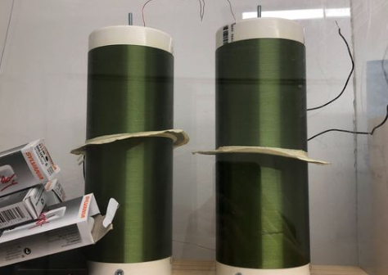
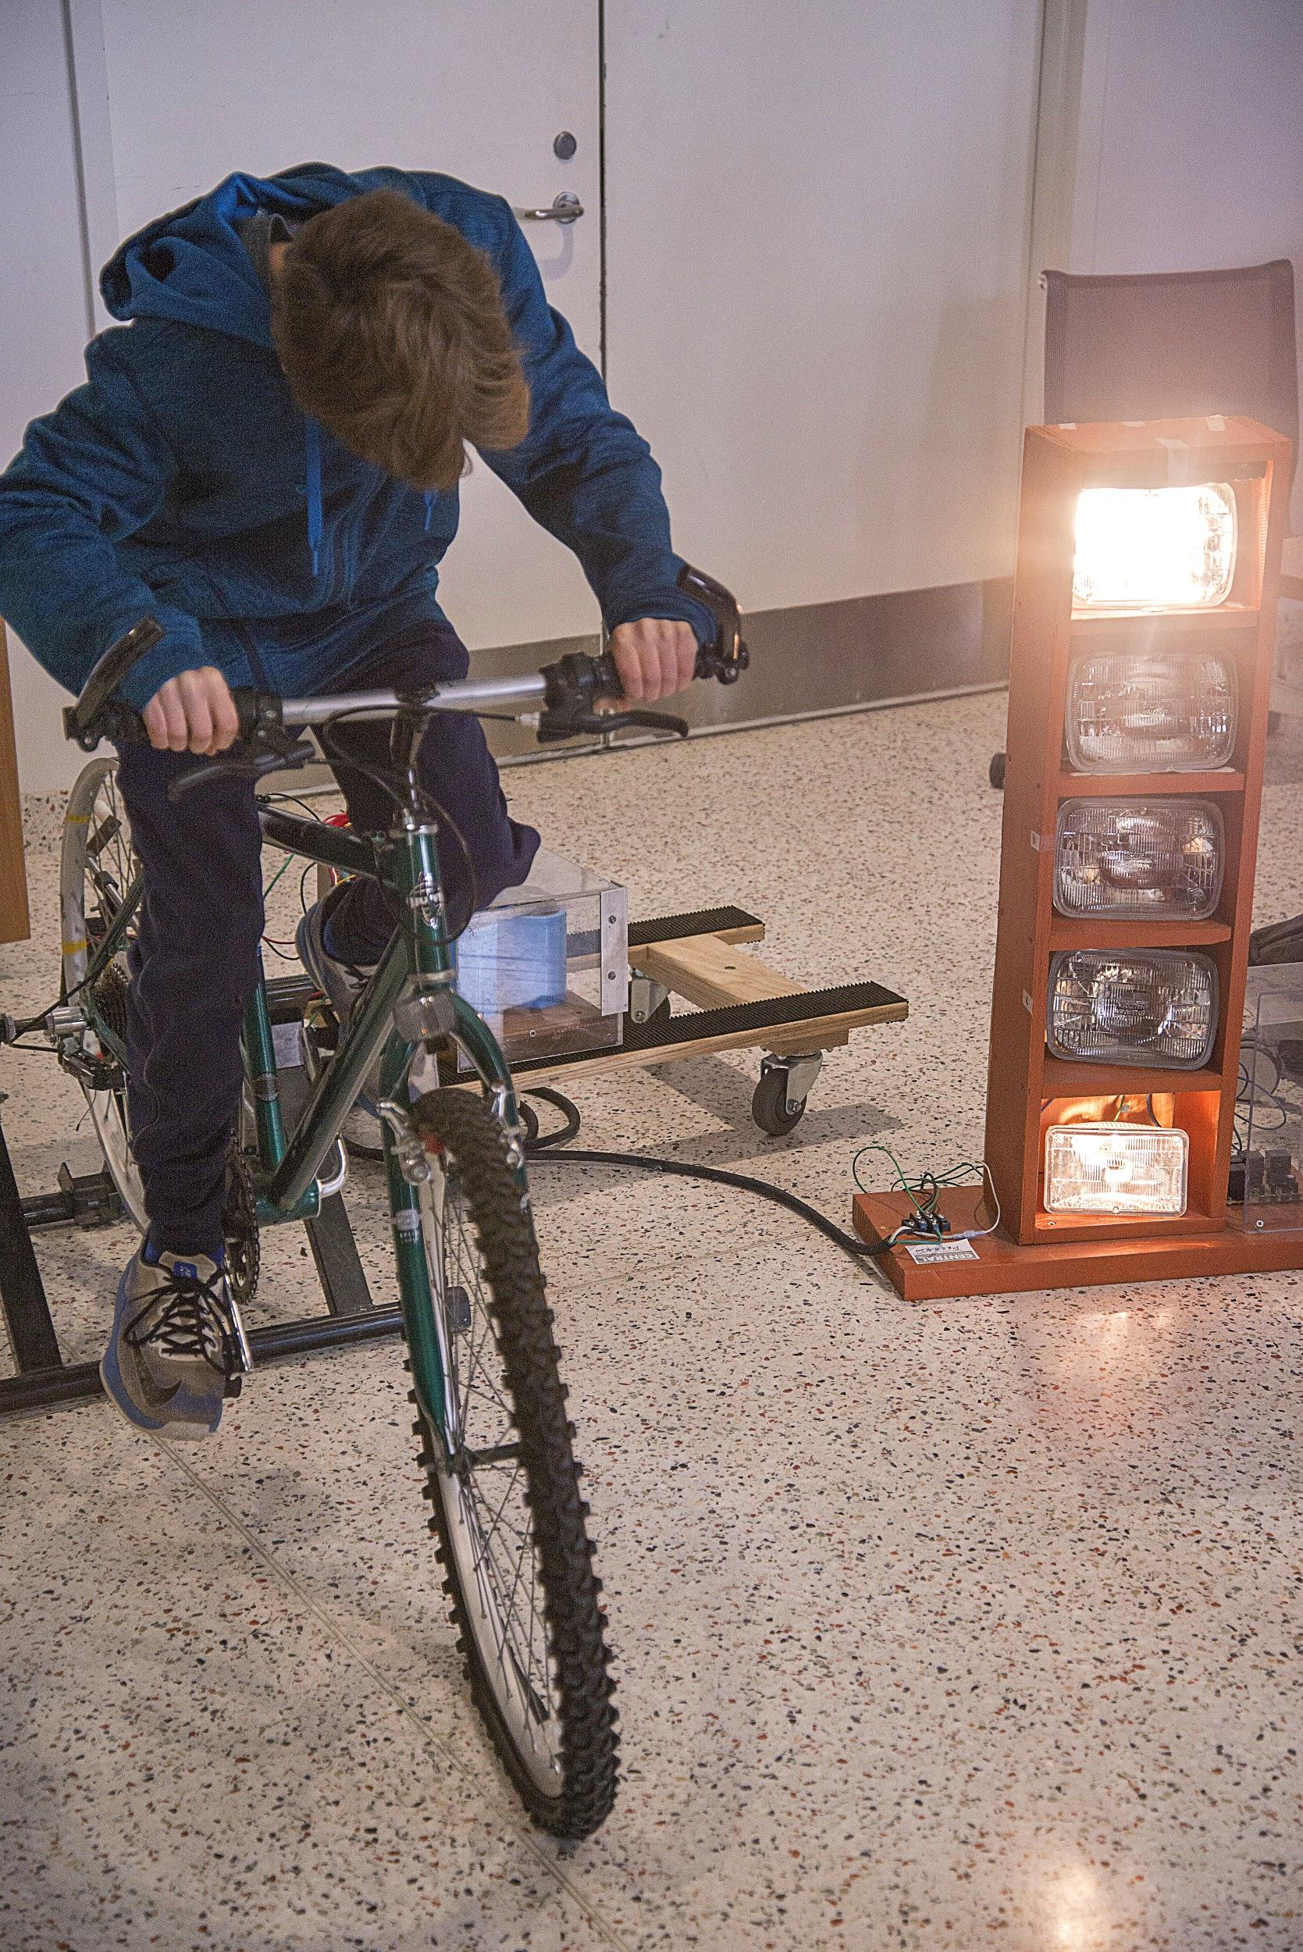
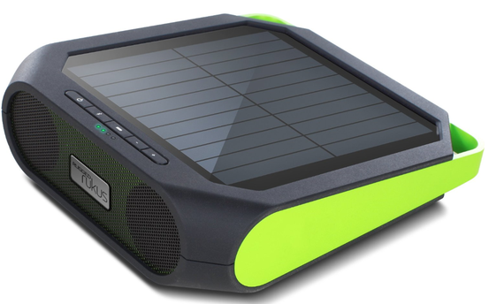
Projects Meeting Times
Located at EER 0.820.
Times: Wed 4:30 - 6:30pm, Fri 4:00 - 6:00pm
Interested in building / modifying projects centered around circuits / hardware / power electronics and power generation? Stop by a project meeting! Projects help in getting experience, internships, etc.
In-depth project discussion today!
Contact: projects.ut.ieeepes@gmail.com

Slide 5
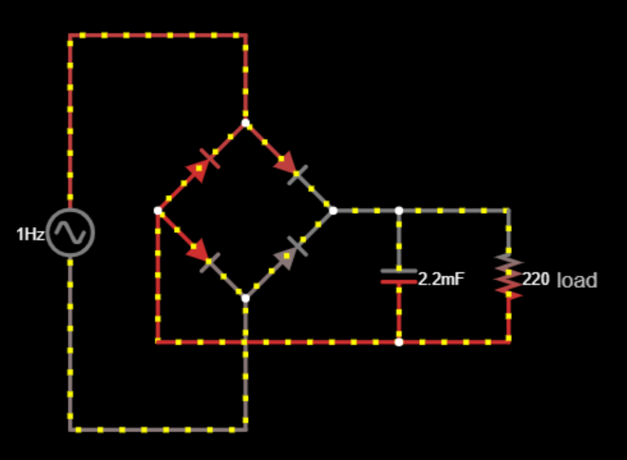
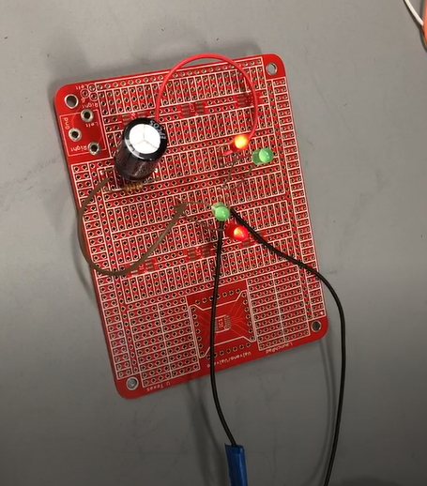
LED REC
The LED Rectifier is a simple example of diode bridge rectification and uses LEDs to make the process easy to visualize.
It operates between 2.5 and 6v and the rectification is visible between 1 and 30Hz.

Slide 6
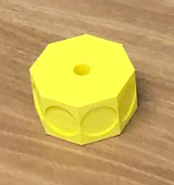
PES MiniGen
The Miniature Generator a generator made of small 3D printed parts. It serves as an introductory project into the field of power generation.
Meant to generate current for small load circuits (can power and LED or small bulb, for example).

Slide 7
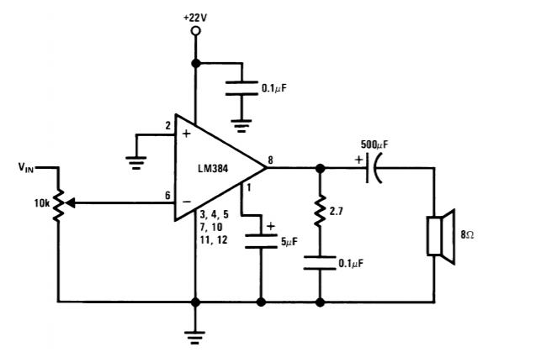
Solar Speaker
Speaker that uses DC solar energy connected to an audio amplifier circuit to power op-amps.
Current work-in-progress project.

Slide 8
Power Bike (now with Royce Union)
The power bike is classic project in need of repair! It uses a voltage generated from spinning bike pedals and a DBR + capacitor array to generate voltage to power bulb array.
We ditched the Huffy Brand.
Task of debugging the generator.

Slide 9
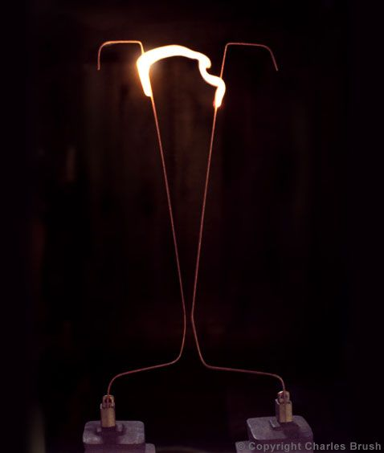
Ladder of POWER
You touch it with a nail and it goes sparky sparky boom boom.
The Ladder of POWER (commonly called a Jacob’s Ladder) is one of our most ambitious projects this year. It utilizes a breakdown between two extremely high energy prongs to create a voltage “arc”.
Typically operates at 3 - 8kV

Slide 10
Want Up To Date Announcements?
Join Our Slack!
tinyurl.com/pesslack2019

Slide 11
Want Event-Specific Updates? Join Our Facebook Group!
tinyurl.com/facepower

Slide 12
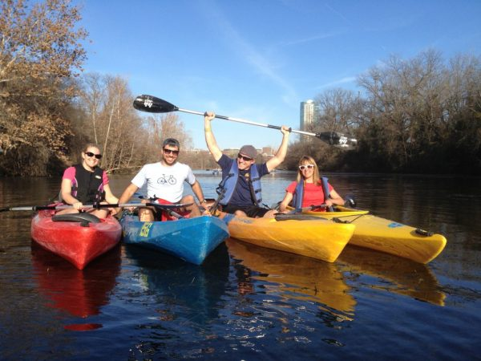
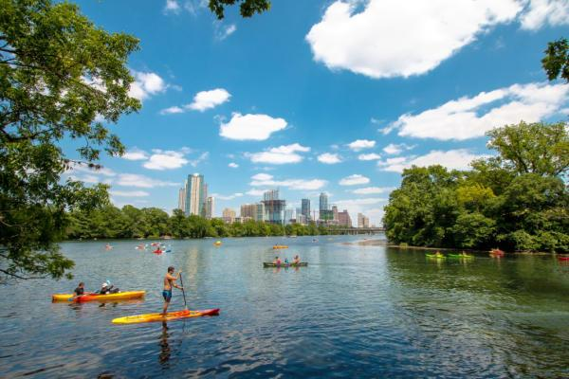
Upcoming Events: Kayak!
tinyurl.com/peskayak2019

Slide 13
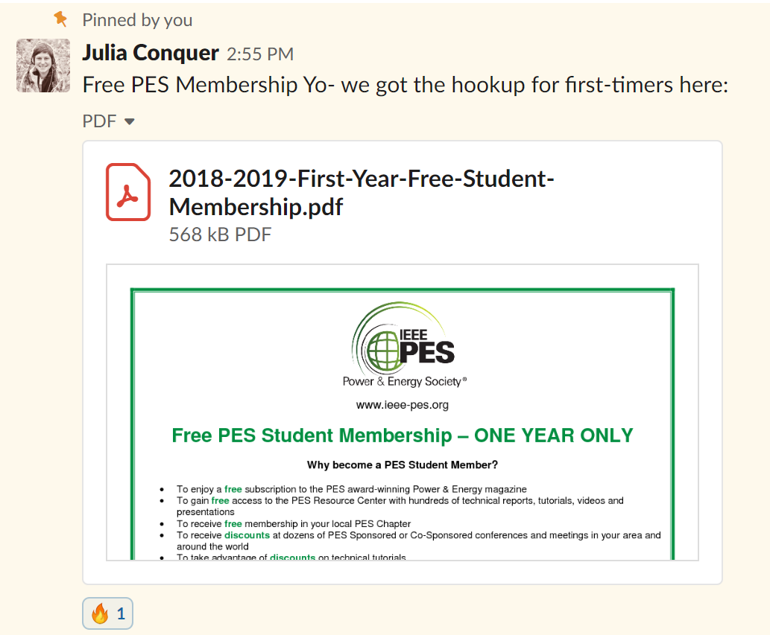
IEEE PES Membership for Students
Go to the PES slack.
Go to #announcements.
Look for a pinned message on September 28th, 2018 from Julia at 2:55pm.
Read the attachment to learn how to get a free one-year PES official membership for students.

Slide 14
IEEE PES WEBINAR
Deep Learning and its Application to Power System Analysis
http://resourcecenter.ieee-pes.org/education/webinars/PESVIDWEBRAG300.html?source=IBP
An Energy IoT Platform for Real-time Production and Delivery of Wind Power Generation Forecasts
http://resourcecenter.ieee-pes.org/education/webinars/PESVIDWEBRAG240.html?source=IBP

Slide 15
Final Remarks
Sign In: tinyurl.com/pes2019gm4
Projects: W- 4:30-6:30pm F- 4:00-6:00pm EER 0.820
Slack: tinyurl.com/pesslack2019
Facebook: tinyurl.com/facepower
Kayak Social Form: tinyurl.com/peskayak2019

