Slide 1
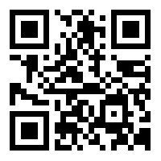
IEEE PES
8th GENERAL MEETING
SIGN IN HERE: tinyurl.com/pesgm8

Slide 2
PAY ATTENTION FOR THE EOY QUIZ
Bigger Twists, Bigger Prizes!

Slide 3
ATTEND EVENTS
GET SWAG
Every GM, Social, and Tech Talk will get you 1 Point.
Every Project Meeting will get you ½ Point.
Getting 4 Points Will Earn You IEEE PES Swag!

Slide 4
PES SWAG WINNERS
Devin Shoemaker 13 Points
Landon Fox 8 Points
Felipe Palacios II 7 Points
Chris Whitfill 5.5 Points
JJ Gomez 4.5 Points
Evelyn Li 4.5 Points

Slide 5
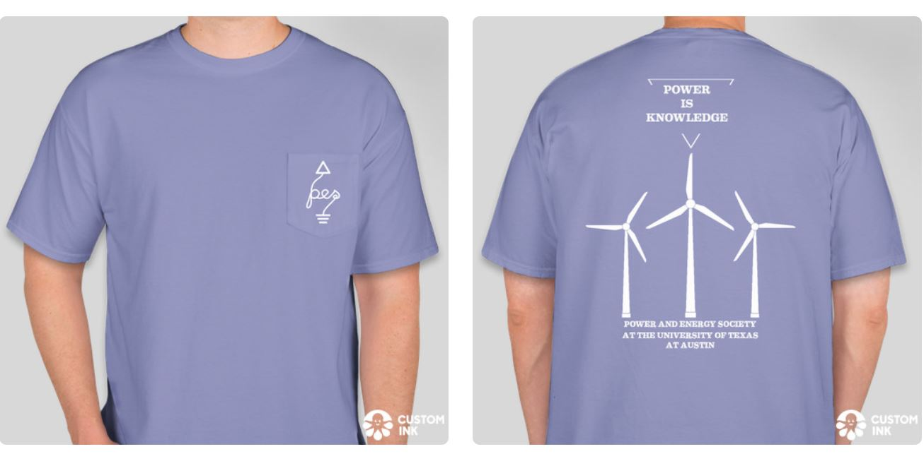
New T-Shirts Are In!

Slide 6
New Publicity Officer!
(Happy Birthday Also!)

Slide 7
Projects Meetings
Welcome back! Projects meetings are an excellent source of electronics hardware group work and fun! I hope to see more of you at the meetings.
We will likely only have one meeting a week this semester, which will be different from previous semesters.
Projects Form:
https://tinyurl.com/rexdj5w

Slide 8
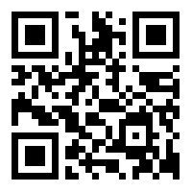
Want Up To Date Announcements?
Join Our Slack!
tinyurl.com/pesslack2019

Slide 9
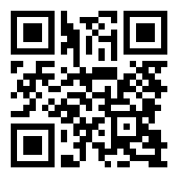
Want Event-Specific Updates? Join Our Facebook Group!
tinyurl.com/facepower

Slide 10
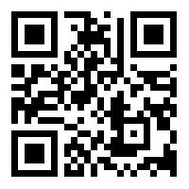
Kayaking Social Part 2: Electric Boogaloo
February 29th 2/29/20 DEADLINE 2/15/20
https://tinyurl.com/peskayak

Slide 12
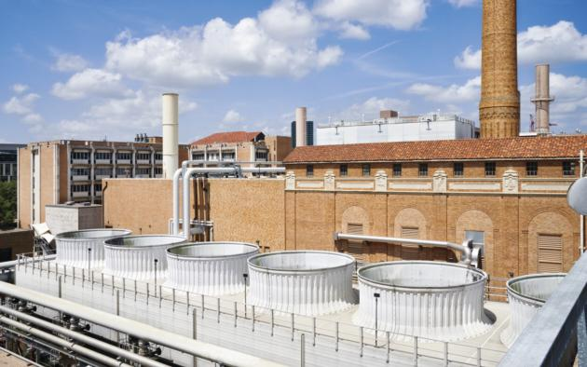
Other Future Events
Girls’ Day- February 22nd
ExploreUT- March 7th
UT Power Plant Tour- March
Pickle Center for Electromechanics Tour-April
‘Are You Smarter Than An Electrician’- Next GM (Feb 26th) ! Win Prizes!

Slide 13
IEEE PI^2
4th Tuesday of Every Month- Ercot
Presentation-Cybersecurity
Cover 3-Anderson Lane
Subsidize $20

Slide 14
IEEE PES Membership for Students
Go to the PES slack.
Go to #announcements.
Look for a pinned message on November 10th, 2019 from Filipe.
Read the attachment to learn how to get a free one-year PES official membership for students.
NEW CODE

Slide 15
Final Remarks
Sign In: tinyurl.com/pesgm8
Projects: tinyurl.com/rexdj5w
Slack: tinyurl.com/pesslack2019
Facebook: tinyurl.com/facepower
IEEE-PES Kayak Social: tinyurl.com/peskayak
Sign In
Slack
Facebook
Kayaking

Slide 16
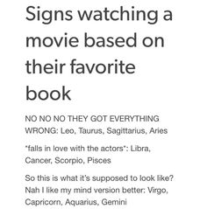
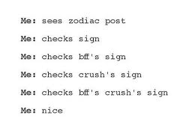
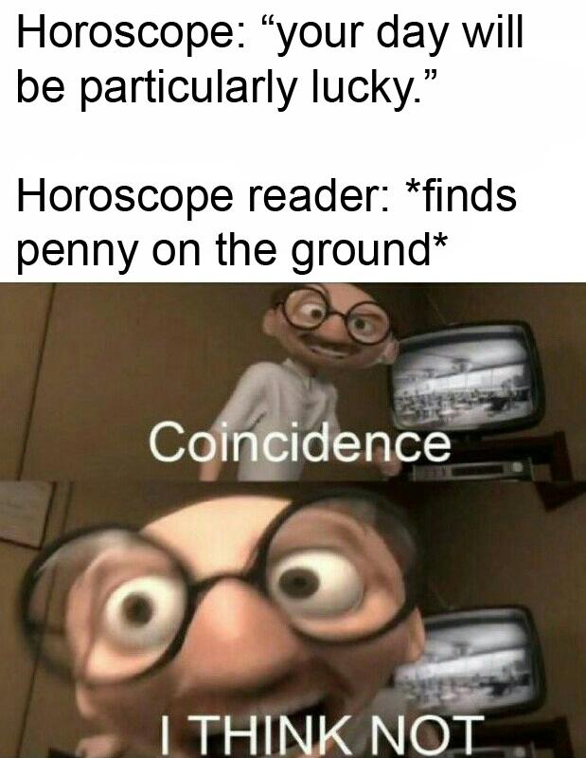
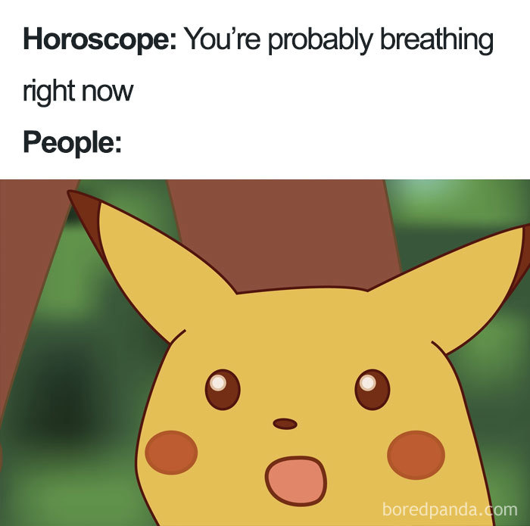
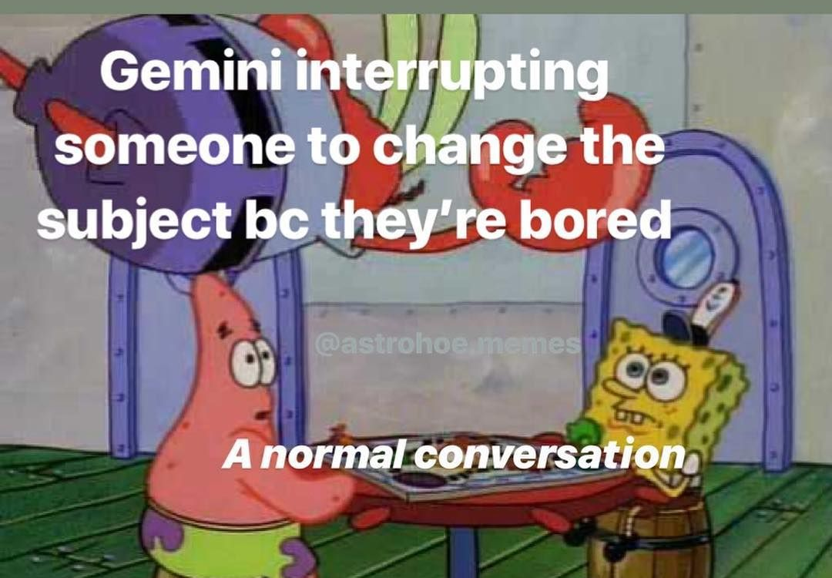
Astrology

Slide 17
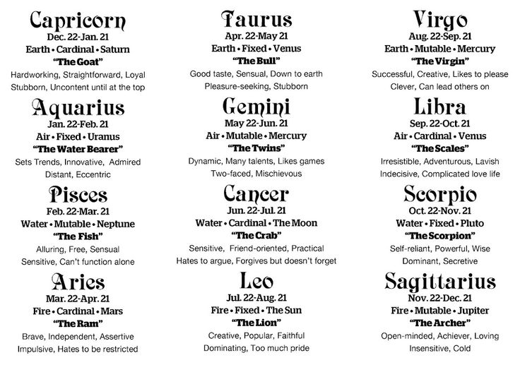

Slide 18
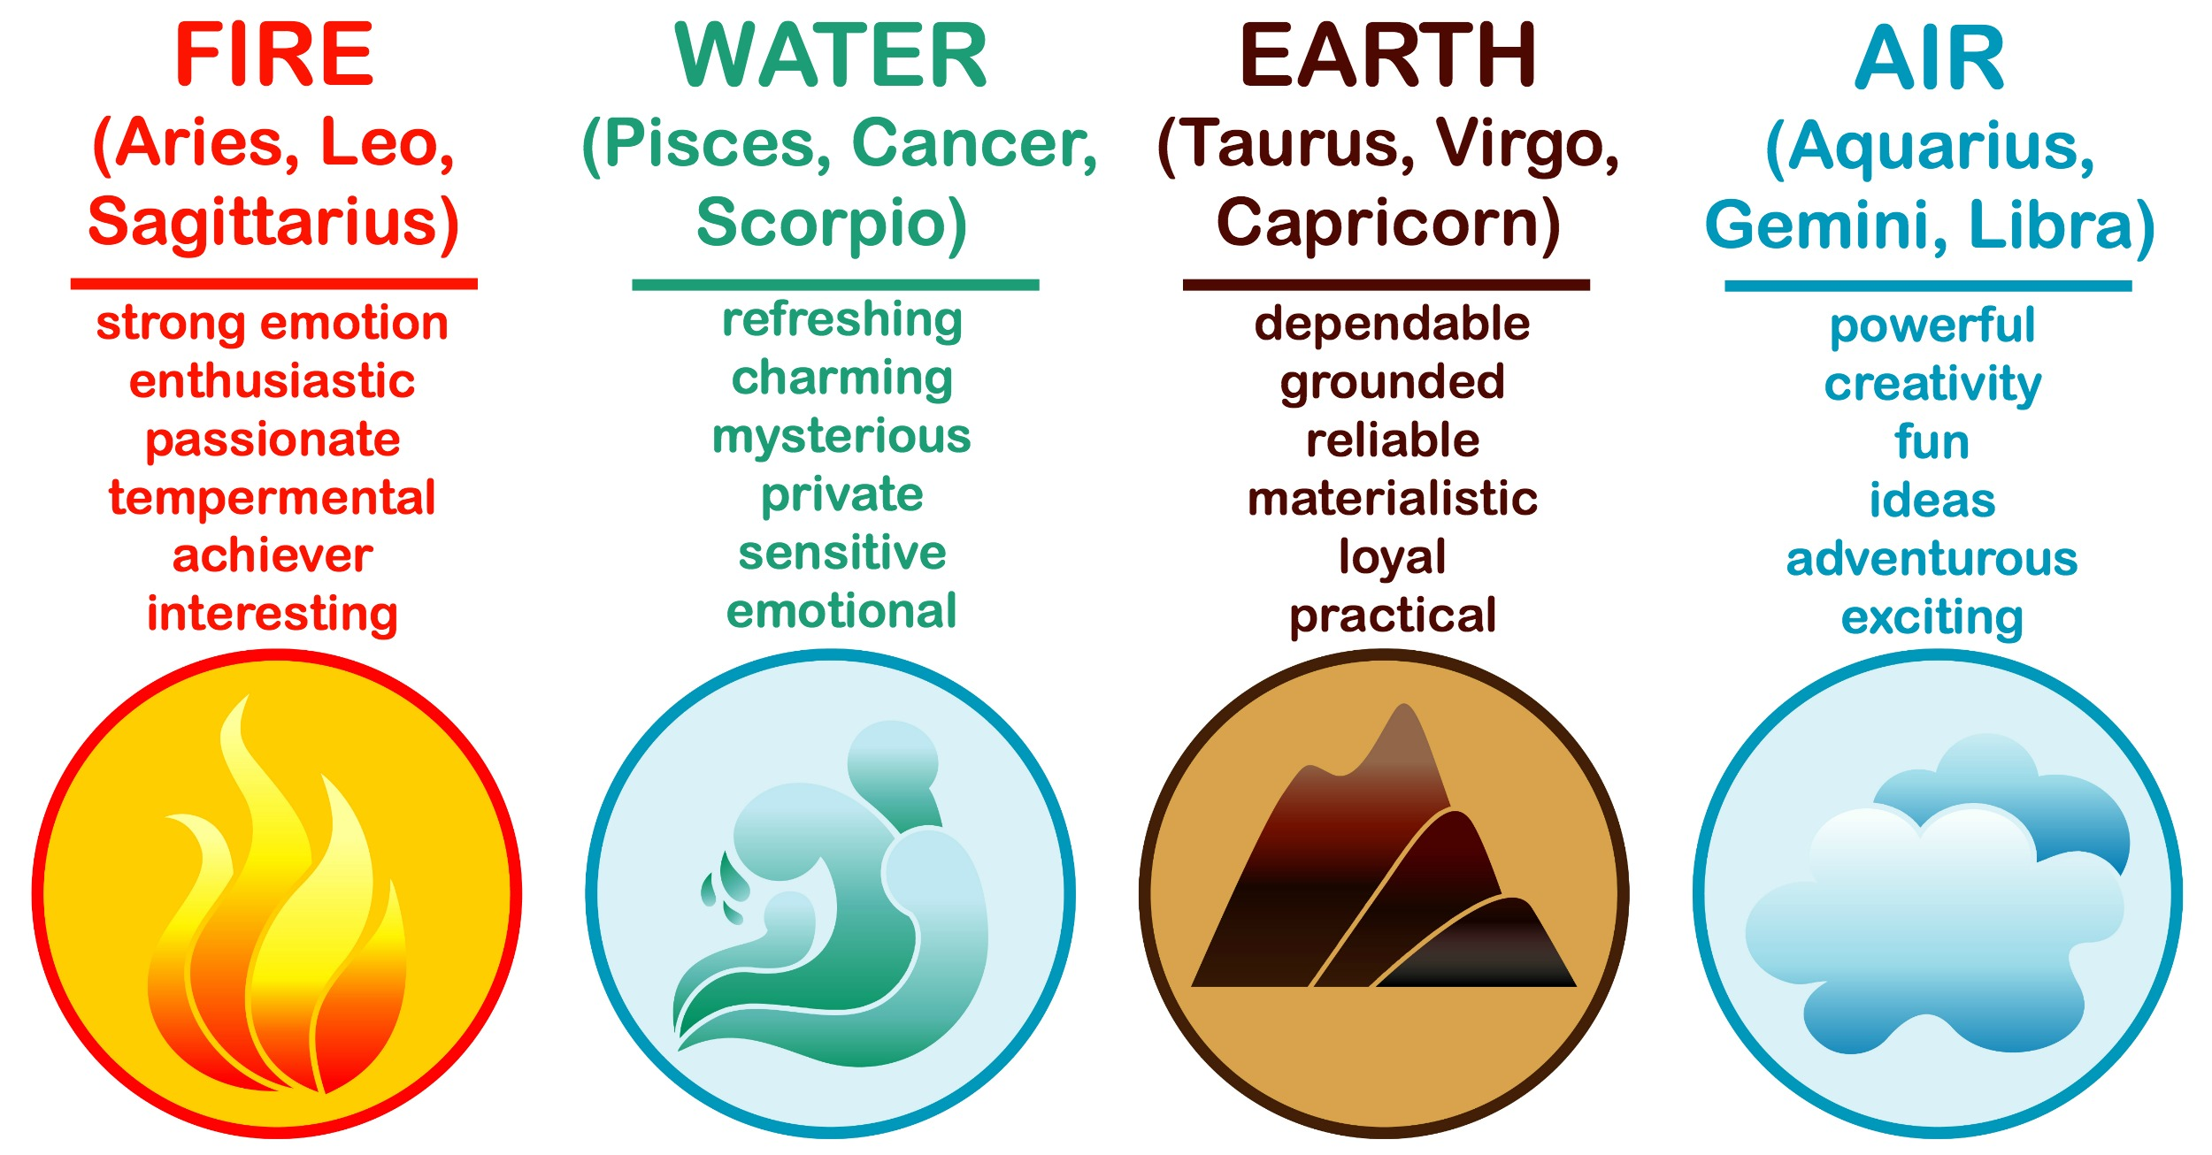
Elements of the Zodiac

Slide 19
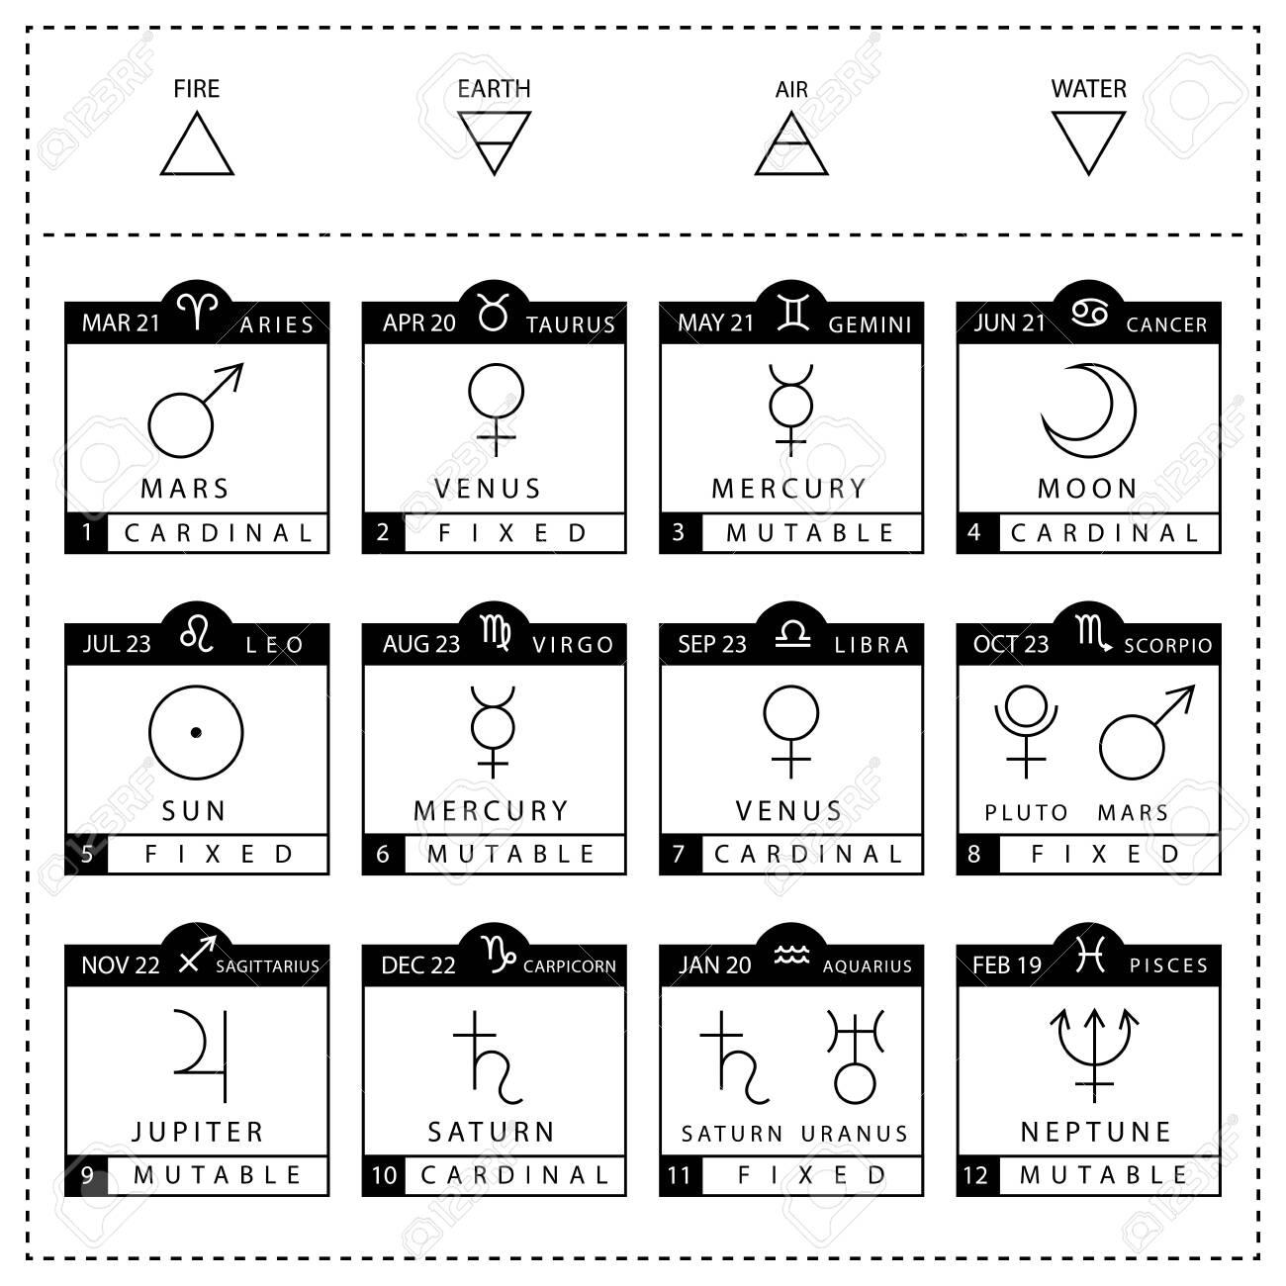
Birth Charts
Full Name
Your Birthday
Time of Birth
City You were Born In

Slide 20
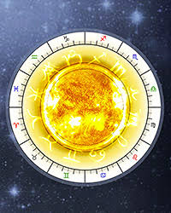
How To Read Your Birth Chart
Sun Sign : Your identity, self-expression, your values
Moon Sign : Your subconscious, your inner self, controls your emotions
Rising Sign/Ascendant : How you appear to others, your outer-self
Mercury Sign : Rules how you communicate in all aspects, ex.listening, negotiating and buying

Slide 21
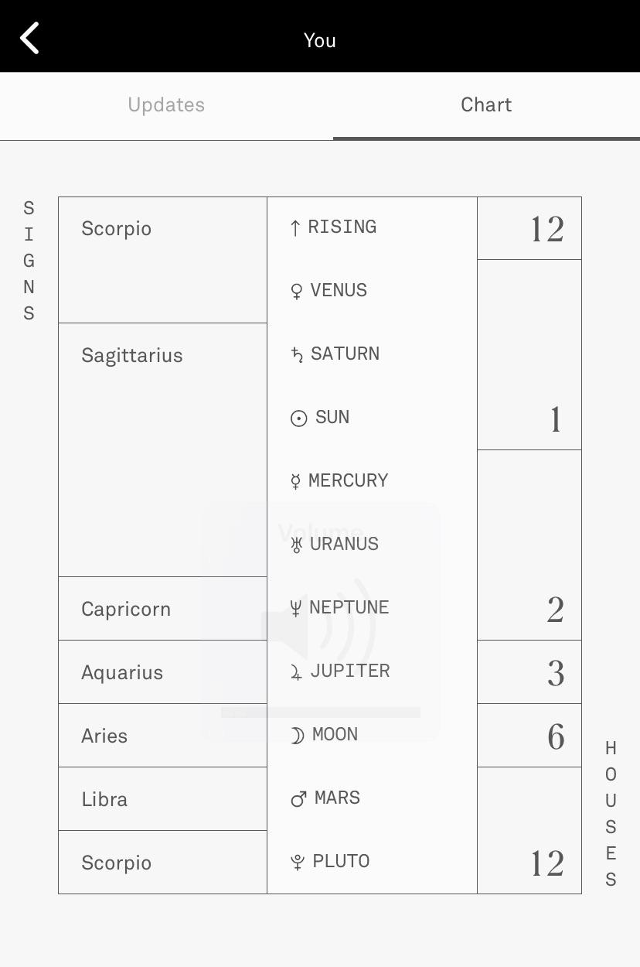
Apps

Slide 22
Final Remarks
Sign In: tinyurl.com/pesgm8
Projects: tinyurl.com/rexdj5w
Slack: tinyurl.com/pesslack2019
Facebook: tinyurl.com/facepower
IEEE-PES Kayak Social: tinyurl.com/peskayak
Sign In
Slack
Facebook
Kayaking

