Slide 1

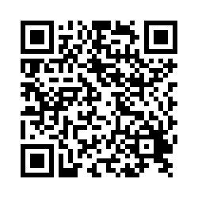
Seeking Arab American Undergraduate Students For Research Study
Consider participating in a study exploring the Arab American college student experience. The primary focus of this study will be about how Arab American college students navigate their identity and how they experience belonging.
Participants should meet the following criteria:
Self-identify as Arab American
Be born in the United States
Have a least one parent who immigrated to the United States from the Southwest Asia and North Africa (SWANA) region and they identify as Arab
Be enrolled as a first-year or later as an undergraduate student at The University of Texas at Austin
To participate please email Jinane at jinane@utexas.edu
Participants will be paid $40 per interview.
This study has been approved through The University of Texas at Austin Institutional Review Board (IRB) (STUDY00003303).

