Slide 1


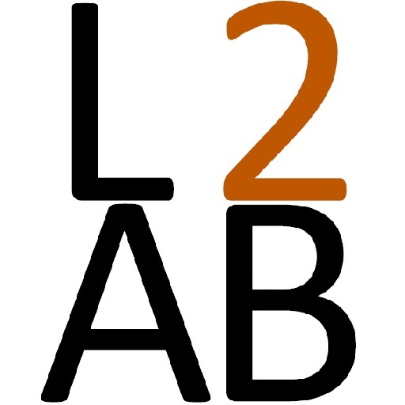
Processing Instruction: an approach for understanding language comprehension and developing input-based grammar activities
Nick Henry
The University of Texas at Austin
Carleton College, 1/31/23

Slide 2

A simple model of L2 Acquisition
Input Processing
Production Interface
DEVELOPING SYSTEM
INPUT
OUTPUT
Notes:
I want to start with a very simply model of acquisition. You can see that right in the center of this model, I’m putting the “developing system”. This, to me, is what we’re looking at when we talk about “acquisition”. It’s the development of an implicit, abstract system or representation of the target language. This system, as you can see here, starts with comprehensible input and meaningful communication. And as you can see, it’s ultimately used to produce language. But what’s interesting to me – and important for today’s talk, is INPUT Processing: that’s the interface between the input and our developing system.

Slide 3
Input Processing Model
(VanPatten, 1996; 2004; 2015)
Two major assumptions of the model
  Primacy of Meaning: Learners process input for meaning before they process it for form.
  Availability of Resources: Learners have limited resources with which to process input.
Two major principles in the model
  Lexical Preference Principle
  First Noun Principle
Notes:
This second insight was formalized in VanPatten’s Input Processing Model

Slide 4
Lexical Preference
(Morphology vs. lexical cues)
Learners will tend to rely on lexical items as opposed to grammatical form to get meaning when both encode the same semantic information.
Yesterday I played baseball in the park.
Evidence from:
  Psycholinguistics
    Conflict Studies (“Yesterday James does his biology homework”) (e.g., Dracos & Henry, 2018); Sagarra, Cravetz, and Pfursich, 2006; VanPatten & Keating (2007)
    Tasks showing sensitivity to form-meaning mismatches (Cameron, 2011)
  Classroom research
    Accuracy Studies (many in the Processing Instruction Literature (e.g., Cadierno, 1995)
Notes:
Tend s to focus on verbal morphology: subject / verb agreement

Slide 5
First Noun Strategies
(Word Order vs. Case vs. Animacy vs. Context)
Learners tend to process the first noun or pronoun they encounter in a sentence as the subject or agent.
The man was bitten by the dog.
Evidence from
  Psycholinguistics
    Competition Model studies (e.g., “The dog the cat saw”) (e.g., Gass; 1987)
  Classroom Research
    Accuracy Studies investigating the role of:
      Context: VanPatten & Houston (1998)
      Case / Animacy : LoCoco (1987); Jackson (2007)
      Linguistic Universals: Isabelli (2008); Seibert-Hanson (2012)
      Processing Instruction: e.g., VanPatten et al., (2013)

Slide 6
Processing Instruction
Processing Instruction is the pedagogical application of VanPatten’s Input Processing model. It’s aimed at helping learners to avoid a particular processing problem and promoting the processing of a target form.
Word Order
Plausibility
Probability
Context
Prosody
Der Hund beißt den Mann.
The dog bites the man.
NOM ACC
The dog bites the man.

Slide 7

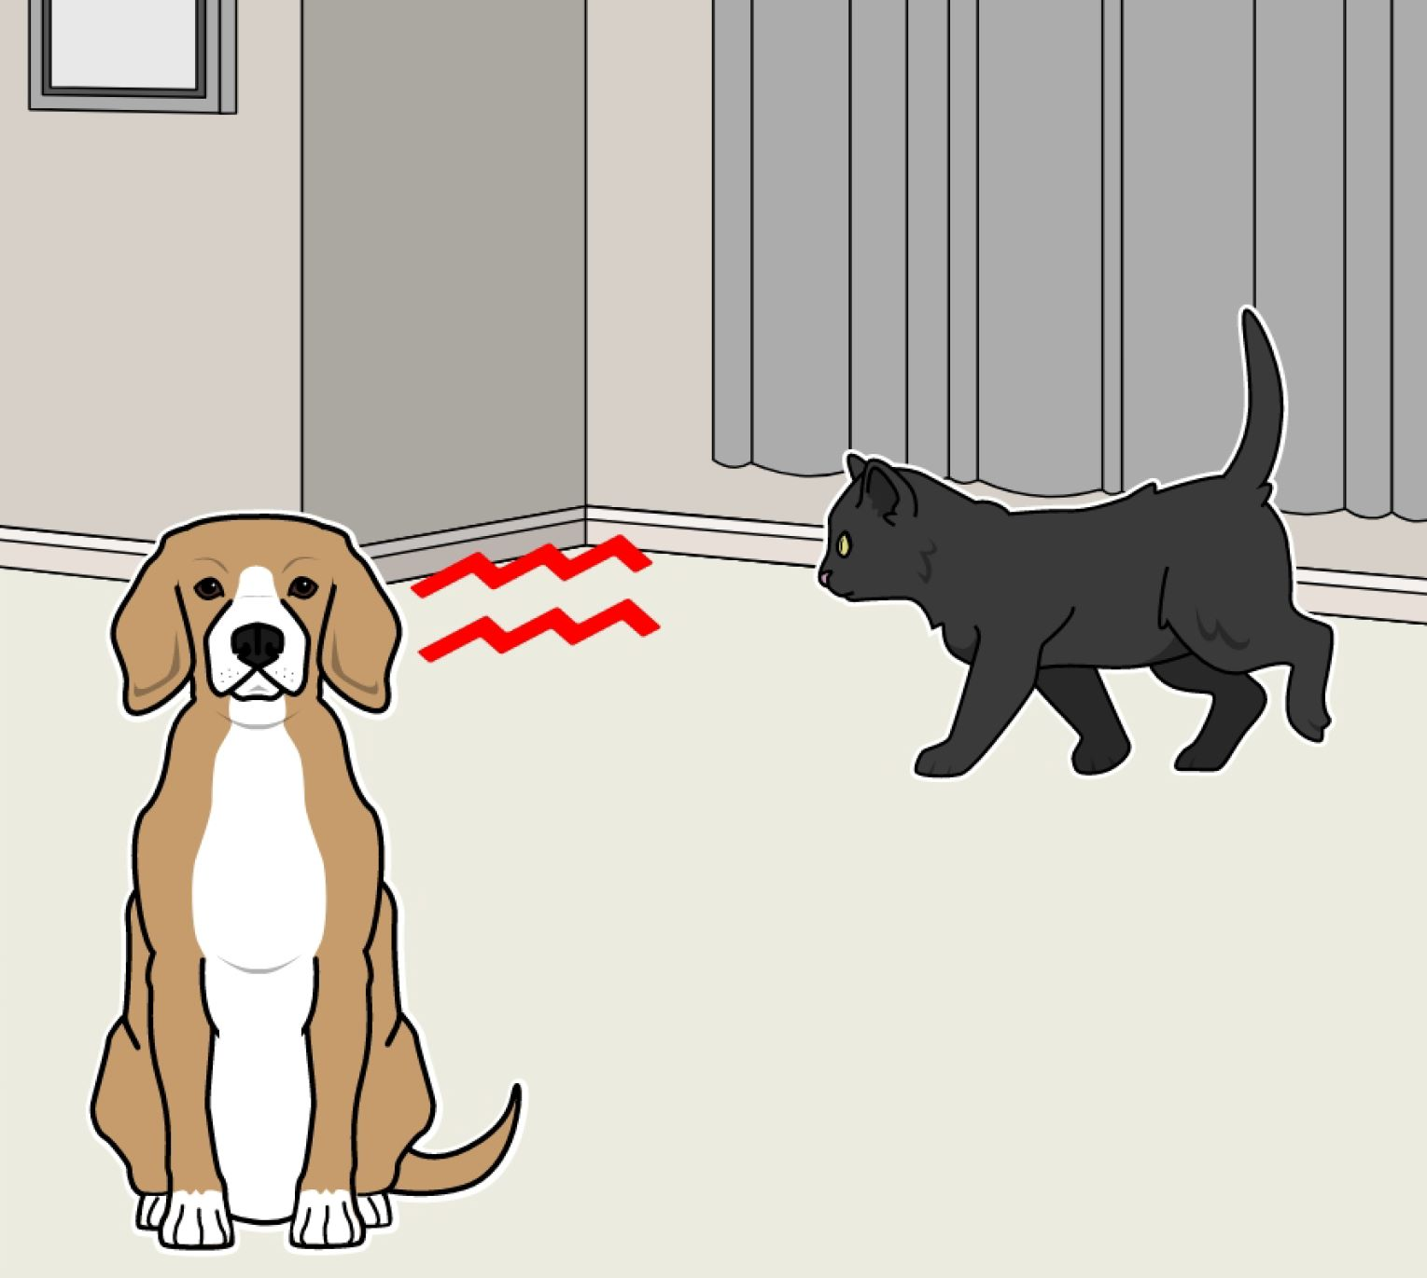
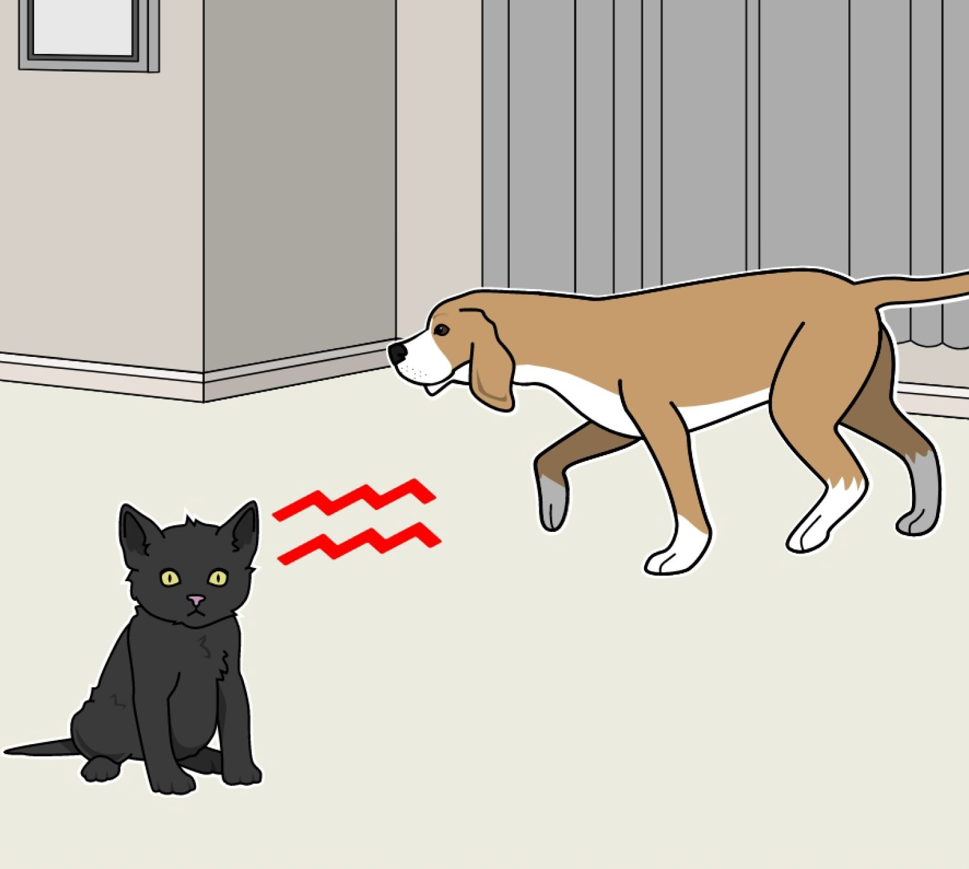
Den Hund hört die Katze.
The dog hears the cat.
“The cat hears the dog”
ACC NOM
A
B
Correct! Good Job!
Incorrect.

Slide 8
Lo oye el gato.
The dog hears the cat.
“The cat hears the dog”
A
B
Correct! Good Job!
Sound from VanPatten et al. (2013)

Slide 9
Собаку слышит кошка.
Dog_{FEM-ACC} hears cat_{FEM-NOM}
“The cat hears the dog”
A
B
Correct! Good Job!
Sound from VanPatten et al. (2013)

Slide 10
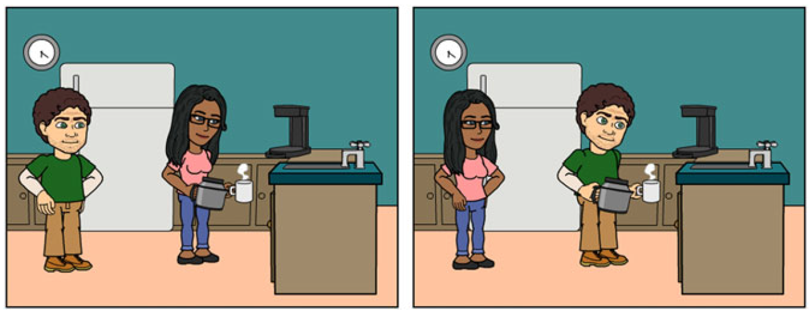
Marie fait faire du café à Pierre.
Marie makes to make coffee to Pierre
“Marie makes Pierre make coffee.”
A
B
Correct! Good Job!
From Wong & Ito (2018)

Slide 11
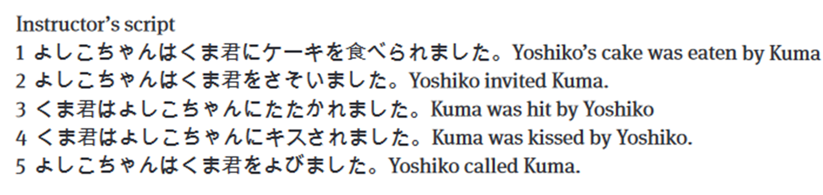
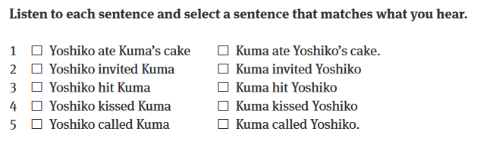
✓
✓
✓
✓
✓
From Benati (2015)

Slide 12
The central claim of PI research
VanPatten & Cadierno (1993): “… processing instruction alter[s] the way in which learners process[] input, which in turn [has] an effect on the developing system,” resulting in knowledge useful for comprehension AND production.
Initially this claim was made on the basis of pretests / posttest assessment. This claim is now being investigated using online measures that track processing in real-time.
  Henry (2015 → 2022a, 2022b)
  Wong & Ito (2018)
  McManus & Marsden (2018, 2019)
  Issa & Morgan Short (2019)
  Dracos & Henry (2021)
Notes:
This movement from offline tests is a general trend within the field of input processing and within cognitive branches of SLA more broadly.

Slide 13
Milestones in 20 years of PI
(Lee, 2015)
PI is effective instruction compared to other types of training:
  Traditional Instruction: VanPatten & Cadierno; 1993; VanPatten & Uludag, 2011; VanPatten & Wong, 2004; Benati, 2001, 2009; Cadierno, 1995; Cheng, 2002; Collentine, 1998; Marsden & Chen, 2011
  Meaning-based Output: Benati, 2005; Farley, 2001; VanPatten, Farmer, & Clardy, 2009,
Activities are the causative variable, not explicit information:
  VanPatten & Oikkenon, 1996; Fernandez, 2008; Henry, Jackson & DiMidio, 2017; Sanz & Morgan-Short, 2004; Lee & Benati, 2007; VanPatten et al., 2013
PI affects discourse-level language use
  VanPatten & Sanz, 1995; Sanz, 1997; Sanz, 2004; Sanz & Morgan-Short, 2004; Cheng 2002, 2004; Henry et al., 2017; Benati and Lee, 2010
The effects of PI are durable
  VanPatten & Cadierno, 1993; Cadierno, 1995; VanPatten, Inclezan, Salazar & Farley, 2009; VanPatten, Farmer & Clardy, 2009; Marsden, 2006; VanPatten & Fernandez, 2004

Slide 14
Key insights
In order to acquire forms, learners must attend to these forms and the meanings that they impart on an utterance.
  Notice: I didn’t say notice!
When use of a form is essential to completing a task, that form is more likely to be processed and acquired.
Properties of the input significantly impact which forms learners attend to.
  The presence of redundant cues
  Where the cues fall in an utterance (beginning, middle, end)
  Presumably also physical properties of the input: intelligibility, speed, etc.
Notes:
Link to Salience

Slide 15
A short list of forms tested with PI
Spanish
  OVS Word Order / accusative & dative pronouns
  Passive Voice
  Subjunctive
  Tense (Present, Preterite, imperfect, Future)
  Ser & estar
Italian
  Gender agreement
  Future Tense
French
  Faire causative
  Imparfait
  Subjunctive
German
  OVS Word Order / Case
  Two-Way Prepositions (Case)
  Gender assignment
Russian
  OVS Word Order / Case
  Directional vs. locational expressions
Chinese
  Classifiers
Japanese
  Past Tense
  Passive
Notes:
ALSO English
Passive
Causative
Tense (Simple Past, 3rd person singular present)

Slide 16
A short list of forms tested with PI
Spanish
  OVS Word Order / accusative & dative pronouns
  Passive Voice
  Subjunctive
  Tense (Present, Preterite, imperfect, Future)
  Ser & estar
Italian
  Gender agreement
  Future Tense
French
  Faire causative
  Imparfait
  Subjunctive
German
  OVS Word Order / Case
  Two-Way Prepositions (Case)
  Gender assignment
Russian
  OVS Word Order / Case
  Directional vs. locational expressions
Chinese
  Classifiers
Japanese
  Past Tense
  Passive
First Noun Principle
Lexical Preference Principle
Notes:
ALSO English
Passive
Causative
Tense (Simple Past, 3rd person singular present)

Slide 17
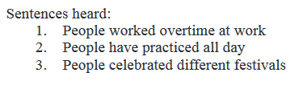
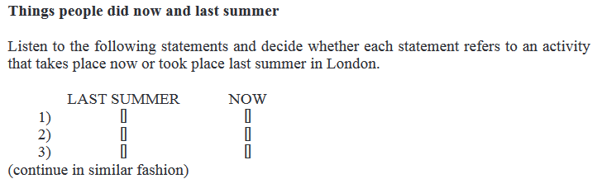
Present vs. Past Tense
From Benati & Angelovska (2015)
✓
✓
✓

Slide 18
Spanish Subjunctive
From Villegas & Morgan-Short (2019)
Adapted from Fernandez (2008)
✓
No pienso que... (I don’t think that…)
Es evidente que... (It’s obvious that…)
[…juegue al tenis todos los días]
[…play-SUB tennis every day]
✓
No es cierto que (It is not true that…)
Es cierto que (It is true that…)
[…cante en español]
[…sing-SUB in Spanish]
✓
Creo que (I think that…)
No creo que (I don’t think that…)
[…tiene una esposa]
[…he has-IND a wife]

Slide 19
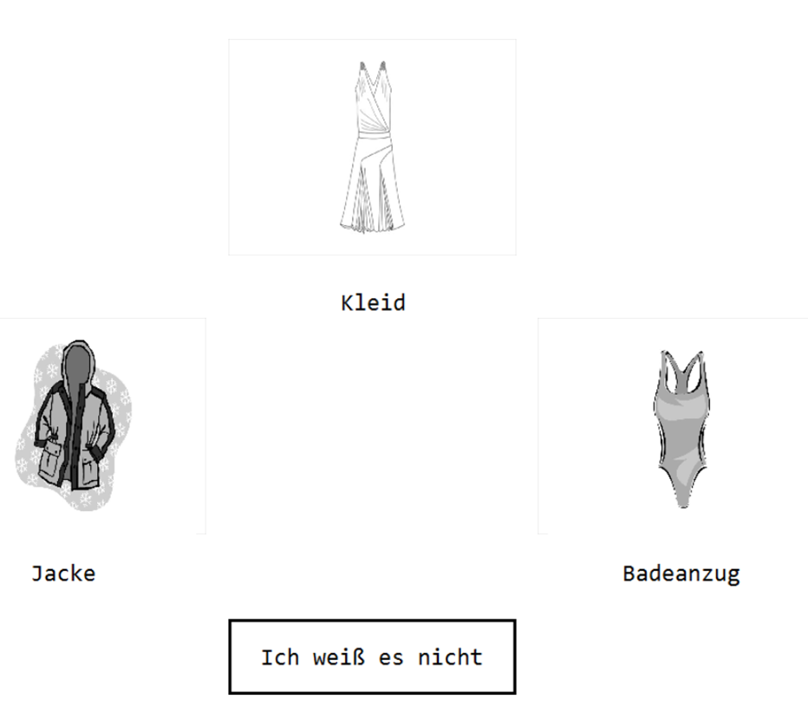
Gender-marked pronouns in German
From Henry (2022)
Sie ist schick.
It_{FEM} is fashionable.

Slide 20
Where does PI fit in a communicative classroom?

Slide 21
Long’s methodological principles (2009)
Input
Use task, not text, as the unit of analysis.
Promote learning by doing.
Elaborate input (do not simplify; do not rely solely on “authentic” texts).
Provide rich (not impoverished) input.
Learning processes
Encourage inductive (“chunk”) learning.
Focus on form.
Provide negative feedback.
Respect “learner syllabuses”/ developmental processes.
Promote cooperative/ collaborative learning.
Learners
Individualize instruction (psycholinguistically, and according to communicative needs).
Focus on Form – NOT FormS
Notes:
Focus on Form Instruction: Instruction in which learners to focus on forms in isolation. This often, for example has learners working with paradigms—verb charts and the like—and applying explicit information to decontextualized examples.
Processing Instruction doesn’t do this: Rather it focuses on the meaning imparted by forms and their communicative function. It therefore fits Long’s definition of Focus on Form, in that learners’ attention brought to the meaning of the form, which appears to cause trouble and is likely to be useful in future communication.
In some ways it differs from Long’s definition (it’s not usually reactive, it’s not usually embedded in input); and some might call this Form Focused Instruction. But at any rate, it clearly fits the broader idea that we can’t just throw grammar instruction out entirely. We just have to be intentional about the ways we do it.

Slide 22
Swan (1998): Seven bad reasons for teaching grammar – and two good ones
“Bad Reasons”
“Good Reasons”
Because it’s there
It’s tidy
It’s testable
Grammar as a security blanket
It formed my character
You have to teach the whole system
Power
Comprehensibility
Acceptibility
Processing Instruction

Slide 23
To Conclude: some general thoughts
Most narrowly: Insights from psycholinguistic research can lead to some types of instruction that help learners acquire linguistic structures and change how they interact with input.
Zooming Out: Communication is not all about speaking.
  It’s about interpreting language for meaning, too.
Most broadly: Classroom instruction must be concerned with how learners engage and interact with the tasks they are given.
  The question we have to ask ourselves is: is this task or activity promoting the type of engagement we want out of our students?

Slide 24
References
Benati, A. G. (2001). A comparative study of the effects of processing instruction and output-based instruction on the acquisition of the Italian future tense. Language Teaching Research, 5(2), 95–127. https://doi.org/10.1177/136216880100500202
Benati, A. G. (2005). The effects of processing instruction, traditional instruction and meaning-output instruction on the acquisition of the English past simple tense. Language Teaching Research, 9(1), 67–93.
Benati, A. G. (2009). Japanese language teaching: A communicative approach. Continuum.
Benati, A. G. (2015). The effects of re-exposure to instruction and the use of discourse-level interpretation tasks on processing instruction and the Japanese passive. International Review of Applied Linguistics in Language Teaching, 53(2), 127–150. https://doi.org/10.1515/iral-2015-0007
Benati, A. G., & Angelovska, T. (2015). The effects of Processing Instruction on the acquisition of English simple past tense: Age and cognitive task demands. IRAL - International Review of Applied Linguistics in Language Teaching, 53(2), 249–269. https://doi.org/10.1515/iral-2015-0012
Benati, A. G., & Lee, J. F. (2010). Processing instruction and discourse. Continuum.
Cadierno, T. (1995). Formal instruction from a processing perspective: An investigation into the Spanish past tense. The Modern Language Journal, 79(2), 179–193.
Cameron, R. D. . (2011). Native and nonnative processing of modality and mood in Spanish. (Unpublished Doctoral Dissertation). Florida State University. Talahassee, FL.

Slide 25
References
Cheng, A. C. (2002). The effects of Processing Instruction on the acquisition of ser and estar. Hispania, 85(2), 308–323.
Cheng, A. C. (2004). Processing Instruction and Spanish ser an estar: Forms with semantic-aspectual values. In B. VanPatten (Ed.), Processing Instruction: Theory, Research, and Commentary. Lawrence Erlbaum.
Collentine, J. (1998). Processing Instruction and the Subjunctive. Hispania, 81(3), 576–587.
Dracos, M. J., & Henry, N. (2018). The effects of task-essential training on L2 processing strategies and the development of Spanish verbal morphology. Foreign Language Annals, 51(2), 344–368. https://doi.org/10.1111/flan.12341
Dracos, M. J., & Henry, N. (2021). The role of task-essential training and working memory in offline and online morphological processing. Languages, 6(1), 24.
Farley, A. P. (2001). Authentic Processing Instruction and the Spanish subjunctive. Hispania, 84(2), 289–299.
Fernández, C. (2008). Reexamining the role of explicit information in Processing Instruction. Studies in Second Language Acquisition, 30, 277–305. https://doi.org/10.1017/S0272263108080467
Gass, S. M. (1987). The resolution of conflicts among competing systems: A bidirectional perspective. Applied Psycholinguistics, 8(4), 329–350. https://doi.org/10.1017/S0142716400000369
Henry, N. (2015). Morphosyntactic processing, cue interaction, and the effects of instruction: An investigation of processing instruction and the acquisition of case markings in L2 German. (Unpublished Doctoral Dissertation). The Pennsylvania State University. University Park, PA.
Henry, N. (2022a). The offline and online effects of Processing Instruction. Applied Psycholinguistics, 43, 945–971.
Henry, N. (2022b). The additive use of prosody and morphosyntax in L2 German. Studies in Second Language Acquisition, First View, 1–22. https://doi.org/10.1017/S0272263122000092

Slide 26
References
Henry, N. (2022c). The effects of Processing Instruction on the acquisition and processing of grammatical gender in German. Language Teaching Research, 136216882210963. https://doi.org/10.1177/13621688221096368
Henry, N., Jackson, C. N., & DiMidio, J. (2017). The role of prosody and explicit instruction in Processing Instruction. Modern Language Journal, 101(2), 1–21.
Isabelli, C. A. (2008). First Noun Principle or L1 Transfer Principle in SLA? Hispania, 91(2), 465–478.
Issa, B. I., & Morgan-Short, K. (2019). Effects of external and internal attentional manipulations on second language grammar development. Studies in Second Language Acquisition, 41(2), 389–417. https://doi.org/10.1017/S027226311800013X
Jackson, C. N. (2007). The Use and Non-Use of Semantic Information , Word Order , and Case Markings During Comprehension by L2 Learners of German. The Modern Language Journal, 91(3), 418–432.
Lee, J. F. (2015). Processing instruction on the Spanish passive with transfer-of-training effects to anaphoric and cataphoric reference contexts. International Review of Applied Linguistics in Language Teaching, 53(2), 203–223. https://doi.org/10.1515/iral-2015-0010
Lee, J. F., & Benati, A. G. (2007). Delivering processing instruction in classrooms and virtual contexts: Research and practice. Equinox.
LoCoco, V. (1987). Learner comprehension of oral and written sentences in German and Spanish: The importance of word order. In B. VanPatten, T. Devorak, & J. F. Lee (Eds.), Foreign language learning: A research perspective (pp. 119–129). Newbury House.
Long, M. H. (2009). Methodological Principles for Language Teaching. The Handbook of Language Teaching, 371–394. https://doi.org/10.1002/9781444315783.ch21
Marsden, E. (2006). Exploring input processing in the classroom: An experimental comparison of processing instruction and enriched input. Language Learning, 56(3), 507–566. https://doi.org/10.1111/j.1467-9922.2006.00375.x

Slide 27
References
Marsden, E., & Chen, H. Y. (2011). The roles of structured input activities in processing instruction and the kinds of knowledge they promote. Language Learning, 61(4), 1058–1098. https://doi.org/10.1111/j.1467-9922.2011.00661.x
McManus, K., & Marsden, E. (2017). L1 explicit instruction can improve L2 online and offline performance. Studies in Second Language Acquisition, 39(3), 459–492. https://doi.org/10.1017/s027226311600022x
Sagarra, N., Cravetz, A., & Pfursich, J. (2006). Proficiency level and morphosyntactic processing: Evidence from eye movement records.
Sanz, C. (1997). Experimental tasks in SLA research: Amount of production, modality, memory, and production processes. In W. R. Glass & A. T. Perez-Leroux (Eds.), Contemporary perspectives on the acquisition of Spanish. Cascadilla Press.
Sanz, C. (2004). Computer delivered implicit vs. Explicit feedback in processing instruction. In B. VanPatten (Ed.), Processing Instruction: Theory, Research, and Commentary (pp. 245–259). Lawrence Erlbaum.
Sanz, C., & Morgan-Short, K. (2004). Positive evidence versus explicit rule presentation and explicit negative feedback: A computer-assisted study. Language Learning, 54(1), 35–78. https://doi.org/10.1111/j.1467-9922.2004.00248.x
Seibert Hanson, A. E. (2012). How second language learners process argument structure: The effects of first language and individual differences (Issue August). (Unpublished Doctoral Dissertation). The Pennsylvania State University. University Park, PA.
Swan, M., Richards, J. C., & Renandya, W. A. (2002). Seven bad reasons for teaching grammar – and two good ones. In Methodology in language teaching: An anthology of current practice (pp. 148–152). Cambridge University Press.
VanPatten, B. (1996). Input processing and grammar instruction in second language acquisition. Alex Publishing Corperation.
VanPatten, B. (2004). Input Processing in second language acquisition. In B. VanPatten (Ed.), Processing Instruction: Theory, Research, and Commentary (pp. 5–31). Lawrence Erlbaum.

Slide 28
References
VanPatten, B. (2015). Foundations of processing instruction. International Review of Applied Linguistics in Language Teaching, 53(2), 91–109. https://doi.org/10.1515/iral-2015-0005
VanPatten, B., & Cadierno, T. (1993). Explicit instruction and input processing. Studies in Second Language Acquisition, 15, 225.
VanPatten, B., Collopy, E., Price, J. E., Borst, S., & Qualin, A. (2013). Explicit information, grammatical sensitivity, and the First-Noun Principle: A cross-linguistic study in Processing Instruction. The Modern Language Journal, 97(2), 506–527. https://doi.org/10.1111/j.1540-4781.2013.12007.x
VanPatten, B., Farmer, J., & Clardy, C. L. (2009). Processing Instruction and Meaning-Based Output Instruction: A response to Keating and Farley (2008). Hispania, 92(1), 116–126.
VanPatten, B., & Fernández, C. (2004). The long-term effects of Processing Instruction. In B. VanPatten (Ed.), Processing Instruction: Theory, Research, and Commentary (pp. 273–289). Lawrence Erlbaum.
VanPatten, B., & Houston, T. (1998). Contextual effects in processing L2 input sentences. Spanish Applied Linguistics, 2(1), 53–70.
VanPatten, B., Inclezan, D., Salazar, H., & Farley, A. P. (2009). Processing instruction and dictogloss: A study on object pronouns and word order in spanish. Foreign Language Annals, 42(3), 557–575. https://doi.org/10.1111/j.1944-9720.2009.01033.x
VanPatten, B., & Keating, G. D. (2007). Getting tense: Lexical preference, L1 transfer, and native and non-native processing of temporal reference. Paper delivered at the annual meeting of the American Association for Applied Linguistics, Costa Mesa, CA.

Slide 29
References
VanPatten, B., & Oikkenon, S. (1996). Explanation versus structured input in processing instruction. Studies in Second Language Acquisition, 18(4), 495–510.
VanPatten, B., & Sanz, C. (1995). From input to output: Processing instruction and communicative tasks. In F. R. Eckman, D. Highland, P. W. Lee, J. Mileham, & R. Rutkowski Weber (Eds.), Second Language Acquisition Theory and Pedagogy. Routledge. https://doi.org/10.4324/9781315044903
VanPatten, B., & Uludag, O. (2011). Transfer of training and processing instruction: From input to output. System, 39(1), 44–53. https://doi.org/10.1016/j.system.2011.01.013
VanPatten, B., & Wong, W. (2004). Processing instruction and the French causative: Another replication. In B. VanPatten (Ed.), Processing Instruction: Theory, Research, and Commentary (pp. 97–118). Lawrence Erlbaum.
Villegas, B., & Morgan-short, K. (2019). The Effect of Training Condition and Working Memory on Second Language Development of a Complex Form: The Spanish Subjunctive. 185–199.
Wong, W., & Ito, K. (2018). The effects of processing instruction and tranditional instruction on L2 online processing of the causative construction in French: An eye-tracking study. Studies in Second Language Acquisition, 40(2), 241–268. https://doi.org/10.1017/S0272263117000274

