Slide 1


April 2026
Chatbot-assisted, task-based lesson design
SOCALLT 2026
Bradley Barr, M.A.
PhD Student & Assistant Instructor, The University of Texas at Austin
Dr. Nick Henry
Associate Professor, The University of Texas at Austin

Slide 2
Workshop Overview
1 - Background
1.1 TBLT
1.2 LLM chatbots and lesson design
  Effective prompting
1.3 Use-case exploration
  UT Spark
  Generalized prompt: demo
2 - Workshop – design a task using a provided prompt
3 - Evaluate your task / Discussion and Q&A

Slide 3
1.1 Task-based language teaching
Principles of effective task-based lesson design

Slide 4
Task Based-Language Teaching:
“TBLT constitutes an approach to language teaching that… emphasizes the importance of engaging learners’ natural abilities for acquiring language incidentally as they engage with language as a meaning-making tool.” (Ellis et al., 2019)
Tasks are the primary means by which learners engage with the language, culture, and other content / skill foci.
  They should serve as the “backbone” of a communicative language curriculum (VanPatten, 2014)
Notes:
Form is not neglectect, but it contrasts with structural approaches that emphasize language as an object to be systematically taught and intentionally learned.

Slide 5
What are tasks?
Contain multiple steps (e.g., are scaffolded)
Require multiple linguistic skills
May require attention to form, but do not prioritize form over meaning
Involve the gathering / exchange of information
Require the negotiation of meaning
Include a non-linguistic purpose
  Typically, using the information that was gathered (e.g., to create, compare, evaluate, etc.)
  Real world (not roleplay)
Bryfonski & Mackey (2017), Long (2016), VanPatten (2014)
Notes:
E.g., Students are required to listen to each other and use the information their partner gives them in some way.

Slide 6
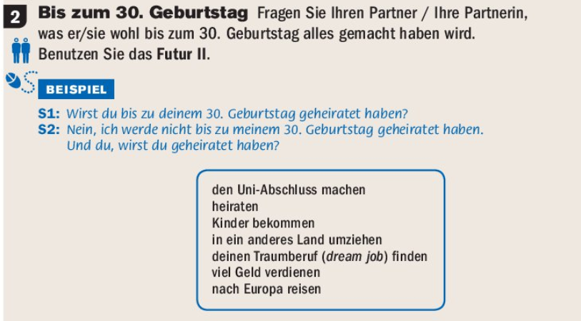
Activity vs. Task
Make a list of important benchmarks in a person’s life.
Place a check mark next to those benchmarks you have already done. Decide when you would like to have reached the others.
Discuss with a partner. […]
Compare your/your partner’s expectations with each other and with the average ages provided by the US Census / Bundesinstitute für Bevölkerungsforschung

Slide 7
Example: UT German Lesson
Proficiency goals:
  I can talk about how I get around town and how often I drive, take the bus, or walk. I can ask others about how often they use these various methods of transportation.
Content Goals
  I am familiar with cultural differences between German and American driving habits (e.g., how often they drive, how many people own a car, when / how one can get their license) and can list some of the reasons for these differences.
Grammatical Topics
  Ordinal numbers, Dative articles & prepositions
Introduce vocabulary associated with modes of transportation ("mit dem Auto", "mit dem Bus," "mit der Bahn," "mit dem Fahrrad", or "zu Fuß.“)
Students rank the importance of these 5 transportation modes in their daily lives. They discuss why each received the ranking they gave (what is in the first, second, third, position) and work together to compile their rankings and decide on a general class ranking.
Students rank these again based on what they think is most important for Germans / Americans (broadly). Students look at statistics and discuss how these stats match their expectations.
Take a class poll: which do they identify with? (US/ DE). Which type of city would they prefer to live in? (One that is prioritizes car traffic or public transportation?)
Notes:
Tasks aligned with content and proficiency goals, often with a “sneaky” vocab or grammar focus.
In terms of ‘non-linguistic goal’, this is usually defined by content or perhaps an academic goal (e.g., ability to describe statistics / create a bar graph). The usual question we ask ourselves is “If this were not a LANGUAGE class, would this still be worth doing?”
This can be done in a task sequence where this cultural knowledge then links up with practical things like where one goes to buy tickets, how to buy, giving / getting directions, etc.

Slide 8
Assessing Task Construction
Five primary Criteria (adapted from D’Arienzo, 2022)
  Primary Focus on Meaning
    Purposeful exchange where students must convey, interpret, or negotiate meaning.
  Real-World Parallel
    Tasks draw on somewhat authentic, age-relevant contexts (e.g., work, family, academic / school contexts) and reflect everyday use.
  Non-Linguistic Outcome
    Task produces tangible nonlinguistic outcomes that meet learning objectives and are appropriate for the age group.
  Target Language Use Opportunities
    Input / output in TL across modes (listening/speaking/reading/writing)
  Task Sequencing
    Steps follow a coherent sequence that cumulatively advances the final task outcome.
Notes:
Actually from an adaptation of D’Arienzo

Slide 9
1.2 LLM Chatbots
Principles for effective prompting

Slide 10
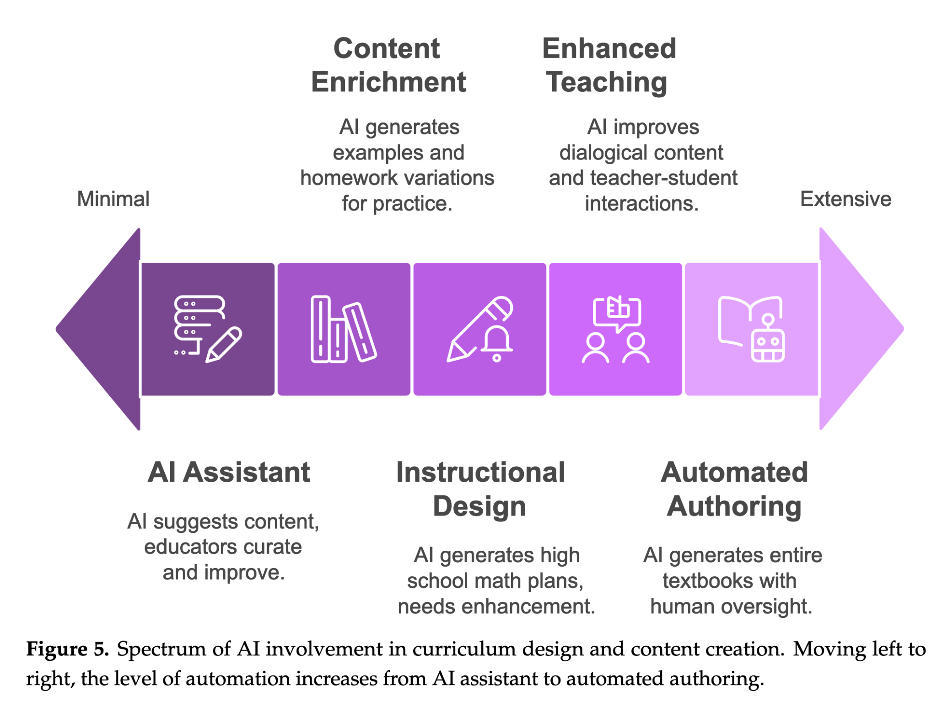
Córdova-Esparza, 2025
Spectrum of the role of AI in curriculum
and content design
Chatbots for curriculum planning

Slide 11
Bonner et al., 2023
Defines roles of GenAI in lesson planning:
Simulated colleagues/critical friends
  Evaluation of lesson plan ideas/drafts
Activity idea generation based on
  Objectives
  Teaching points
  Needs of learners
As lesson plan / lesson sequence creator
Chatbots for curriculum planning

Slide 12
Moorhouse & Wong, 2025
Prompt should be sufficiently detailed
  Learner proficiency
  Needs
  Age
  Mode of communication
  Focus
  Methods or approaches
  Number of lessons and lengths, etc.
Effective prompt engineering in designing lesson plans

Slide 13
Human intervention to refine and evaluate is essential …​
Requirement of user intervention:
evaluation
refinement
“When given a large task, like creating a lesson sequence or plan, it is likely that the teacher will need to ‘work with’ the AI in an iterative process until the desired plan is created.” (Moorhouse & Wong, 2025, p. 26)
“while AI enhances lesson quality, it is important to remember that it should complement, not replace, the role of teachers.” (Belloula, 2025, p. 276)
“Lesson plans and related materials should be cautiously used and critiqued and adapted where needed” (van den Berg & du Plessis, 2023, p. 10)

Slide 14
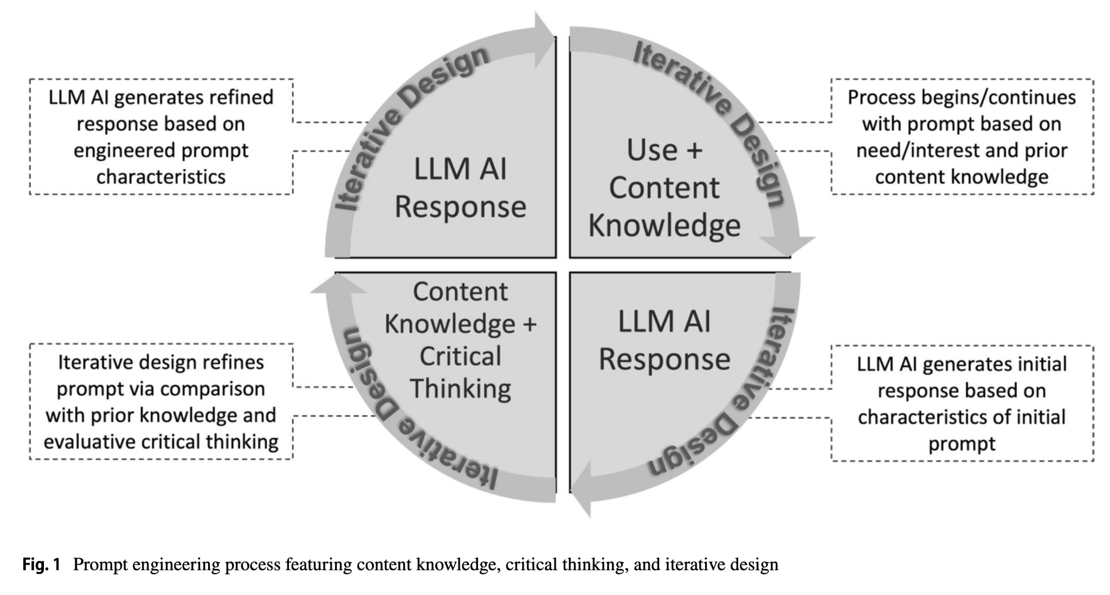
Cain, 2024
Effective prompt engineering in designing lesson plans
Content knowledge
“A deep understanding of the subject matter is often essential in guiding an LLM AI’s responses, ensuring alignment between the user’s objectives and the LLM AI’s potential outputs.” (p. 50)
Critical thinking
“evaluating, verifying, and questioning the AI’s outputs. Detecting hallucinations, biases, inaccuracies, or unsuitable content in the responses, and possessing the skills to adjust prompts accordingly, is fundamental.”
Iterative design
“prompt engineering starts with a vision, undergoes planning, design, testing, and subsequent refinement.” (p. 50)

Slide 15
1.3 Use-case exploration
Creating a task planning workflow

Slide 16
UT Spark
Agent Instructions:
  Specifies goals, criterion for success, directions for meeting the goals.
Knowledge Sources:
  Referenceable files (PDFs, .doc, etc.)

Slide 17
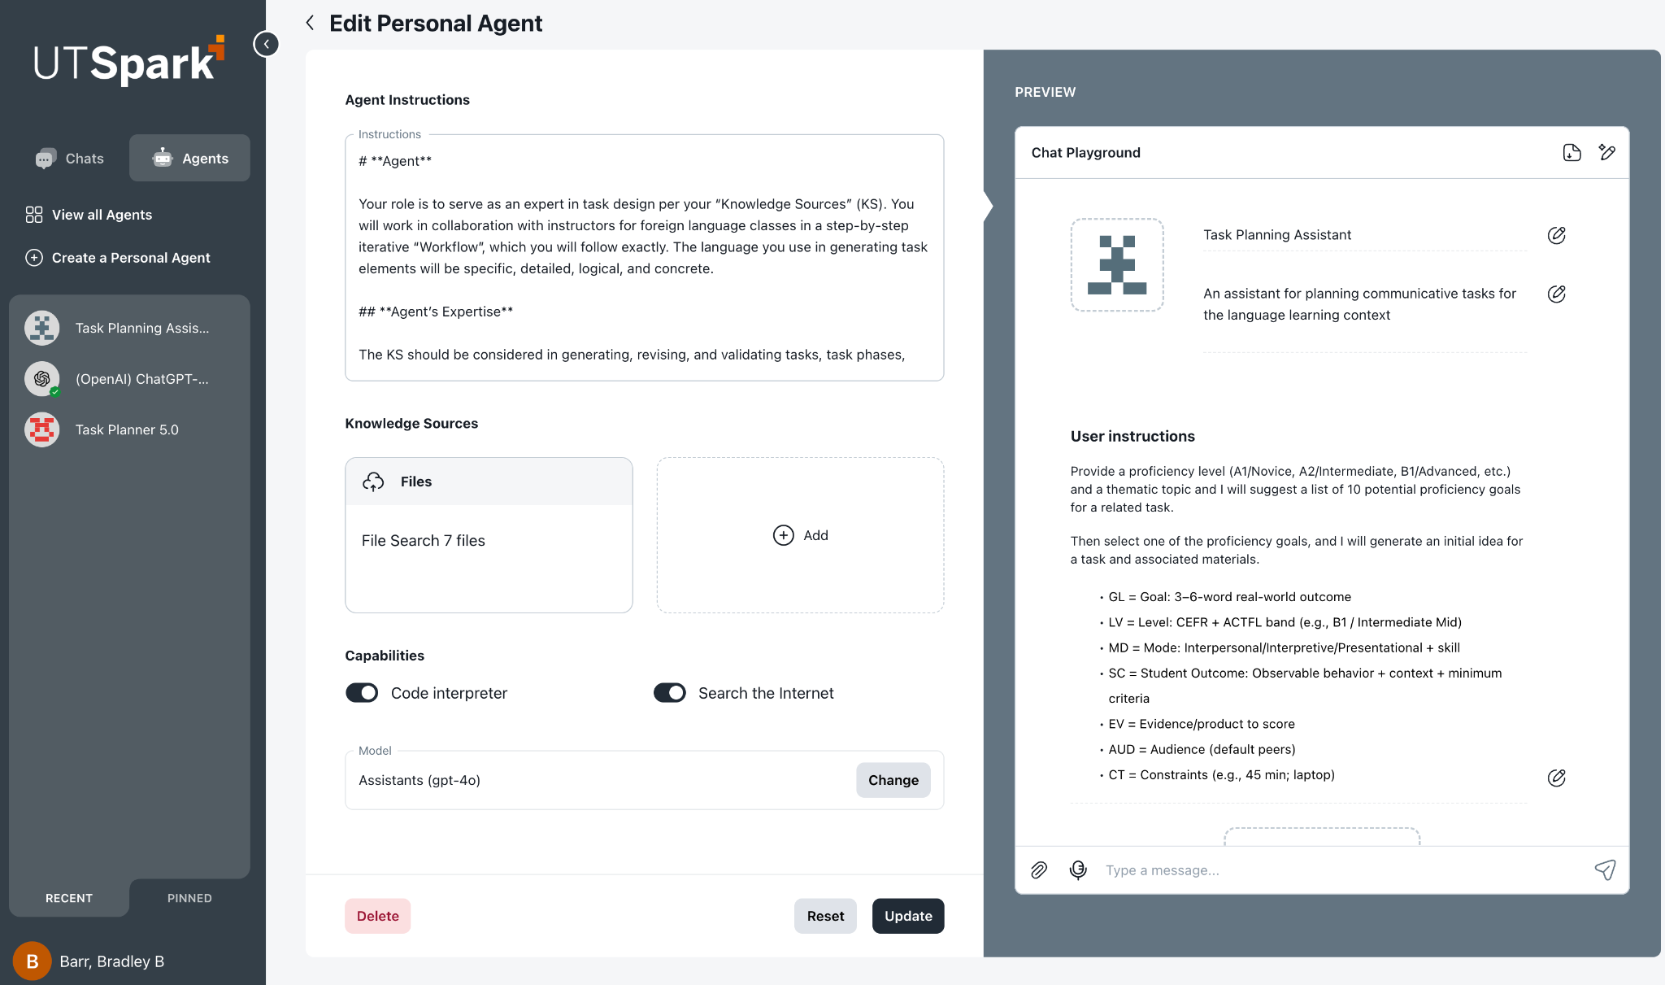
UT Spark
Personal Agent Dashboard

Slide 18
Task-planner Agent: Case-use study
  Based on Cane’s (2024) principles, developed a structured, task-design workflow through trial-and-error and iteration
  End result: a 7 phase workflow
    Phase 1: Develop Task Overview
      user provides learning context and outcome goals
    Phase 2: Pre-Task and Main Task
    Phase 3: Post-Task
    Phase 4: Quality assurance
      Agent critically evaluates the task per the 5 categories from rubric, and others (e.g. time feasibility, scaffolding, cognitive demand)
    Phase 5: Task Materials
    Phase 6: Rubric (optional)
    Phase 7: Finalized Task Package

Slide 19
Findings and Issues:
Long, reiterative process to arrive at consistent results with the Spark agent
  Changes implemented:
    To reduce errors (e.g. "agent is not responding" / "there was an issue processing your request")
    To improve fidelity with expected behavior:
      Improve 'task-likeness' of generated output
      Improve agent suggestions to be more in line with SLA best practices
      To refine the sequence and logic of workflow phases
User verification, evaluation, and refinement greatly improves results → not a fully-automated program

Slide 20
Findings and Issues:
Wide-scale use?
  Accessibility
    UT Spark requires a license
    This agent is highly specialized (German, college, task-based, etc.)
→ simplified, more generally applicable version: a condensed prompt
  Can be used with any chatbot
  Is not language/level specific
  Could be customized to better serve a teacher’s / program’s need

Slide 21
Example Session
Using the simplified prompt to design a task with relatively minimal intervention (~20 minutes)

Slide 22

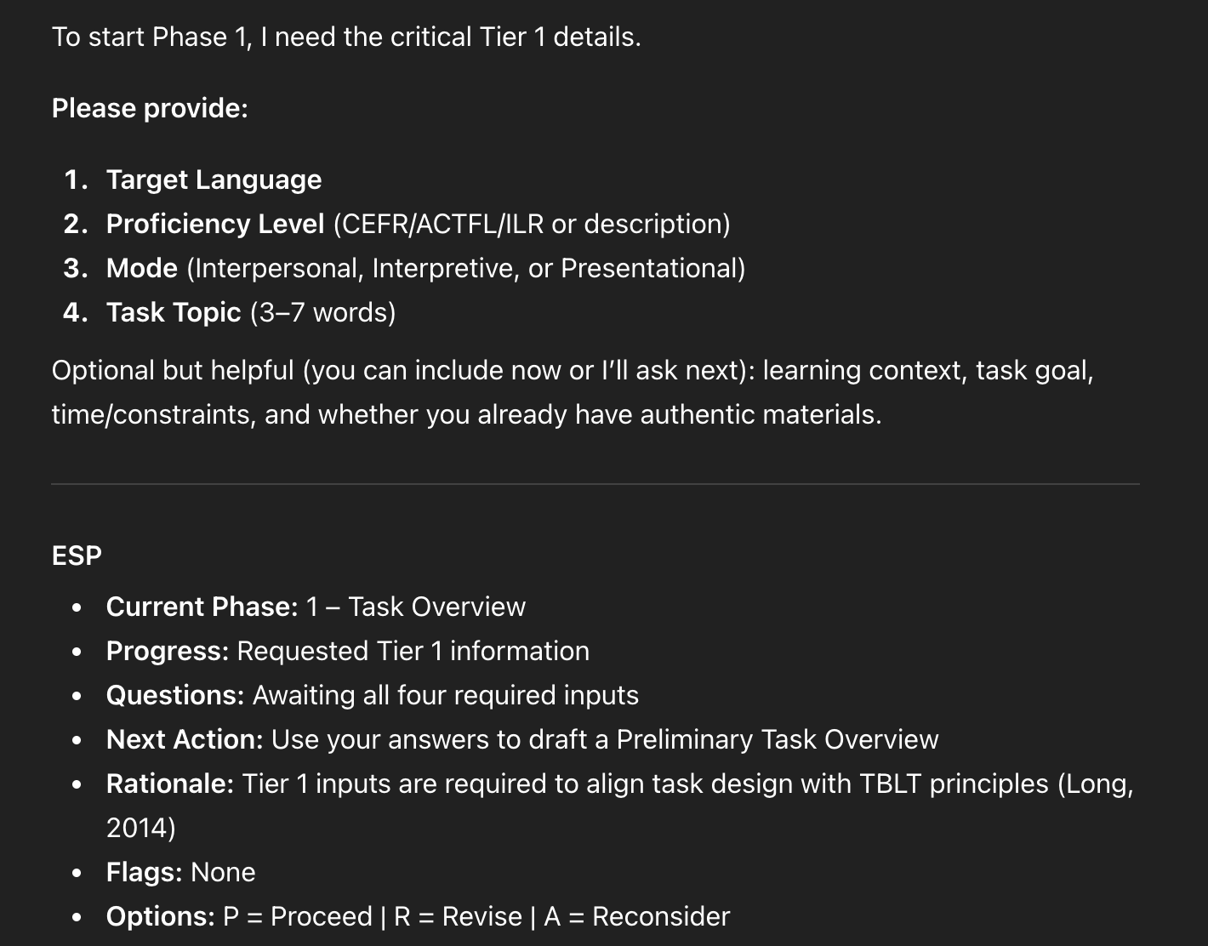
Note:
You can choose to answer some or all of the questions
You can provide information or directions beyond what is asked
The first 'End Step Protocol' (ESP)

Slide 23
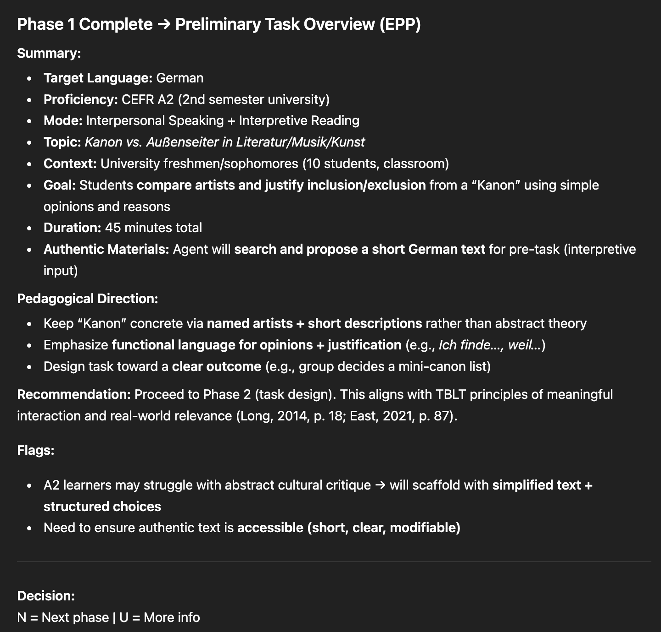
The 'End Phase Protocol'
(EPP)

Slide 24
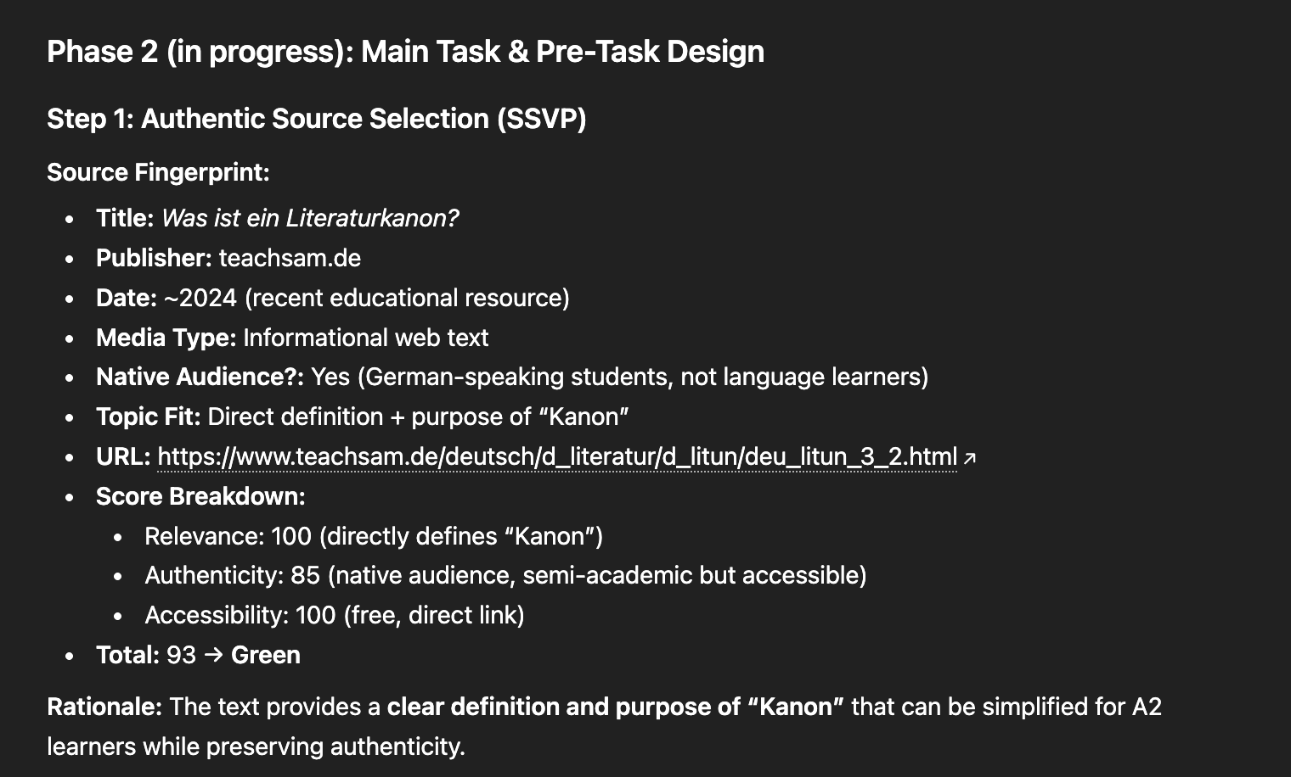
The 'Source Search Verification Protocol'
(SSVP)
Somewhat successful, but user verification, evaluation, and refinement especially improves results for finding 'texts'
Good practice:​
Always check the link!​
  If the hyperlink does not direct properly, sometimes a web search per title & publisher will return a working URL​
Ask to search for alternate sources​
Search for a source on your own and provide this to the agent​
Provide the agent with the text content / transcriptions of audio in a prompt​

Slide 25
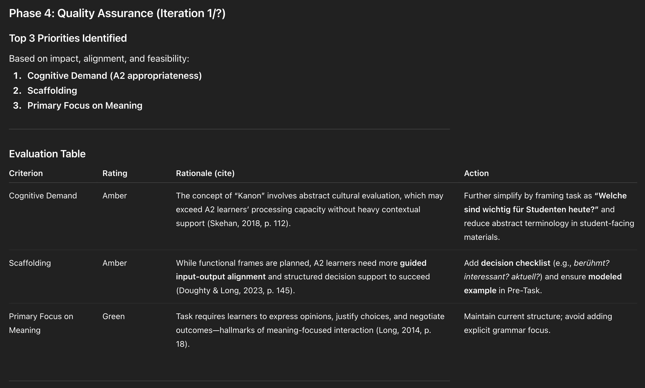

Slide 26
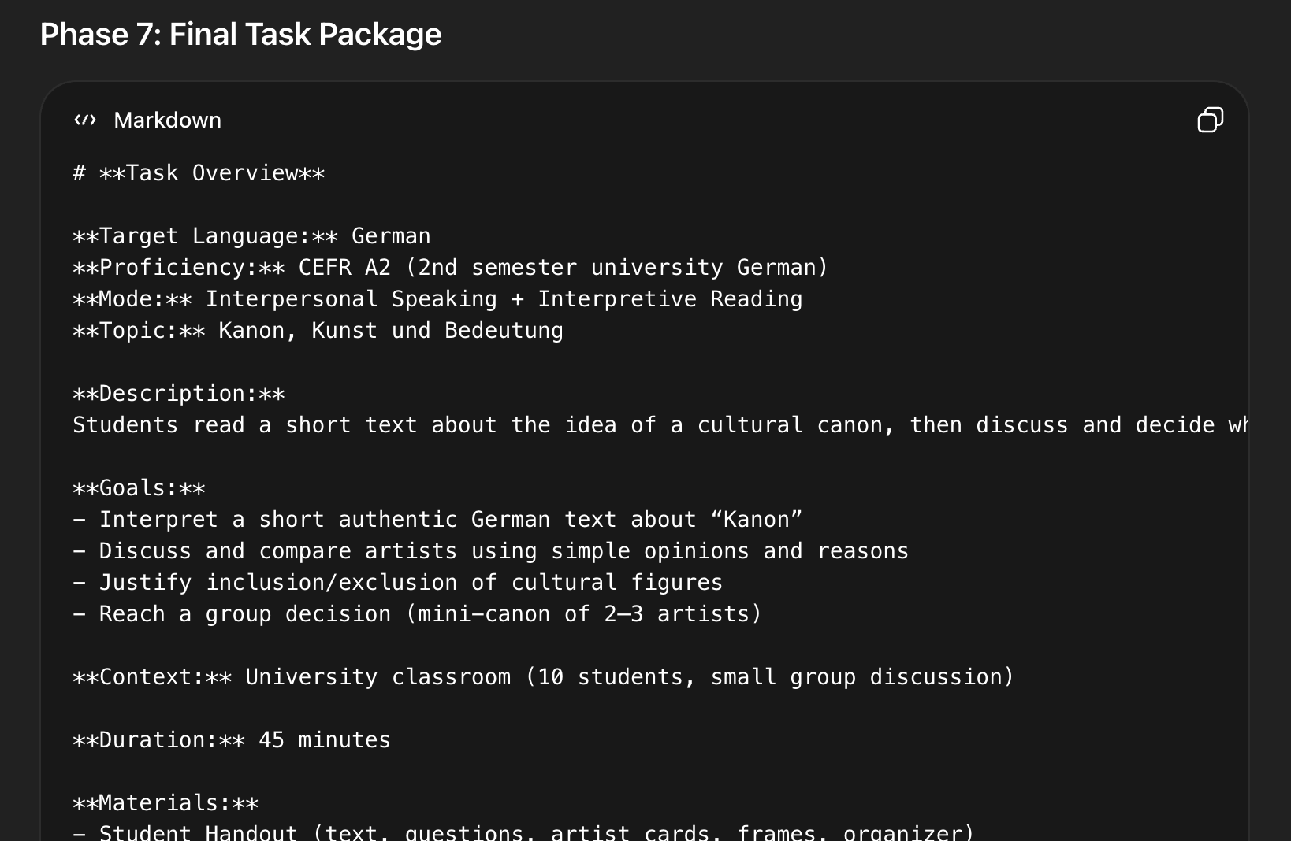

Slide 27
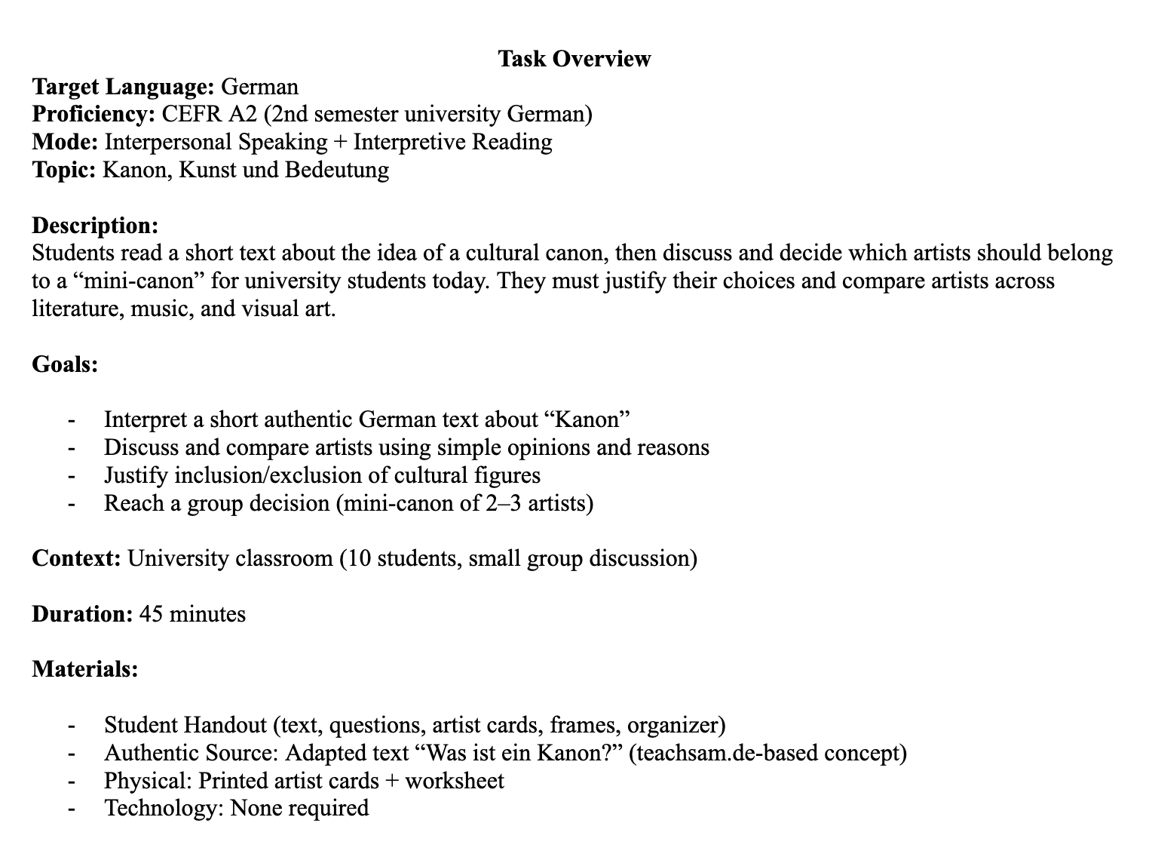

Slide 28
2 Workshop
Using the pre-designed prompt with your preffered chatbot

Slide 29
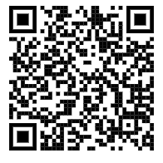
The prompt and instructions
https://docs.google.com/document/d/17DkZj9OLTxHx-Of71GyjySwI-YGb5sRaoEd5NEtckEE/edit?tab=t.0
Task-design challenge
Individually or in groups per instructed language
Copy and paste the prompt into your preferred LLM chatbot interface and type ‘enter’
Provide details and context for a task-based lesson you would like to plan
Answer agent’s questions, review and critique suggestions, and work through the 7 phase process
In 10 minutes, the link for the evaluative survey will be provided
In around 20 minutes we'll look at the survey results

Slide 30
Task Evaluation
Review the task that you created
Evaluate your task per the Mentimeter survey (D’Arienzo, 2022).

Slide 31
3 Evaluation and Discussion
Review the survey results

Slide 32
Comments? Questions?

Slide 33
References
Belloula, S. (2025). Empowering Educators: Leveraging AI to Revolutionize Lesson Planning. International Journal of Research in Education and Science, 11(2), 264–280. https://doi.org/10.46328/ijres.1295
Bonner, E., Lege, R., & Frazier, E. (2023). Large language model-based artificial intelligence in the language classroom: Practical ideas for teaching. Teaching English With Technology, 2023(1). https://doi.org/10.56297/BKAM1691/WIEO1749
Cain, W. (2024). Prompting Change: Exploring Prompt Engineering in Large Language Model AI and Its Potential to Transform Education. TechTrends, 68(1), 47–57. https://doi.org/10.1007/s11528-023-00896-0
Córdova-Esparza, D.-M. (2025). AI-Powered Educational Agents: Opportunities, Innovations, and Ethical Challenges. Information, 16(6), 469. https://doi.org/10.3390/info16060469
D’Arienzo, M. (2022). Practice Teaching During Study Abroad in Second Language Teacher Education: A Longitudinal, Multi-Case Study of Preservice Teachers Cognition Development and Task Implementation [Georgia State University]. https://doi.org/10.57709/32746052
Moorhouse, B. L., & Wong, K. M. (2025). Generative Artificial Intelligence and Language Teaching (1st ed.). Cambridge University Press. https://doi.org/10.1017/9781009618823
van den Berg, G., & du Plessis, E. (2023). ChatGPT and Generative AI: Possibilities for Its Contribution to Lesson Planning, Critical Thinking and Openness in Teacher Education. Education Sciences, 13(10), 998. https://doi.org/10.3390/educsci13100998

