Slide 1
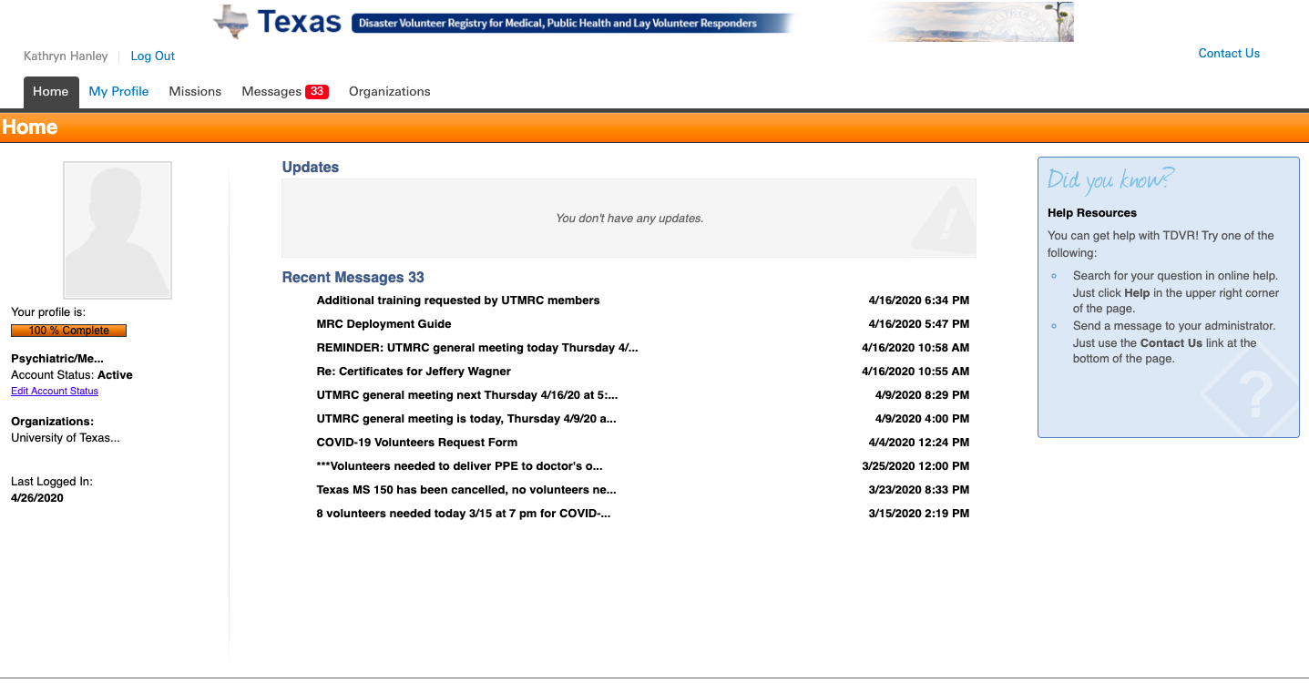
1-Log into your TDVR account
2-Select My Profile

Slide 2
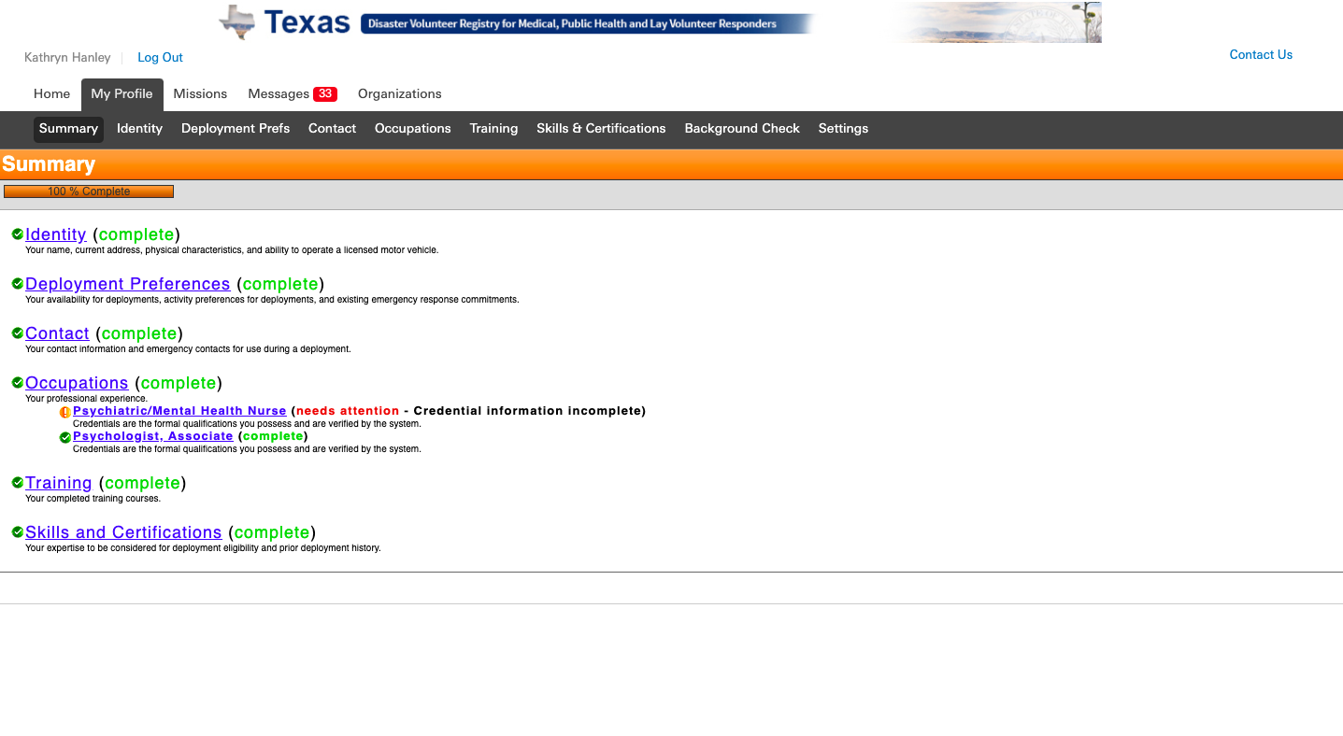
3- Select Training tab

Slide 3
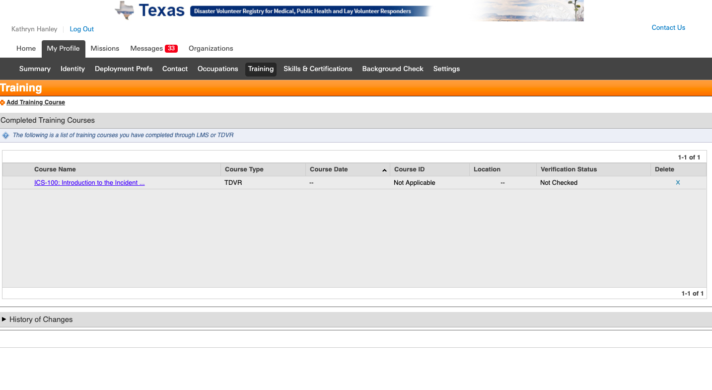
4-Select Add Training Course

Slide 4
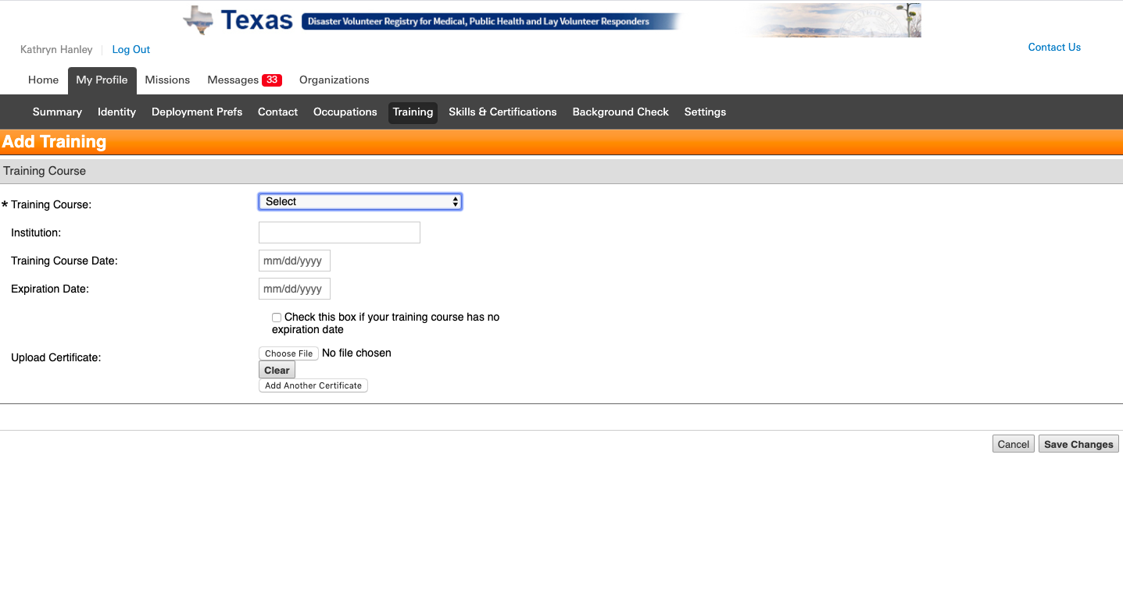
5- Pull down select menu

Slide 5
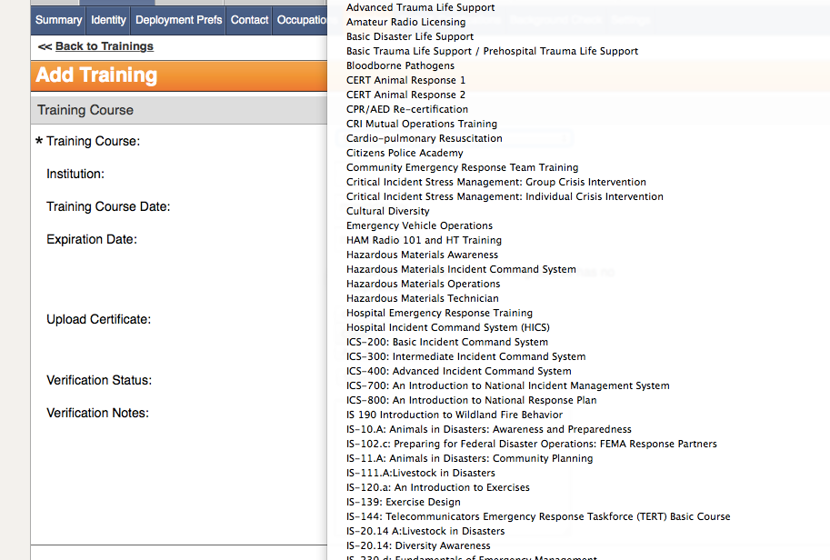
6- Select training you are uploading certificate for

Slide 6
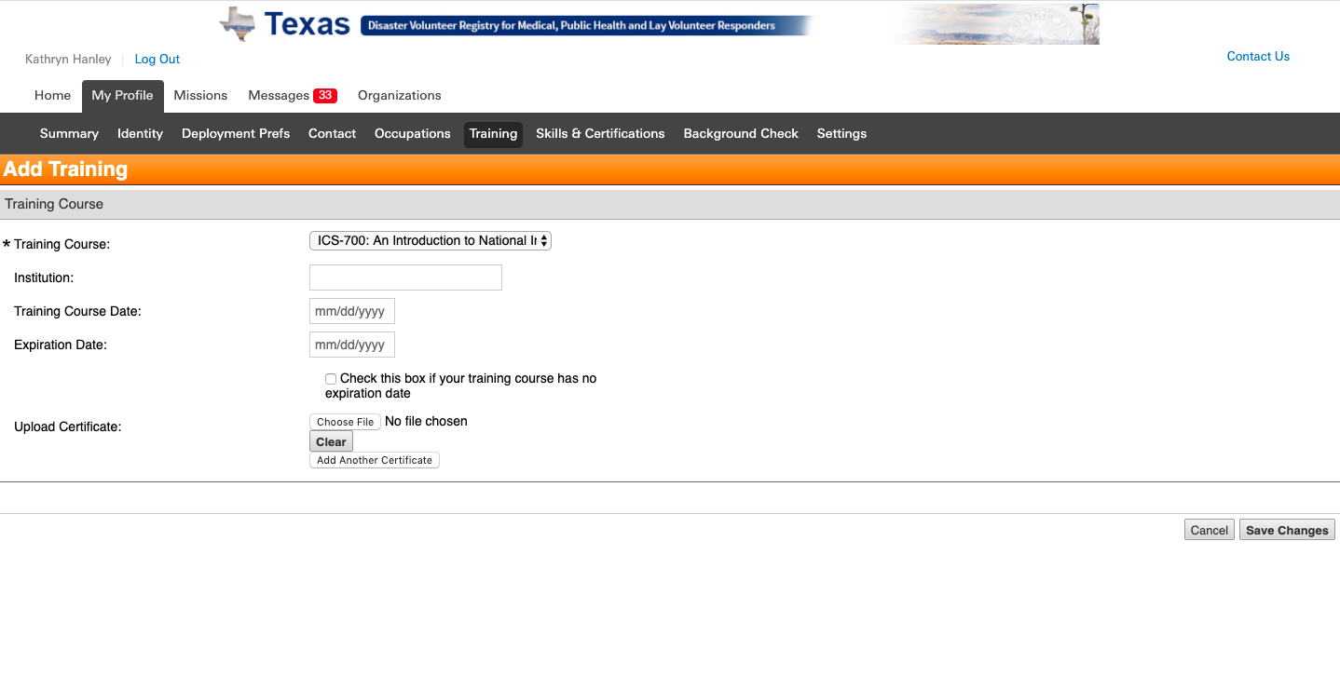
7- Select Choose File

Slide 7
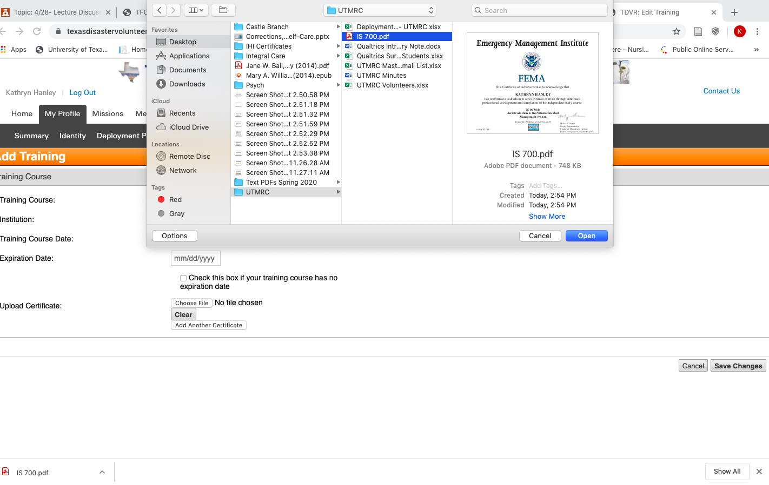
7- Select file that contains your certificate

Slide 8
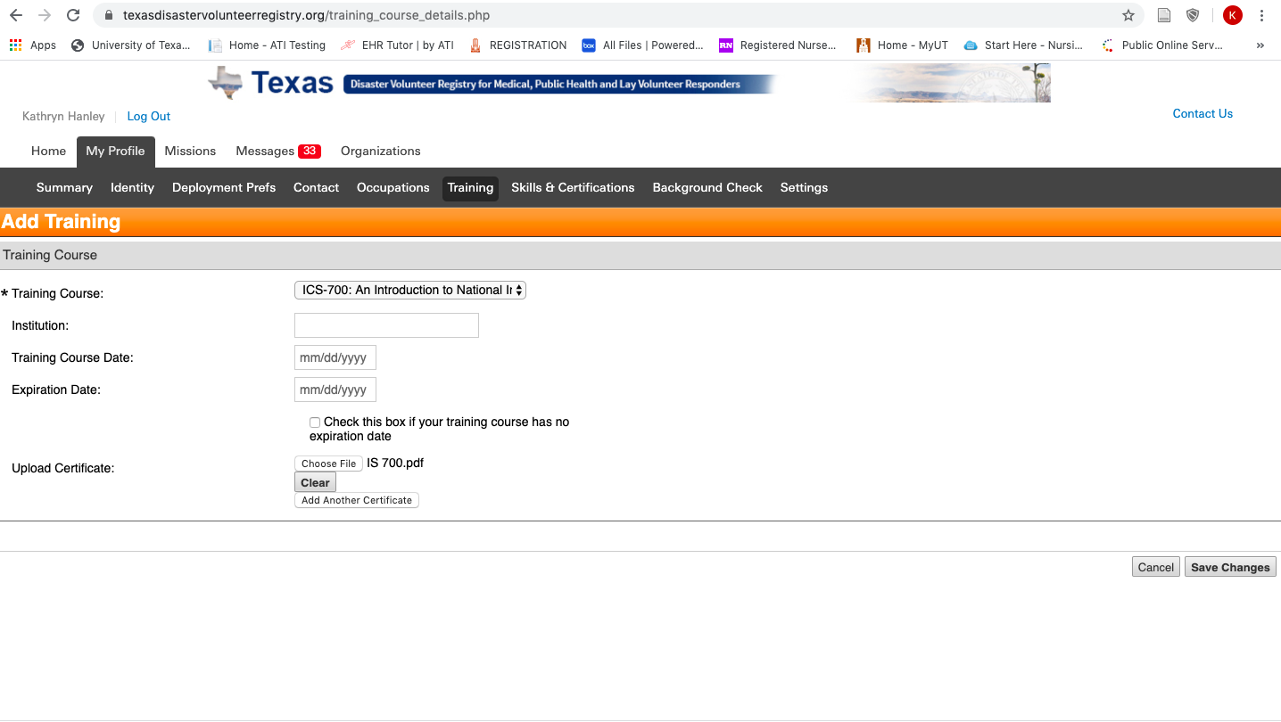
8- Select Save Changes

