Slide 1
CDC COVID-19 Training Certificate
This PowerPoint will help you through the steps required to access the training certificate for:
CDC: COVID-19 Vaccine Training: General Overview of Immunization Best Practices for Healthcare Providers

Slide 2
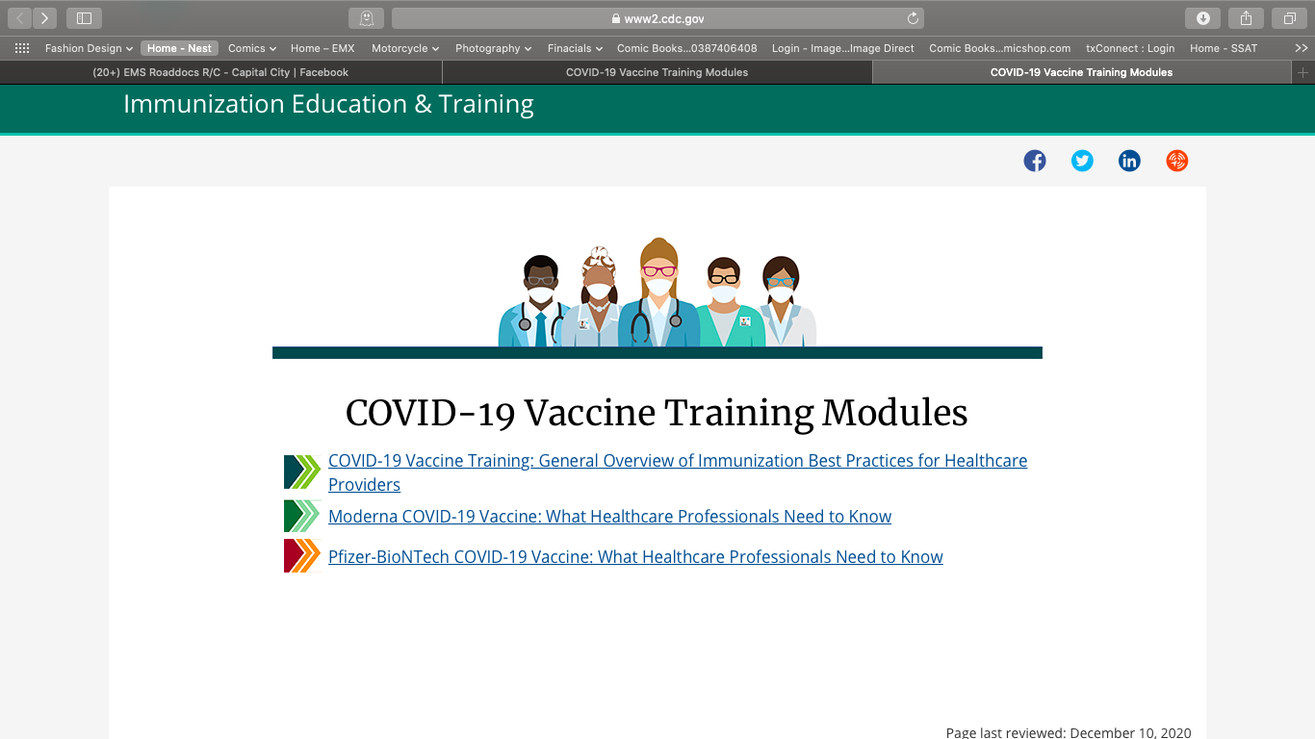
Select the training module you wish to take.

Slide 3
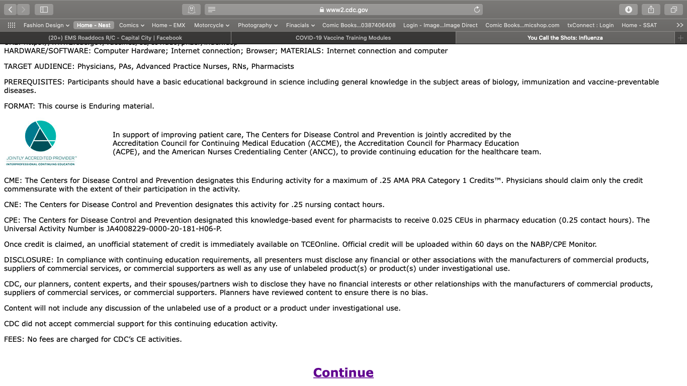
Click ”Continue”

Slide 4
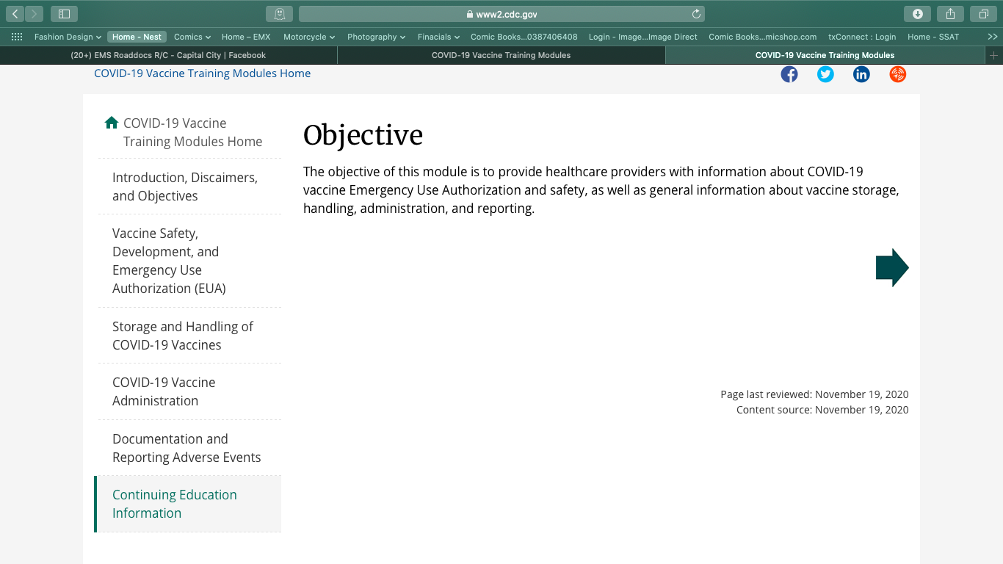
Select “Continuing Education Information”

Slide 5
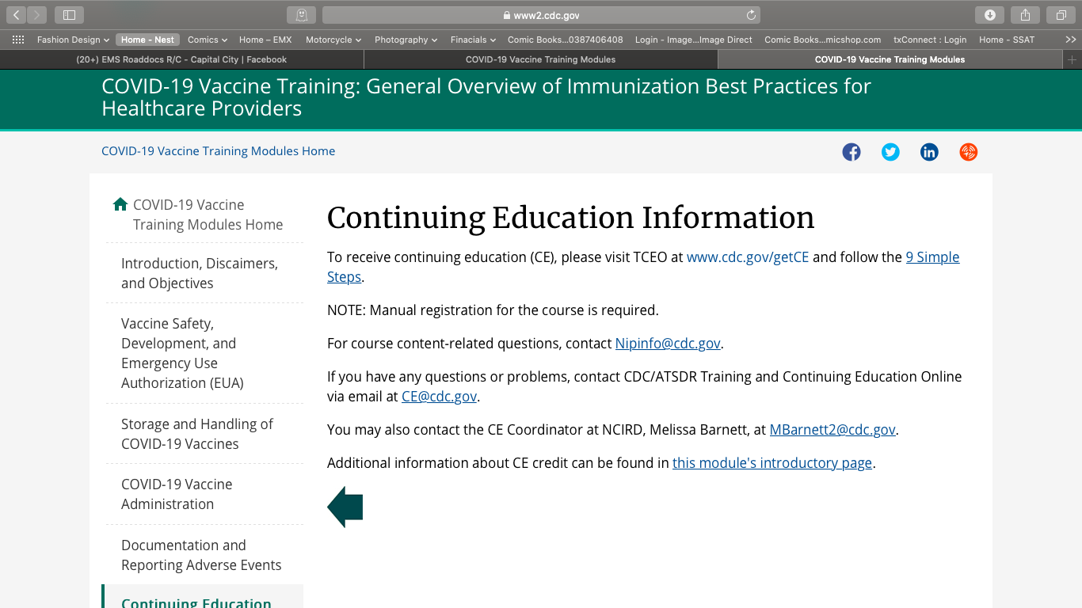
Select “cdc.gov/getCE” hyperlink

Slide 6
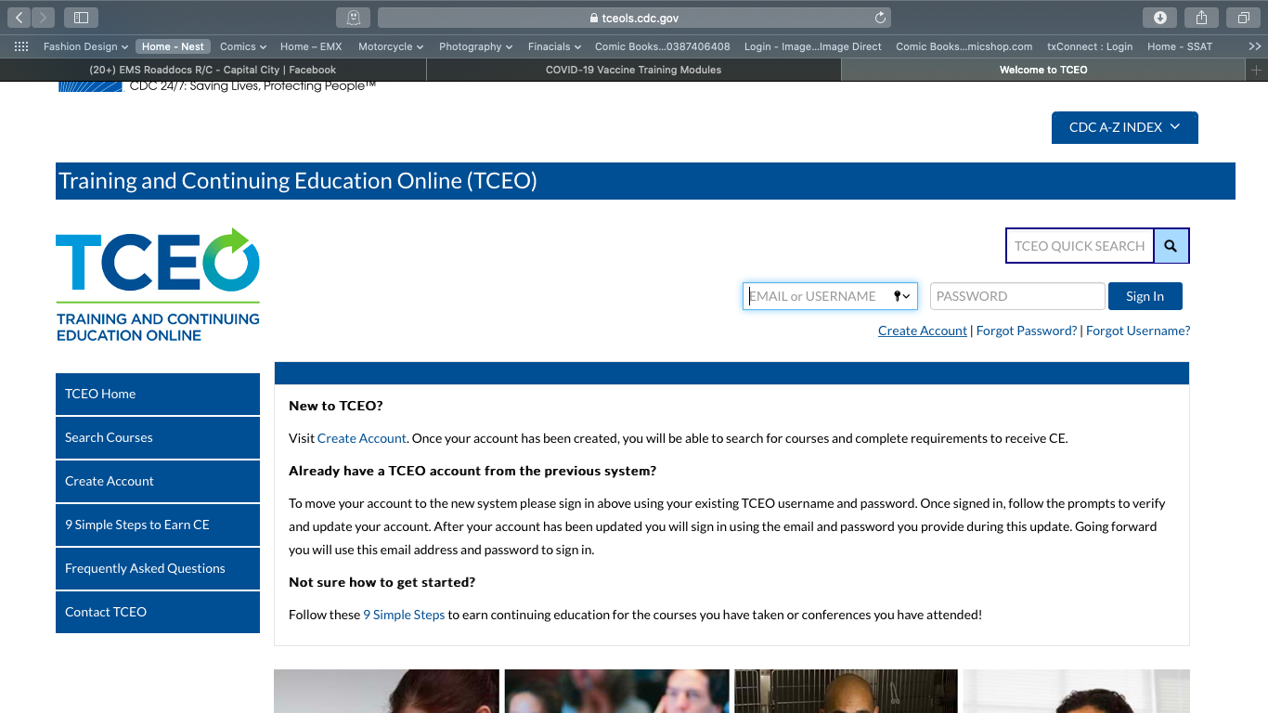
Create an Account

Slide 7
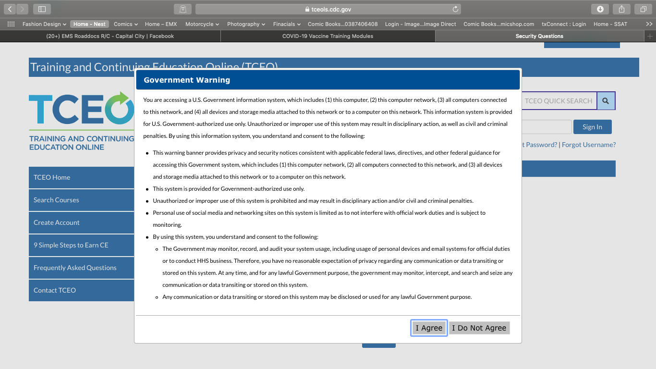
Agree to Terms

Slide 8

Log in to your new Account.

Slide 9
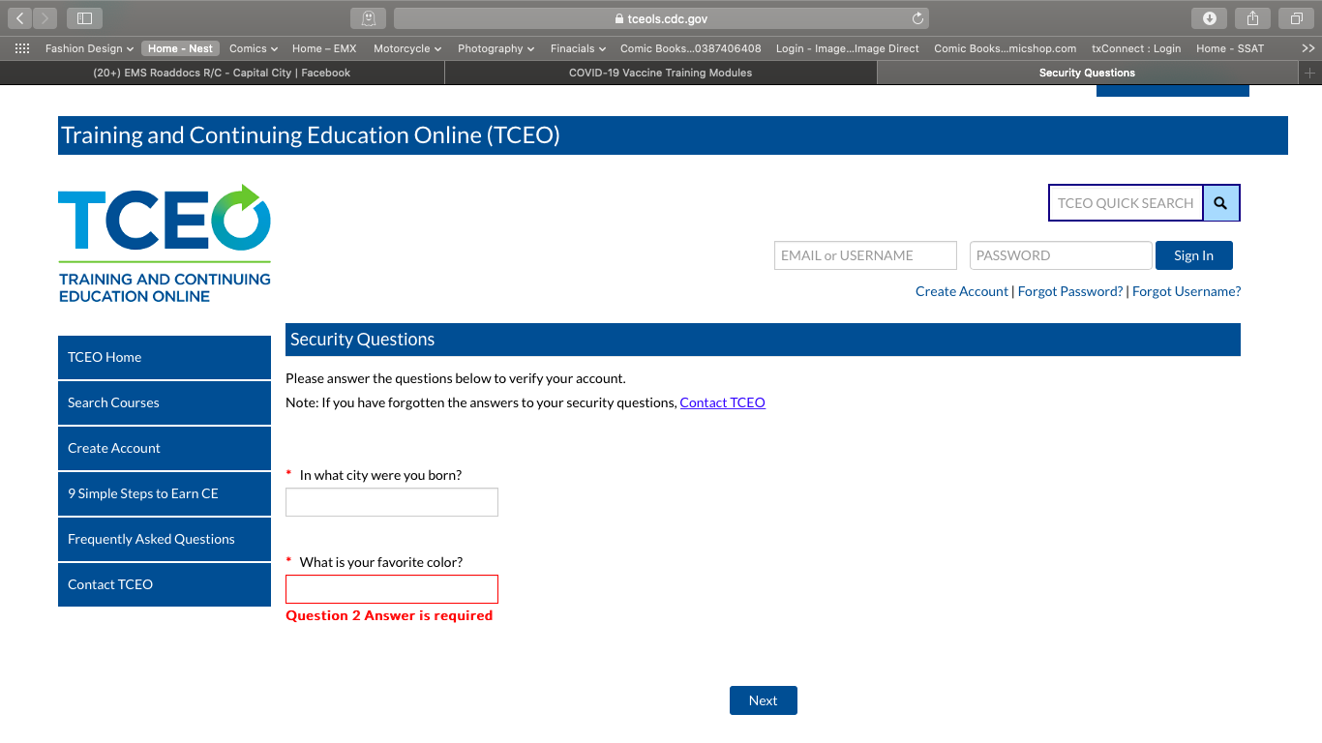
Answer 2 security questions.

Slide 10
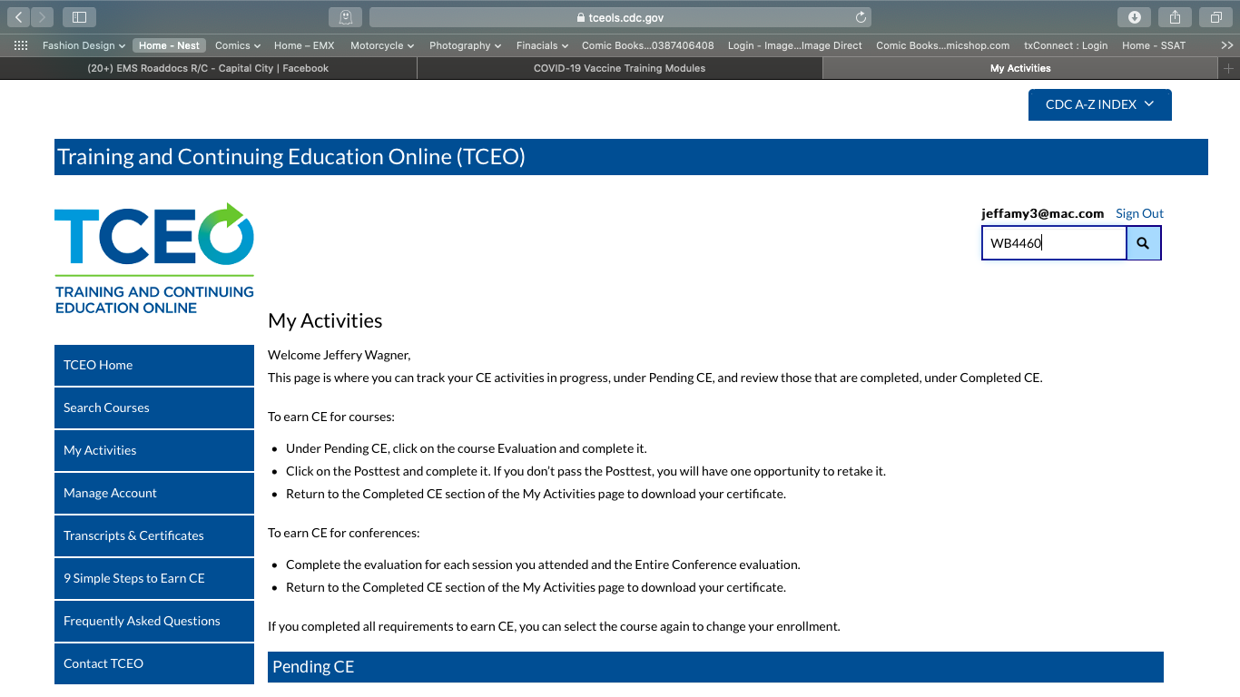
Search for course “WB4460”

Slide 11
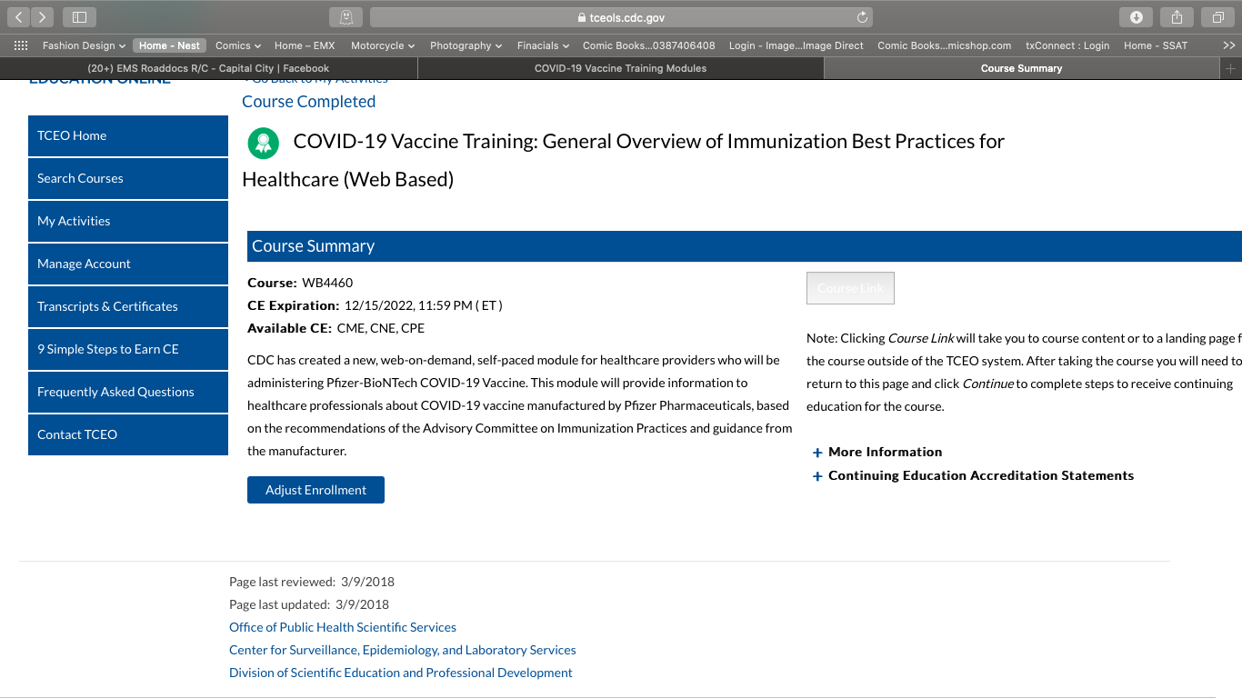
Enroll in the course

Slide 12
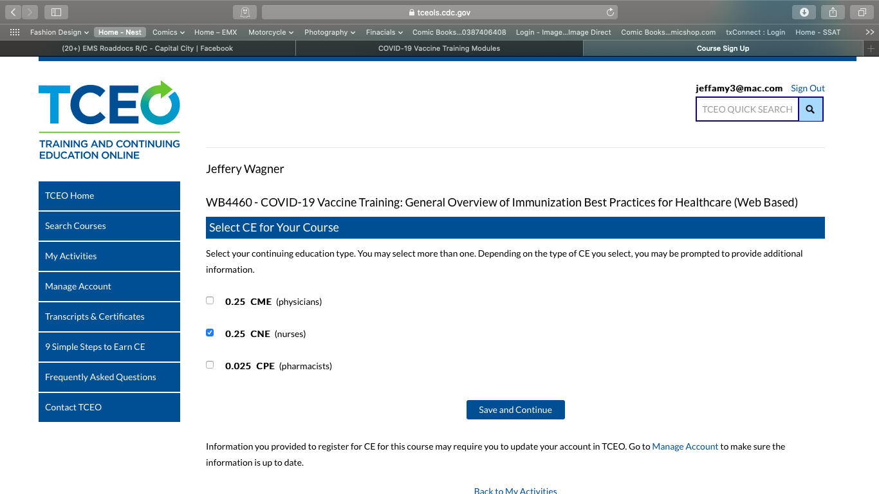
Select “CNE” credit, even though you don’t actually need the CE’s.

Slide 13
Complete the Survey and Quiz
After you have selected the class, and picked the CE’s, you will be taken to a survey where you will give feedback on the course.
Be sure to click on the words “evaluation” and complete the evaluation at the end of the training.
After the survey, you will take a 5 question quiz.
At the end of the quiz, you will be given the option to save and download your certificate.
Upload your certificate into your training profile in TDVR.

