Slide 1
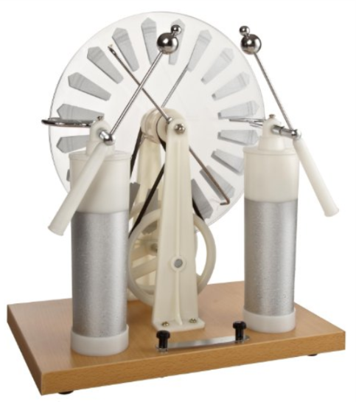
Wimshurst Machine
Electrified-Efficiency Analysis of Wimshurst Machine
Xiaoyu Niu
Ocean University of China
Notes:
Hello, everybody! Nice to meet you! Today, the topic of my presentation is Wimshurst Machine. I’ll show you my method to instruct students to comprehend the Wimshurst Machine.

Slide 2
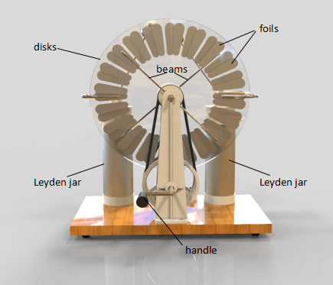
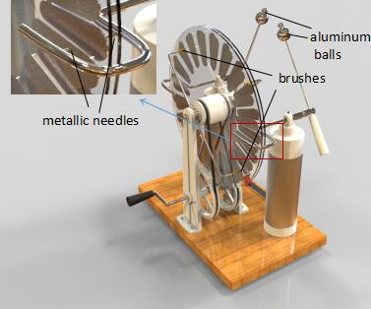
How does the Wimshurst Machine electrify?
Why does the Wimshurst Machine electrify efficiently?
Several extensions about Wimshurst Machine
Rotate the handle--the sparks between aluminum balls--display electro-discharge
(Authentically Display)
Notes:
To begin with, we introduce the Wimshurst Machine, which is made up of handle, Leyden Jar, beams, disks and balls. When we rotate the handle, the brushes would rub with foils on the disks. And then we would observe the sparks between balls. Now, we display authentically.

Slide 3
How does the Wimshurst Machine electrify?
Why does the Wimshurst Machine electrify efficiently?
Several extensions about Wimshurst Machine
Notes:
First, how does the Wimshurst Machine electrify?

Slide 4
How does the Wimshurst Machine electrify?
Why does the Wimshurst Machine electrify efficiently?
Several extensions about Wimshurst Machine
Notes:
First, how does the Wimshurst Machine electrify?

Slide 5
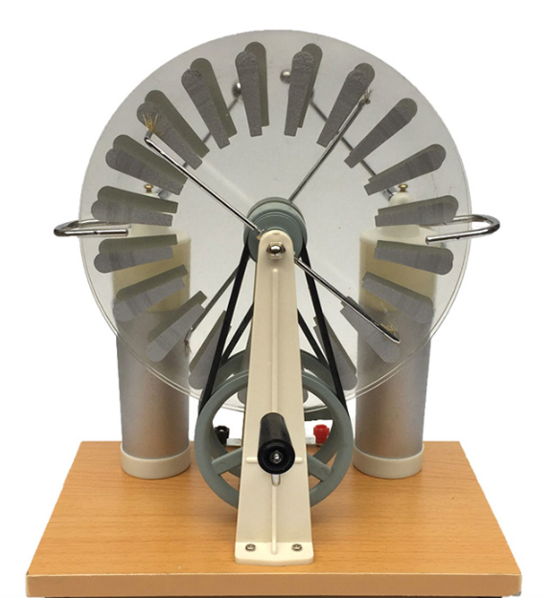
How does the Wimshurst Machine electrify?
Why does the Wimshurst Machine electrify efficiently?
Several extensions about Wimshurst Machine
Aluminum foils
Copper brush
Because of the difference of reactivities, when copper and aluminum rub with each other, they’ll lose or regain electron. Thus, electrification comes up.
Notes:
When I ask this question, students often answer it is electrification by friction. And they also give the basis of this theory. From the metal reactivity sequence, we know that aluminum and copper have different metal reactivity. Because of the difference of reactivities, when copper and aluminum rub with each other, they’ll lose or regain electron. Thus, electrification comes up.

Slide 6
How does the Wimshurst Machine electrify?
Why does the Wimshurst Machine electrify efficiently?
Several extensions about Wimshurst Machine
1）Opposite-Directed Rotating Experiment
Sparks come up by rotating handle towards only one direction. Towards opposite direction, there’s no sparks phenomenon.
√
×
Notes:
At this moment, I’m responsible to contend that electrification by friction is wrong, since it could not explain these following experiments.
First, only if we rotate the handle towards one direction, there are sparks between balls. However, if we rotate the handle towards the other direction, no sparks could be observed.

Slide 7
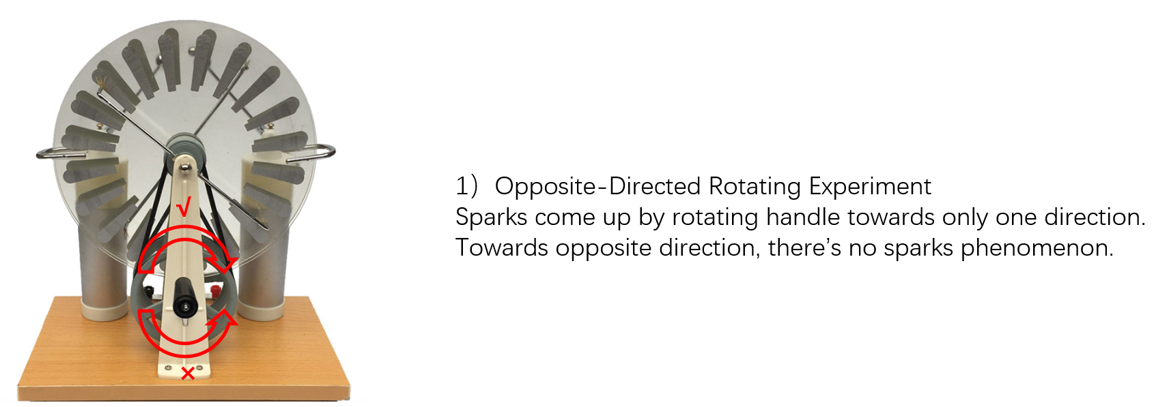
How does the Wimshurst Machine electrify?
Why does the Wimshurst Machine electrify efficiently?
Several extensions about Wimshurst Machine

Slide 8
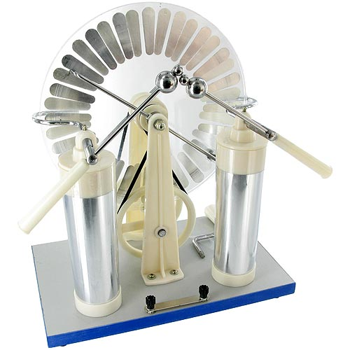
How does the Wimshurst Machine electrify?
Why does the Wimshurst Machine electrify efficiently?
Several extensions about Wimshurst Machine
Aluminum
2)Same-Foils Experiment
The discharge phenomenon is still observed, on the condition that brushes and foils are the same metal material, such as aluminum.
Notes:
Second, it is the same-foils experiment. The discharge phenomenon is still observed, on the condition that brushes and foils are the same metal material, such as aluminum.

Slide 9
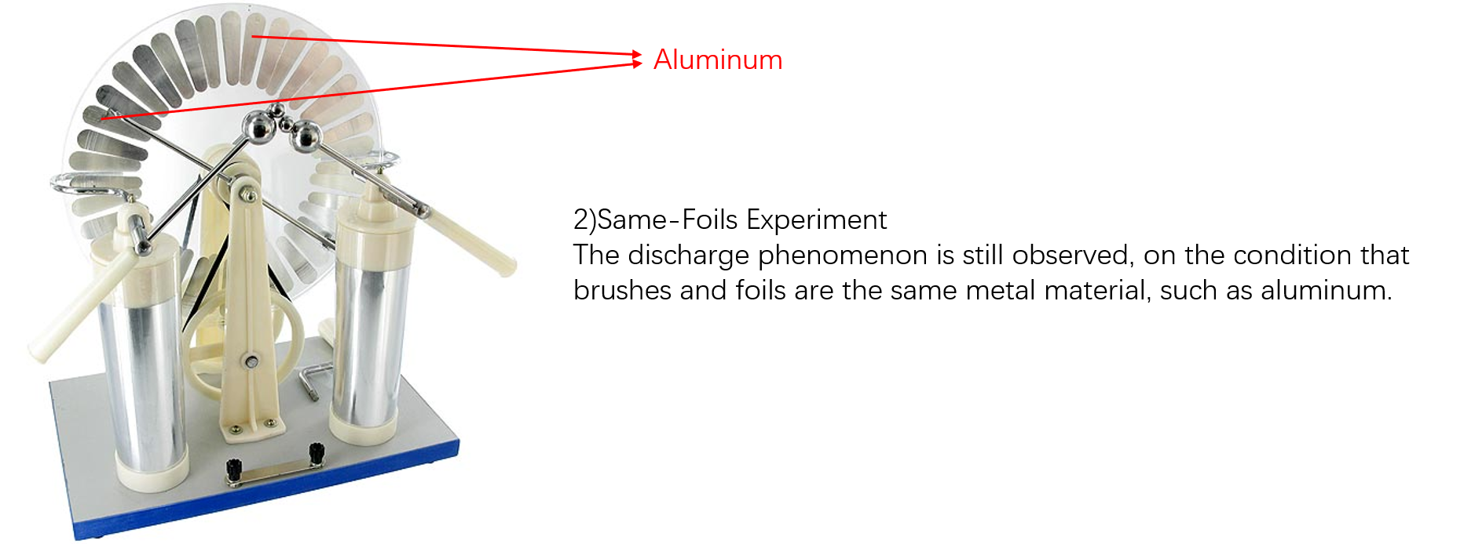
How does the Wimshurst Machine electrify?
Why does the Wimshurst Machine electrify efficiently?
Several extensions about Wimshurst Machine

Slide 10
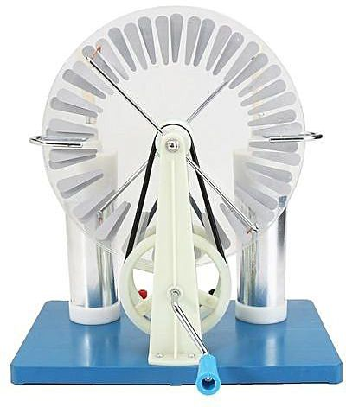
How does the Wimshurst Machine electrify?
Why does the Wimshurst Machine electrify efficiently?
Several extensions about Wimshurst Machine
Angle of brushes
3)Angle of Brushes Experiment
The angle of brushes could also influence the efficiency of electrification.
Notes:
Third, it is Angle of Brushes experiment. We change the angle of beams, which could also influence the efficiency of electrification.

Slide 11
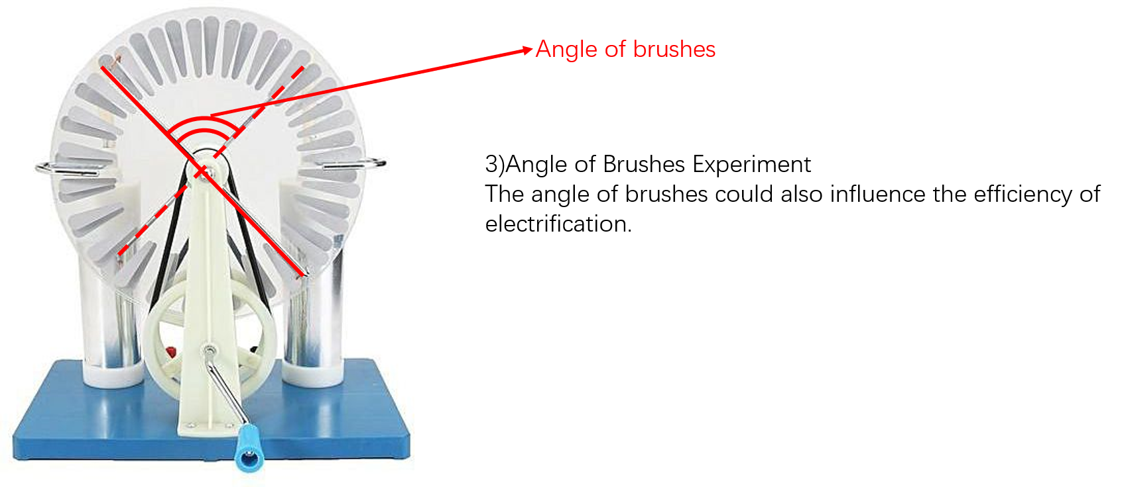
How does the Wimshurst Machine electrify?
Why does the Wimshurst Machine electrify efficiently?
Several extensions about Wimshurst Machine

Slide 12
How does the Wimshurst Machine electrify?
Why does the Wimshurst Machine electrify efficiently?
Several extensions about Wimshurst Machine
These three experiments challenge Electrification by Friction.
Electrification by Friction could not explain them rationally.
Notes:
So these three experiments challenge the basis of electrification by friction, because electrification by friction could not explain them rationally.

Slide 13
How does the Wimshurst Machine electrify?
Why does the Wimshurst Machine electrify efficiently?
Several extensions about Wimshurst Machine
Aluminum foils
The air surrounding ourselves is so stable that copper and aluminum could not show their metal reactivity with each other.
Particularly, sulfate liquid is the appropriate environment for copper and aluminum to show their metal reactivity.
Copper brush
Because of the difference of reactivities, when copper and aluminum rub with each other, they’ll lose or regain electron. Thus, electrification comes up.
Notes:
Additionally, the authentic reason is that the air surrounding ourselves is so stable that copper and aluminum could not show their metal reactivity with each other. Particularly, sulfate liquid is the appropriate environment for copper and aluminum to show their metal reactivity.

Slide 14
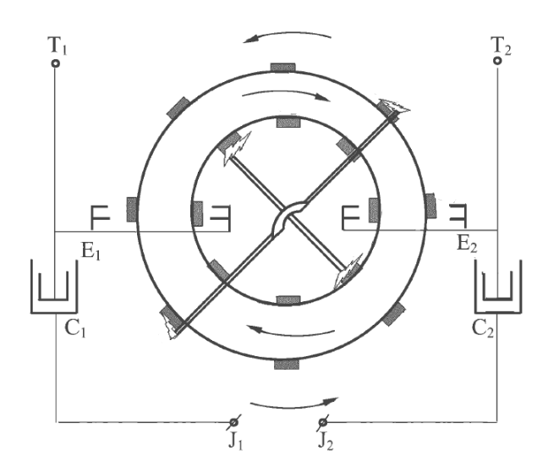
How does the Wimshurst Machine electrify?
Why does the Wimshurst Machine electrify efficiently?
Several extensions about Wimshurst Machine
Electrification by Induction
In order to be convenient, simplify the number of foils into 8.
Notes:
In fact, the reason of electrification is induction not friction.
In order to be convenient, simplify the number of foils into 8.

Slide 15
How does the Wimshurst Machine electrify?
Why does the Wimshurst Machine electrify efficiently?
Several extensions about Wimshurst Machine
A
+1
Notes:
Suppose that one positive charge is in the location A.

Slide 16
How does the Wimshurst Machine electrify?
Why does the Wimshurst Machine electrify efficiently?
Several extensions about Wimshurst Machine
A
+1
-1
+1
-1
Notes:
It would induct a negative charge at this location. Due to the principle of charge balance, a positive charge comes up at this location. This positive charge would induct another negative charge at this location.

Slide 17
How does the Wimshurst Machine electrify?
Why does the Wimshurst Machine electrify efficiently?
Several extensions about Wimshurst Machine
-1
A
-1
+1
+1
Notes:
Rotate again. Location A is close to the needle. Because of the point discharge or needle discharge, charge would travel down to the Leyden Jar.

Slide 18
How does the Wimshurst Machine electrify?
Why does the Wimshurst Machine electrify efficiently?
Several extensions about Wimshurst Machine
+1
-1
-1
A
+1
Notes:
Rotate again.

Slide 19
How does the Wimshurst Machine electrify?
Why does the Wimshurst Machine electrify efficiently?
Several extensions about Wimshurst Machine
+1
-1
+2
-1
+1
A
-2
Notes:
Rotate again. At location A, this charge would induct one negative charge. In the same way, this negative charge would induct another negative at location A.
Moreover, at the same moment, two negative charges are inducted at this location A.

Slide 20
How does the Wimshurst Machine electrify?
Why does the Wimshurst Machine electrify efficiently?
Several extensions about Wimshurst Machine
+1
+2
-1
+1
-1
A
-2
Notes:
Rotate again

Slide 21
How does the Wimshurst Machine electrify?
Why does the Wimshurst Machine electrify efficiently?
Several extensions about Wimshurst Machine
+1
-1
+1
-1
+2
-4
+4
A
-2

Slide 22
How does the Wimshurst Machine electrify?
Why does the Wimshurst Machine electrify efficiently?
Several extensions about Wimshurst Machine
+1
-1
+1
-1
-4
+2
-2
A
+4
Notes:
Charges accumulating in the Leyden Jar.

Slide 23
How does the Wimshurst Machine electrify?
Why does the Wimshurst Machine electrify efficiently?
Several extensions about Wimshurst Machine
+1
-1
+1
-1
+2
-2
-4
A
+4

Slide 24
How does the Wimshurst Machine electrify?
Why does the Wimshurst Machine electrify efficiently?
Several extensions about Wimshurst Machine
+1
-1
+1
-1
+2
-2
+8
A
-4
+4
-8

Slide 25
How does the Wimshurst Machine electrify?
Why does the Wimshurst Machine electrify efficiently?
Several extensions about Wimshurst Machine
+1
+8
A
-1
+1
-1
+2
-2
+4
-4
-8
Notes:
Ok, that’s how Wimshurst Machine electrify.

Slide 26
How does the Wimshurst Machine electrify?
Why does the Wimshurst Machine electrify efficiently?
Several extensions about Wimshurst Machine

Slide 27
How does the Wimshurst Machine electrify?
Why does the Wimshurst Machine electrify efficiently?
Several extensions about Wimshurst Machine
Notes:
Second, why does the Wimshurst Machine electrify efficiently?

Slide 28
Why does the Wimshurst Machine electrify efficiently?
Several extensions about Wimshurst Machine
How does the Wimshurst Machine electrify?
+1
-1
+1
-1
+2
A
-2
+4
+8
-4
-16
+16
-8
$1+2^{0}+2^{1}+2^{2}+…+2^{4n−2}=1+\frac{2^{0}−2^{4n−2}·2}{1−2}=1+(2^{4n−2}·2−1)=2^{4n−1}$(Index explosion)
After rotating for N circles, Leyden Jar would accumulate $2^{16N−1}$ units charges.
Notes:
After above research, we have found the accumulation of Wimshurst Machine is geometric sequence. It is easy for us to calculate the result of geometric sequence.
After rotating for N circles, Leyden Jar would accumulate two to sixteenth multiply N subtract one power units charges.

Slide 29
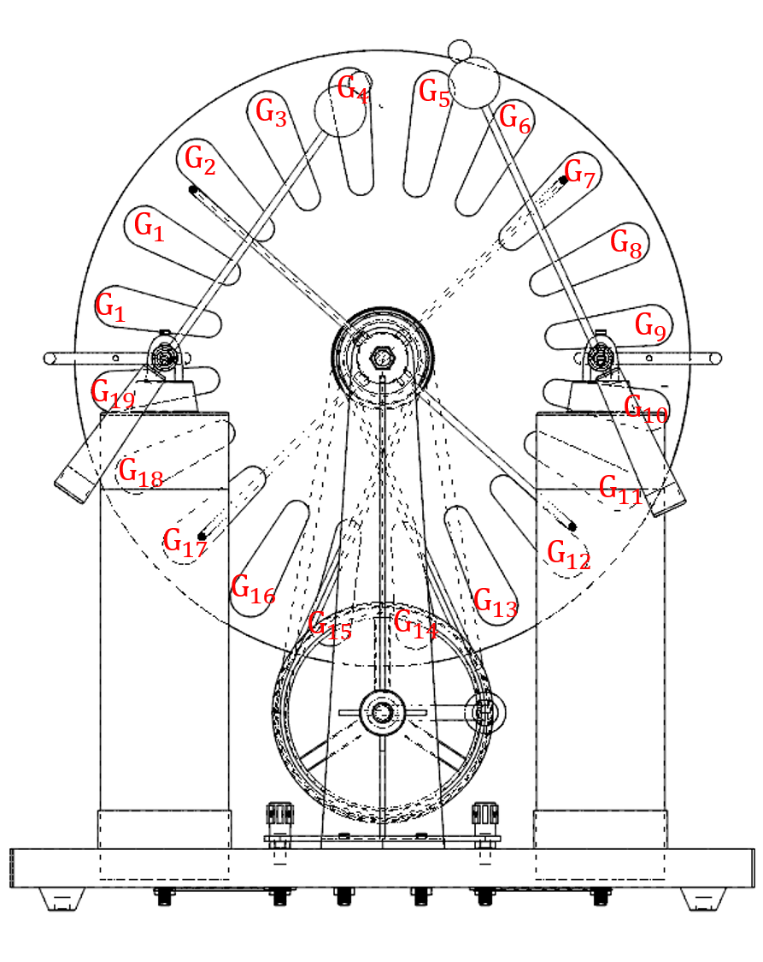
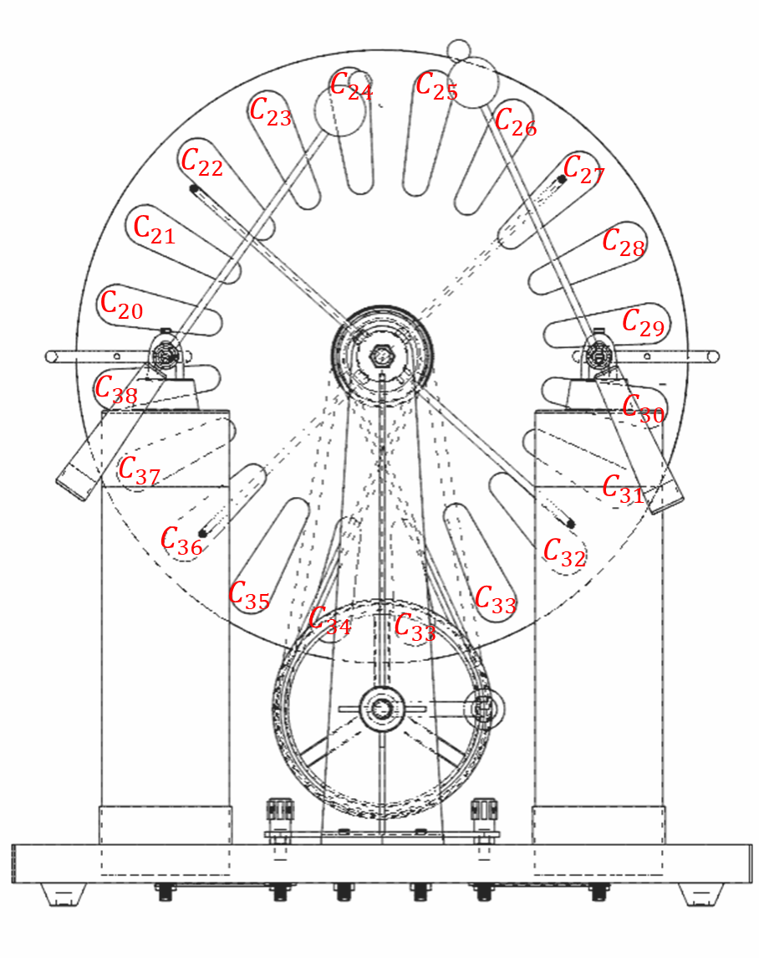
Why does the Wimshurst Machine electrify efficiently?
Several extensions about Wimshurst Machine
How does the Wimshurst Machine electrify?
The front disk
The back disk
In the same way, after rotating N circles, the Leyden Jar would accumulate $(\sum_{i=1}^{i=38}{C_{i})}2^{38N−1}$ units charges.
Notes:
Now, return to our authentic Wimshurst Machine. It has thirty eight foils. In the same way, after rotating N circles, the Leyden Jar would accumulate …
So we could see that it is the index explosion. That’s why within short time, Wimshurst Machine could produce thousands of volt.

Slide 30
How does the Wimshurst Machine electrify?
Why does the Wimshurst Machine electrify efficiently?
Several extensions about Wimshurst Machine

Slide 31
How does the Wimshurst Machine electrify?
Why does the Wimshurst Machine electrify efficiently?
Several extensions about Wimshurst Machine
Notes:
Third, several extensions about Wimshurst Machine.

Slide 32
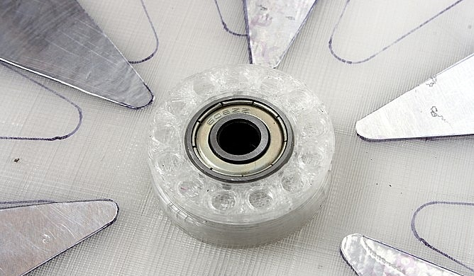
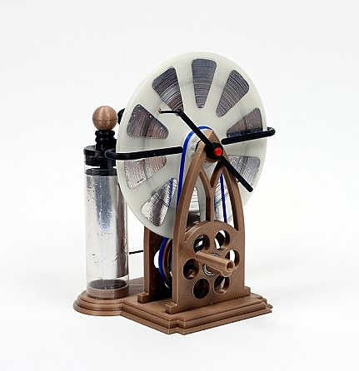
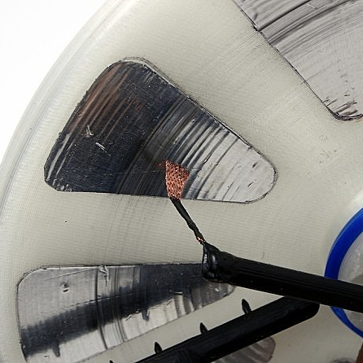
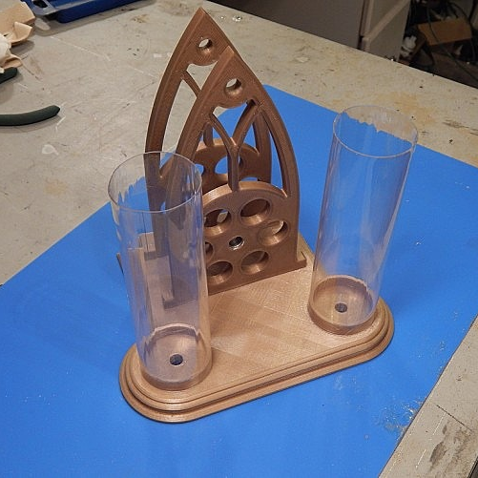
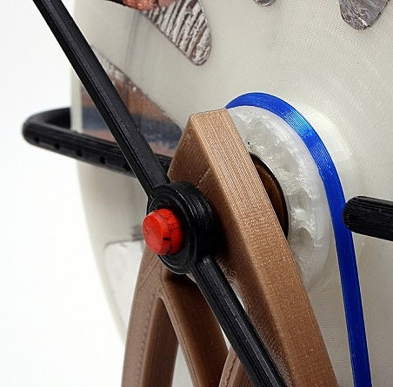
3D print for Wimshurst Machine
Notes:
As far as I have known, some people try to take 3D print for Wimshurst Machine. Personally, I encourage students and my classmates to make Wimshurst Machine on their own. If they do that on their own hands, they would have a profound knowledge of the theory and principles of Wimshurst Machine, which is also beneficial for their own academic performance.

Slide 33
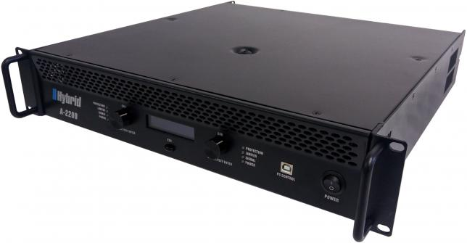
loudspeaker
Perspective of Signal and System
In fact, the Wimshurst Machine is a self-enhancing circle system of positive feedback. The process of charge accumulation is similar to the squeaking which happens when a microphone is put closely in front of a loudspeaker.
Squeaking
microphone
Power amplifier
Notes:
What’s more, we could also research Wimshurst Machine from the perspective of signal and system. In fact, the Wimshurst Machine is a self-enhancing circle system of positive feedback. The process of charge accumulation is similar to the squeaking which happens when a microphone is put closely in front of a loudspeaker.

Slide 34
Xiaoyu Niu
Senior
Ocean University of China
Phone number: 86-17854228305
Email: xiaoyuniu-ouc@foxmail.com
Notes:
That’s all. It’s the ending of my presentation. If you have any questions or innovations about Wimshurst Machine, please contact with me. This is my phone number and email address.

