Slide 1
THE BIG PICTURE

Slide 2
Observations
We use an Acute Care Model to treat a Chronic Condition.
We use a disaggregated “system” of cottage industries to address our greatest health issue.
We look to Mt. Olympus for answers, when the solutions are local.

Slide 3
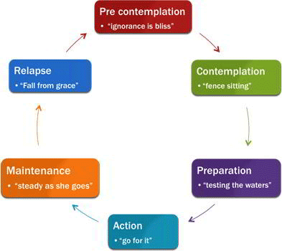
Source: Tracey Long, PhD, A-Train Education: Continuing Education for Health Professionals, “Diabetes: Teaching Patients Self-Care”, https://www.atrainceu.com/course-all/teaching-patients-about-diabetes-171

Slide 4
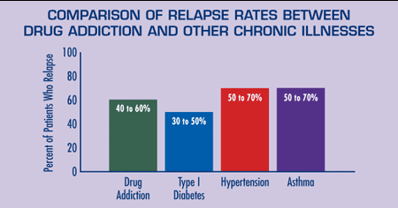
Source: JAMA, 284:1689-1695, 2000; National Institute on Drug Abuse, “Drugs, Brains, and Behavior: The Science of Addiction”,
https://www.drugabuse.gov/publications/drugs-brains-behavior-science-addiction/treatment-recovery

Slide 5
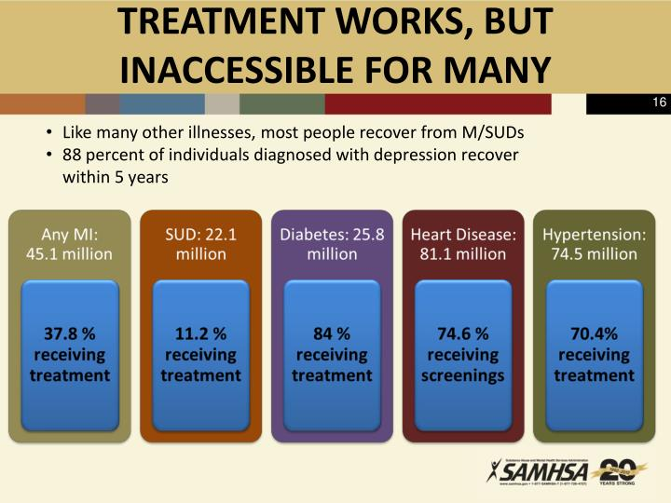
Source: Pamela S. Hyde, J.D., SAMHSA Administrator, “Behavioral Health -- Evidence-Based Treatment and Recovery Practices”, University of Miami Miller School of Medicine, June 13, 2012, https://www.slideserve.com/marcel/behavioral-health-evidence-based-treatment-and-recovery-practices

Slide 6
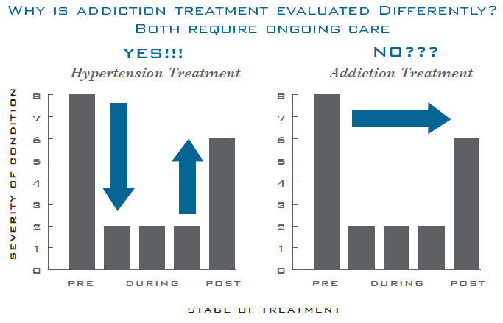
Source: National Institute on Drug Abuse, Principles of Drug Addiction Treatment: A Research-Based Guide (Third Edition), “How effective is drug addiction treatment?”, 2018, https://www.drugabuse.gov/publications/principles-drug-addiction-treatment-research-based-guide-third-edition/frequently-asked-questions/how-effective-drug-addiction-treatment

Slide 7
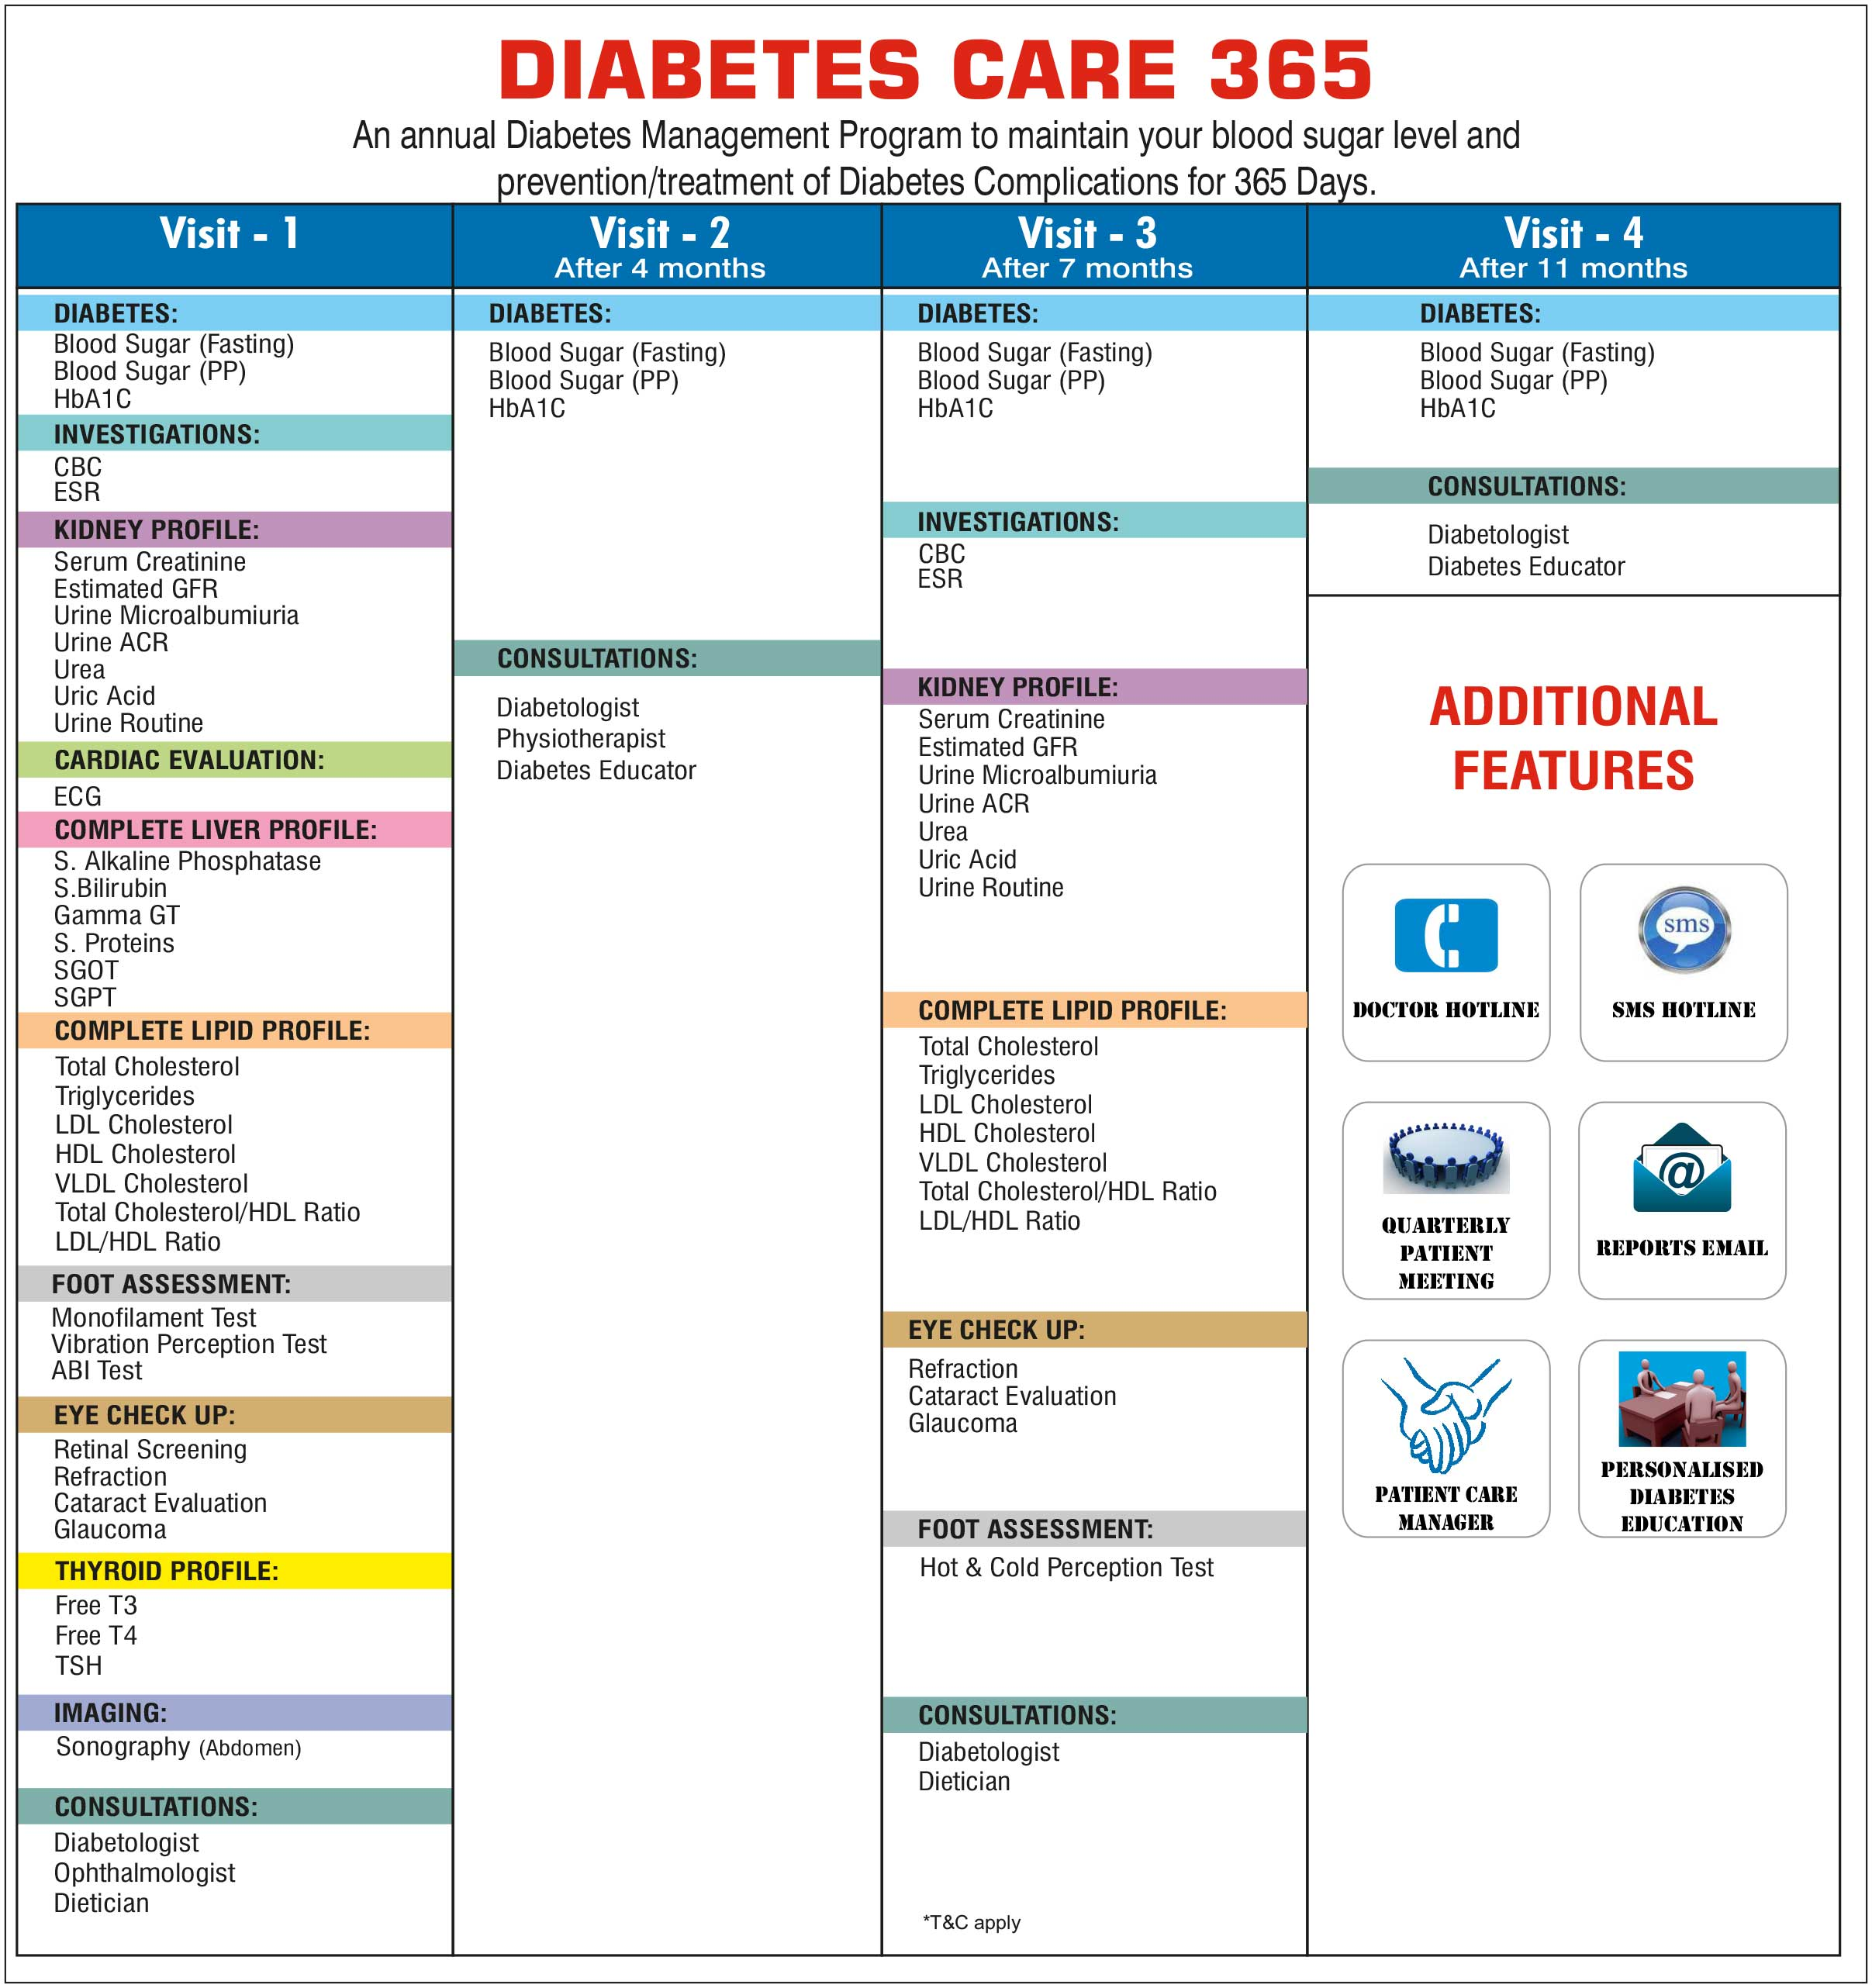
Source: Dr. Dhruv K.Singh. Zest Diabetes Care, 2016, https://yourbusiness.azcentral.com/acknowledge-copyright-statement-7617.html

Slide 8
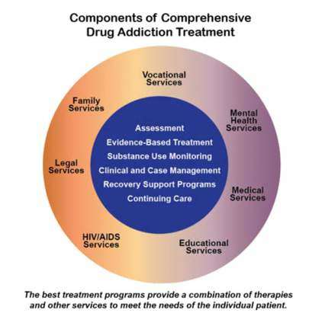
Source: National Institute on Drug Addiction, “Treatment Approaches for Drug Addiction”, 2018, https://www.drugabuse.gov/publications/drugfacts/treatment-approaches-drug-addiction

Slide 9
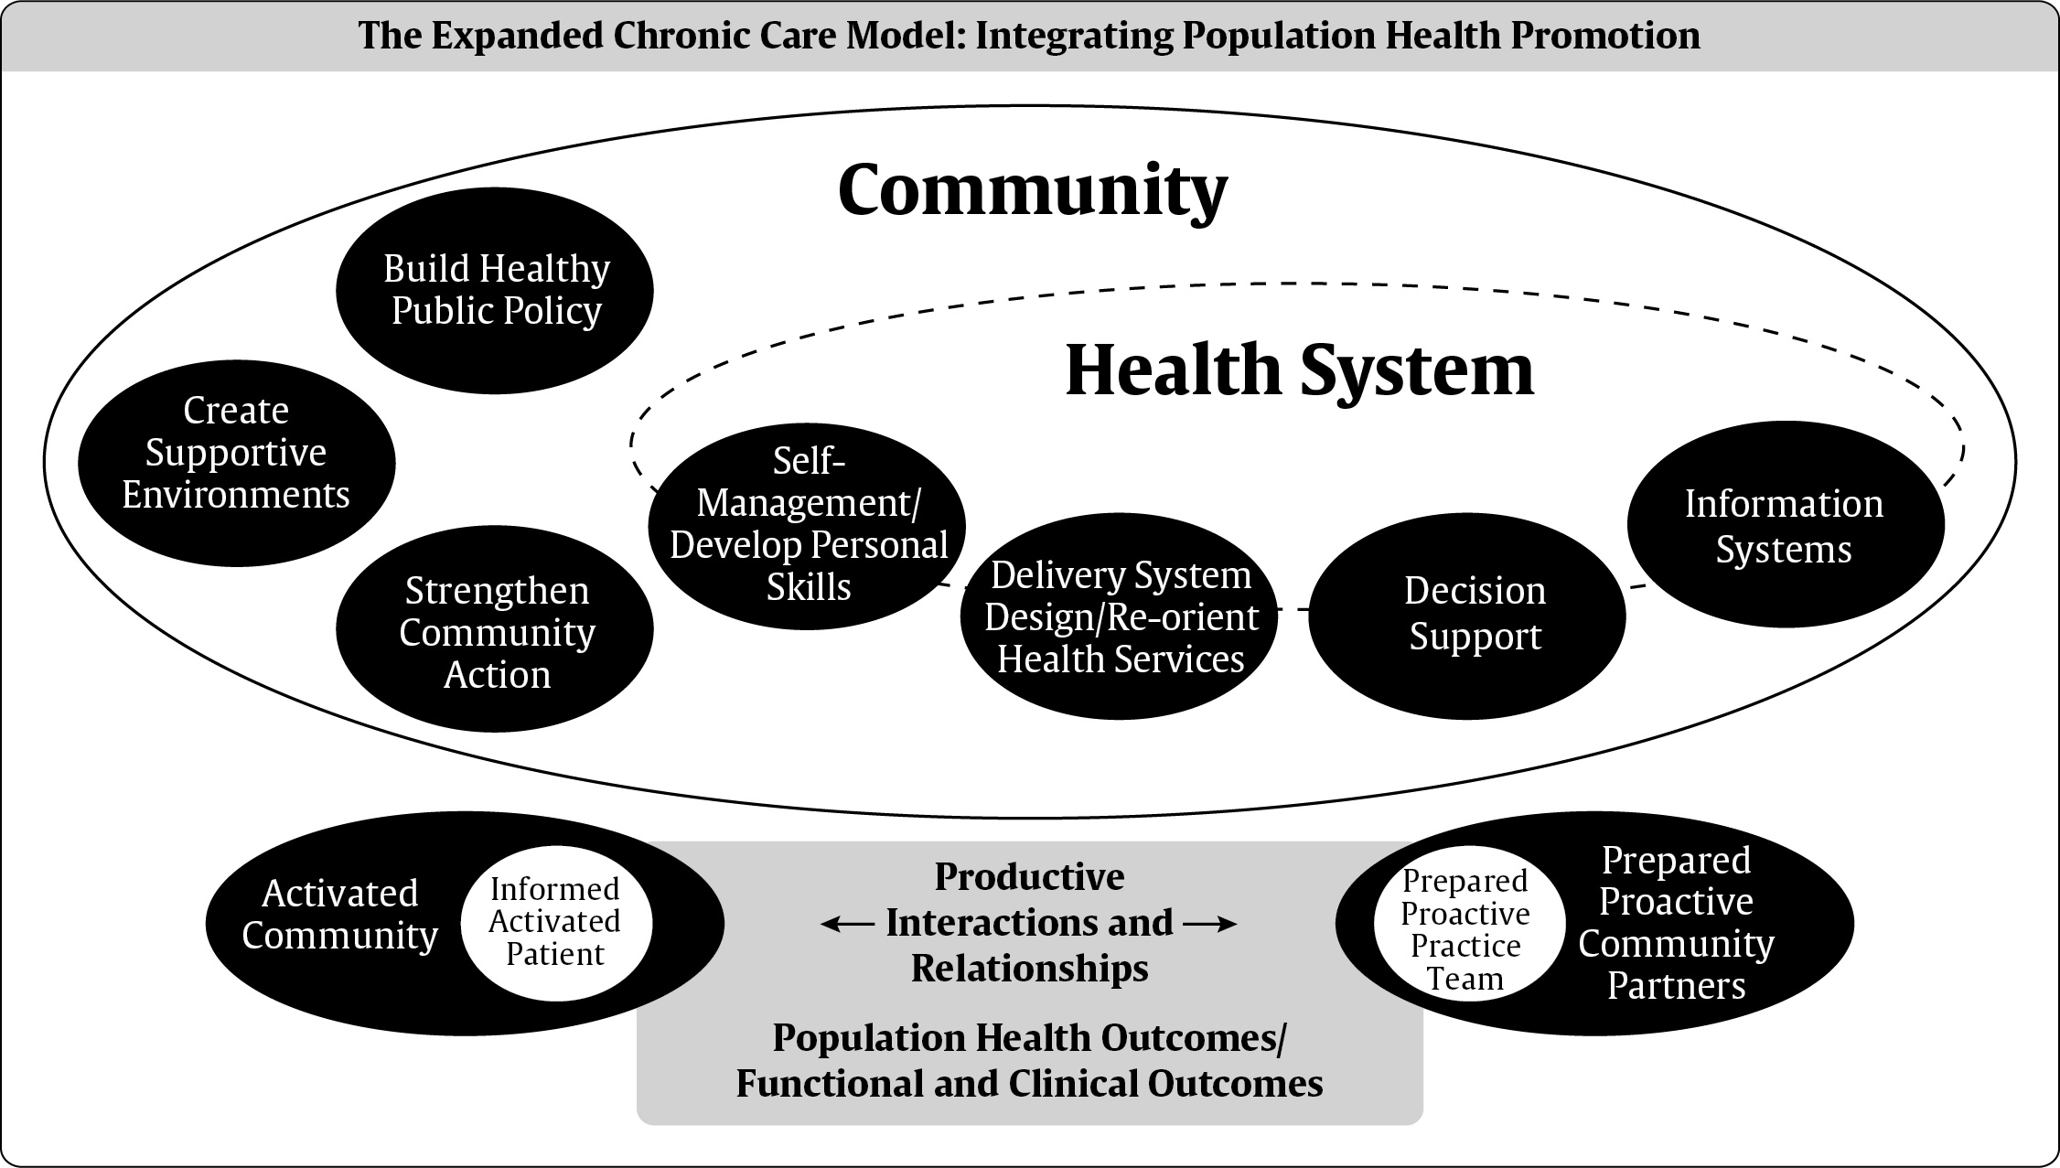
Source: Canadian Pharmacists Association, Canadian Diabetes Association 2013 Clinical Practice Guidelines, Chapter 6: “Organization of Diabetes Care”, 2018,
https://www.pharmacists.ca/education-practice-resources/patient-care/diabetes-practice-tools-and-resources/diabetes-practice-guidelines/cpg-highlights-chapter-6-organization-of-diabetes-care/

